Slide 1
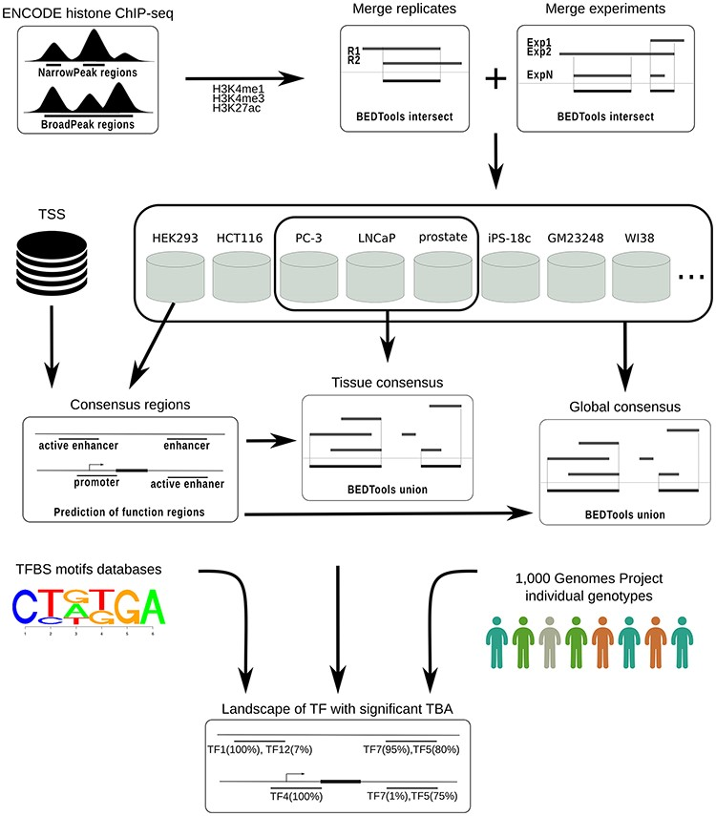
Figure 1. CONREL workflow to generate consensus regions and TBAs annotations.
Notes:
Figure 1. CONREL workflow to generate consensus regions and TBAs annotations.
Unless provided in the caption above, the following copyright applies to the content of this slide: © The Author(s) 2020. Published by Oxford University Press.This is an Open Access article distributed under the terms of the Creative Commons Attribution License (http://creativecommons.org/licenses/by/4.0/), which permits unrestricted reuse, distribution, and reproduction in any medium, provided the original work is properly cited.

Slide 2
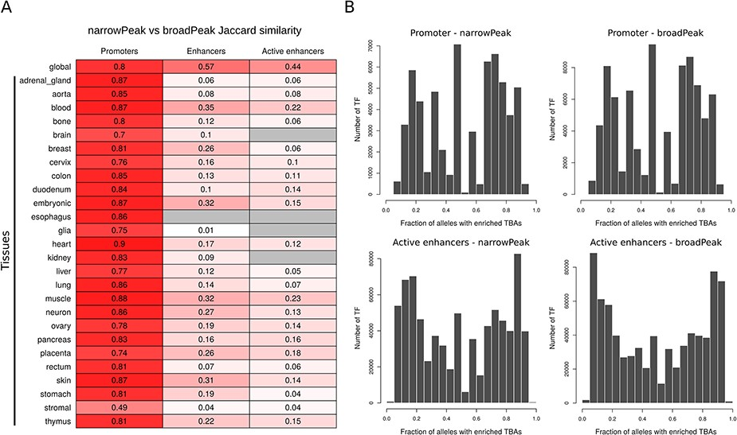
Figure 2. (A) Jaccard similarity of CREs derived from narrow versus broad peak data. Similarity is shown for global and ...
Notes:
Figure 2. (A) Jaccard similarity of CREs derived from narrow versus broad peak data. Similarity is shown for global and tissue CRE promoters, enhancers and active enhancers. Intensity of red color is proportional to the similarity index, while gray color indicates no comparison available. (B) Distribution of the number of TF presenting a specific enrichment fraction across 1000 Genomes Project common alleles for CRE promoters and active enhancers. Since the majority of TFs present a TBA enrichment fraction equal to 1, only TFs with TBA enrichment fraction <1 are depicted in the distribution.
Unless provided in the caption above, the following copyright applies to the content of this slide: © The Author(s) 2020. Published by Oxford University Press.This is an Open Access article distributed under the terms of the Creative Commons Attribution License (http://creativecommons.org/licenses/by/4.0/), which permits unrestricted reuse, distribution, and reproduction in any medium, provided the original work is properly cited.

Slide 3
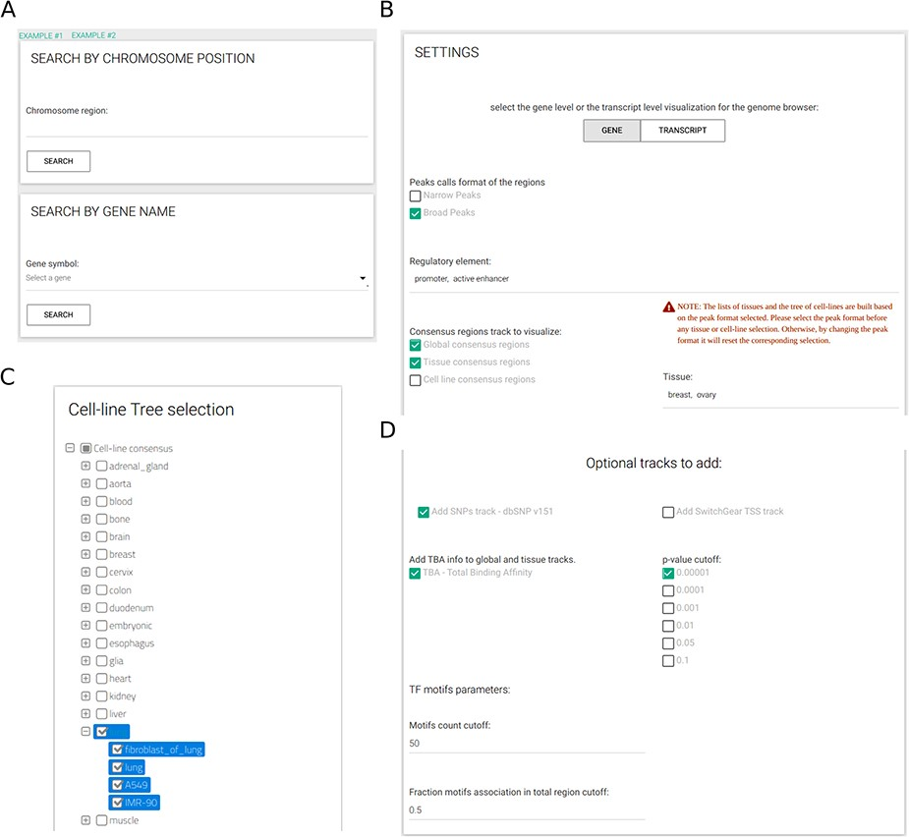
Figure 3. CONREL interface. (A) Search tab allows to select a specific genomic region or a gene name. Input tabs allow ...
Notes:
Figure 3. CONREL interface. (A) Search tab allows to select a specific genomic region or a gene name. Input tabs allow for the selection of source peak data and types of CRE to be displayed (B) using, when needed, also a cell line selection tree when activated (C) and TBA statistical filters (D).
Unless provided in the caption above, the following copyright applies to the content of this slide: © The Author(s) 2020. Published by Oxford University Press.This is an Open Access article distributed under the terms of the Creative Commons Attribution License (http://creativecommons.org/licenses/by/4.0/), which permits unrestricted reuse, distribution, and reproduction in any medium, provided the original work is properly cited.

Slide 4
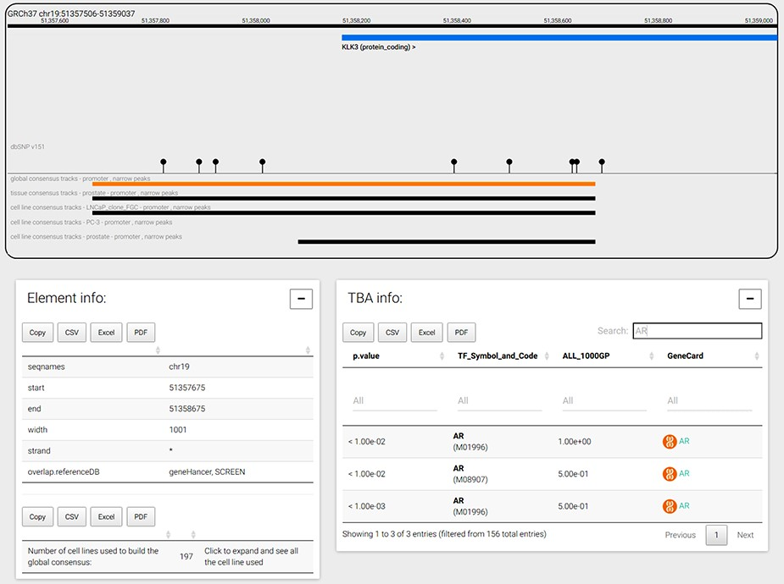
Figure 4. CONREL navigation web-page. The genome browser allows to navigate the selected genomic region or gene, while ...
Notes:
Figure 4. CONREL navigation web-page. The genome browser allows to navigate the selected genomic region or gene, while bottom panels allow to explore CRE information and TBA data. TBA data is shown in a multipage area where for each enriched TBA it is shown the significance at which the TF resulted enriched, and (when available) the fraction of 1000 Genomes Project common alleles that support the enrichment.
Unless provided in the caption above, the following copyright applies to the content of this slide: © The Author(s) 2020. Published by Oxford University Press.This is an Open Access article distributed under the terms of the Creative Commons Attribution License (http://creativecommons.org/licenses/by/4.0/), which permits unrestricted reuse, distribution, and reproduction in any medium, provided the original work is properly cited.

Slide 5
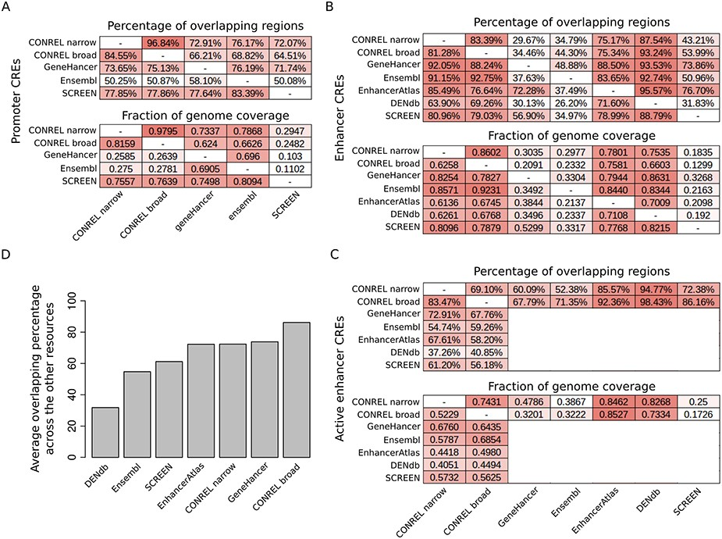
Figure 5. Comparison of CONREL CREs with other regulatory elements resources. (A) One-to-one comparison between CONREL, ...
Notes:
Figure 5. Comparison of CONREL CREs with other regulatory elements resources. (A) One-to-one comparison between CONREL, GeneHancer, Ensembl and SCREEN promoters. Each cell in the top matrix indicates the percentage of promoters annotated in the corresponding row resource that have an overlapping with the promoters annotated in the corresponding column resource. Each cell in the bottom matrix indicates the fraction of the genome covered by the promoters annotated in the corresponding row resource that is also captured by the promoters annotated in the corresponding column resource. (B) One-to-one comparison between CONREL, GeneHancer, Ensembl, EnhancerAtlas, DENdb and SCREEN enhancers. (C) One-to-one comparison between CONREL active enhancer and GeneHancer, Ensembl, EnhancerAtlas, DENdb and SCREEN enhancers. (D) Average percentage of CONREL active enhancer and GeneHancer, Ensembl, EnhancerAtlas, DENdb and SCREEN enhancers that have overlapping with each of the other resources.
Unless provided in the caption above, the following copyright applies to the content of this slide: © The Author(s) 2020. Published by Oxford University Press.This is an Open Access article distributed under the terms of the Creative Commons Attribution License (http://creativecommons.org/licenses/by/4.0/), which permits unrestricted reuse, distribution, and reproduction in any medium, provided the original work is properly cited.

Slide 6
Figure 6. TRRUST transcriptional regulatory relationships captured by CONREL. (A) Cumulative fraction of TRRUST ...
Notes:
Figure 6. TRRUST transcriptional regulatory relationships captured by CONREL. (A) Cumulative fraction of TRRUST relationships captured by CONREL promoters, considering CREs from broadPeaks data and additional CREs from narrowPeaks data. (B) Cumulative fraction of TRRUST relationships captured by CONREL active enhancers, considering CREs from broadPeaks and additional CREs from narrowPeaks data. (C) Cumulative fraction of TRRUST relationships captured by CONREL promoters and additionally by active enhancers.
Unless provided in the caption above, the following copyright applies to the content of this slide: © The Author(s) 2020. Published by Oxford University Press.This is an Open Access article distributed under the terms of the Creative Commons Attribution License (http://creativecommons.org/licenses/by/4.0/), which permits unrestricted reuse, distribution, and reproduction in any medium, provided the original work is properly cited.

