Slide 1
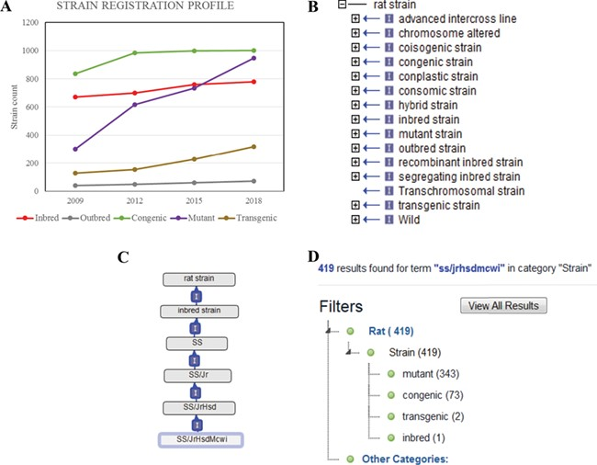
Figure 1 (A) The total counts of the registered rat strains at RGD over a 10-year period. Five strain types, inbred, ...
Notes:
Figure 1 (A) The total counts of the registered rat strains at RGD over a 10-year period. Five strain types, inbred, outbred, congenic, mutant and transgenic strains, are selected to show the growth trends among different strain types. (B) The 15 high-level nodes of the RS Ontology. (C) The ontological tree of SS/JrHsdMcwi. (D) Using SS/JrHsdMcwi as a search keyword to retrieve strains related to this strain. The numbers in parentheses show the total number and the breakdown numbers for the strain types.
Unless provided in the caption above, the following copyright applies to the content of this slide: © The Author(s) 2019. Published by Oxford University Press.This is an Open Access article distributed under the terms of the Creative Commons Attribution License (http://creativecommons.org/licenses/by/4.0/), which permits unrestricted reuse, distribution, and reproduction in any medium, provided the original work is properly cited.

Slide 2
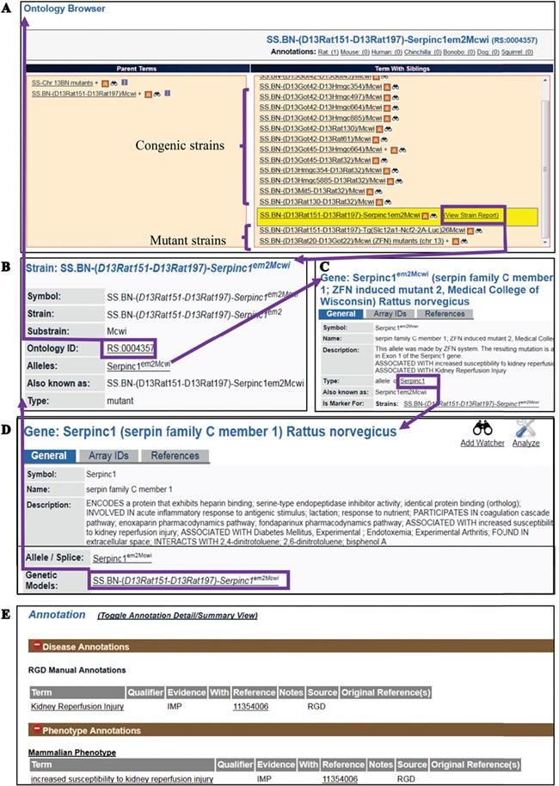
Figure 2 (A) The RS Ontology browser displaying the selected mutant strain ...
Notes:
Figure 2 (A) The RS Ontology browser displaying the selected mutant strain ‘SS.BN-(D13Rat151-D13Rat197)-Serpinc1em2Mcwi’ with its congenic and mutant siblings listed in the same column and its parents on the left. The browser provides the link to the rat strain report page (B), which displays ontology ID and associated data. The report pages for strain (SS.BN-(D13Rat151-D13Rat197)-Serpinc1em2Mcwi), allele (Serpinc1em2Mcwi) (C) and the parent gene (Serpinc1) (D) are integrated by hyperlinks to each other. Annotations (E) are found in all the report pages and are expanded to show links to the curated terms and original references.
Unless provided in the caption above, the following copyright applies to the content of this slide: © The Author(s) 2019. Published by Oxford University Press.This is an Open Access article distributed under the terms of the Creative Commons Attribution License (http://creativecommons.org/licenses/by/4.0/), which permits unrestricted reuse, distribution, and reproduction in any medium, provided the original work is properly cited.

Slide 3
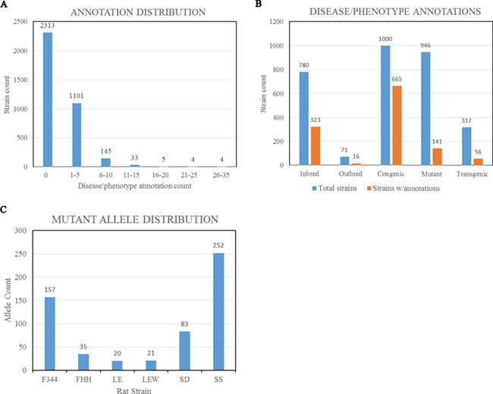
Figure 3 (A) Disease/phenotype distribution among rat strains at RGD. There are total 3605 registered strains shown in ...
Notes:
Figure 3 (A) Disease/phenotype distribution among rat strains at RGD. There are total 3605 registered strains shown in the bar chart. Close to 35% of the strains are annotated with one or more disease/phenotype terms. (B) Bar chart comparing the numbers of rat strains with disease/phenotype annotations across the selected five strain categories. (C) Rat strains carrying mutant alleles are grouped by background strains. Strain groups carrying at least 20 alleles are presented. F344, Fischer 344; FHH, Fawn Hooded Hypertensive; LE, Long Evans; LEW, Lewis; SD, Sprague–Dawley; SS, salt-sensitive Sprague–Dawley.
Unless provided in the caption above, the following copyright applies to the content of this slide: © The Author(s) 2019. Published by Oxford University Press.This is an Open Access article distributed under the terms of the Creative Commons Attribution License (http://creativecommons.org/licenses/by/4.0/), which permits unrestricted reuse, distribution, and reproduction in any medium, provided the original work is properly cited.

Slide 4
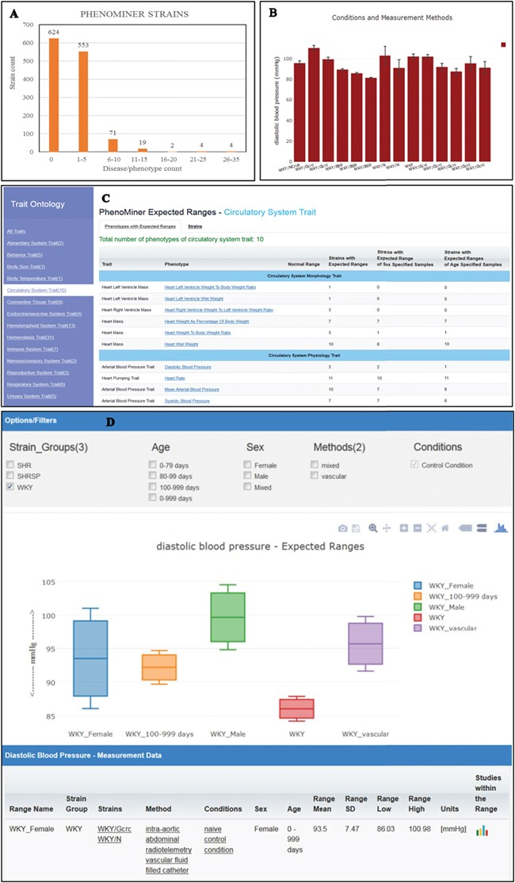
Figure 4 (A) The disease/phenotype annotation distribution of strains with PhenoMiner data. More than half of the ...
Notes:
Figure 4 (A) The disease/phenotype annotation distribution of strains with PhenoMiner data. More than half of the PhenoMiner strains have at least one disease/phenotype qualitative annotation. (B) The result page in PhenoMiner after querying WKY strains for diastolic blood pressure, using specific measurement methods under control conditions. The bar chart displays all the matched records in the PhenoMiner database. (C) Summary of the traits for expected ranges analysis is listed on the left and the list of the available expected ranges under the selected circulatory system trait is shown in blue font. Each phenotype is hyperlinked to the associated expected ranges data. (D) The expected ranges of diastolic blood pressure of the selected WKY strain group. Each color-coded box is an interquartile range graph in which the data median is shown as the line in the middle, the third quartile is shown as the top and first quartile is shown as the bottom of the box. Maximum value is represented by the horizontal bar above the box and the minimum value is represented by the horizontal bar below the box. The calculated expected ranges data associated with the displayed graphs are listed at the bottom of the graph, and the links to the original PhenoMiner records are also provided.
Unless provided in the caption above, the following copyright applies to the content of this slide: © The Author(s) 2019. Published by Oxford University Press.This is an Open Access article distributed under the terms of the Creative Commons Attribution License (http://creativecommons.org/licenses/by/4.0/), which permits unrestricted reuse, distribution, and reproduction in any medium, provided the original work is properly cited.

Slide 5
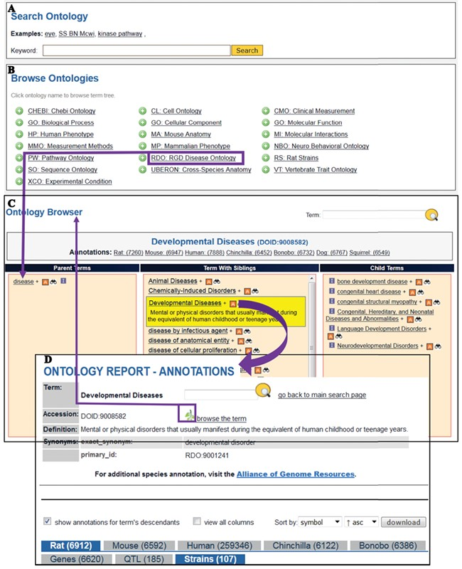
Figure 5 The Search Ontology (A) and Browse Ontologies (B) functions allow users to retrieve all strains annotated to ...
Notes:
Figure 5 The Search Ontology (A) and Browse Ontologies (B) functions allow users to retrieve all strains annotated to a particular term. (C) The selected term ‘Developmental Diseases’ and its definition are highlighted in yellow in the center column with its child terms listed in the right column. The ‘A’ icon is a link to the ontology report page (D) listing all RGD objects annotated to the disease term ‘Developmental Diseases’ and its child terms. The links provided in the browser page and the ontology report page allow users to navigate between the terms and annotations. Strains associated with developmental diseases can be downloaded from the download button above the species tabs.
Unless provided in the caption above, the following copyright applies to the content of this slide: © The Author(s) 2019. Published by Oxford University Press.This is an Open Access article distributed under the terms of the Creative Commons Attribution License (http://creativecommons.org/licenses/by/4.0/), which permits unrestricted reuse, distribution, and reproduction in any medium, provided the original work is properly cited.

Slide 6
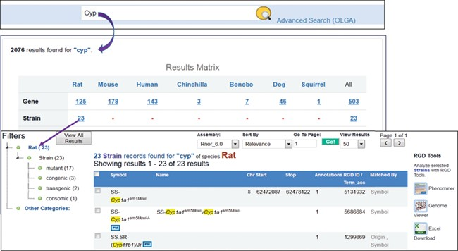
Figure 6 Finding rat strains associated with the cytochrome P450 superfamily. Using the keyword ‘cyp’ in the general ...
Notes:
Figure 6 Finding rat strains associated with the cytochrome P450 superfamily. Using the keyword ‘cyp’ in the general search retrieves RGD data associated with the gene family. Returned results are displayed in a matrix with species as the column titles. There are 23 rat strains associated with the gene family.
Unless provided in the caption above, the following copyright applies to the content of this slide: © The Author(s) 2019. Published by Oxford University Press.This is an Open Access article distributed under the terms of the Creative Commons Attribution License (http://creativecommons.org/licenses/by/4.0/), which permits unrestricted reuse, distribution, and reproduction in any medium, provided the original work is properly cited.

