Slide 1
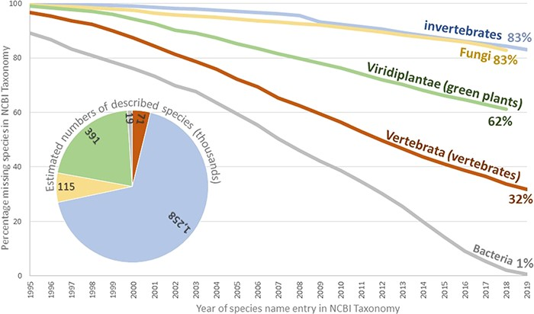
Figure 3 Estimate of the percentage of formal species names missing from the public NCBI databases. Curves were ...
Notes:
Figure 3 Estimate of the percentage of formal species names missing from the public NCBI databases. Curves were generated by plotting the number of formal species in the NCBI Taxonomy against the running total of described species in the corresponding group by the end of the year. The IJSEM was used as the source for bacteria. The International Plant Names Index (IPNI; 27) was used as the source for the green plants. The Species 2000 Annual Checklist (46) was used as the source for invertebrates and Fungi. Vertebrate data were collected from the Catalogue of Fishes (21), Amphibian Species of the World (17), the Reptile Database (32), Avibase (19) and the American Society of Mammalogists (18). Archaea and viruses were omitted for having a small number of species and a specialized process for reporting new species, respectively.
Unless provided in the caption above, the following copyright applies to the content of this slide: Published by Oxford University Press 2020.This work is written by US Government employees and is in the public domain in the US.

