Slide 1
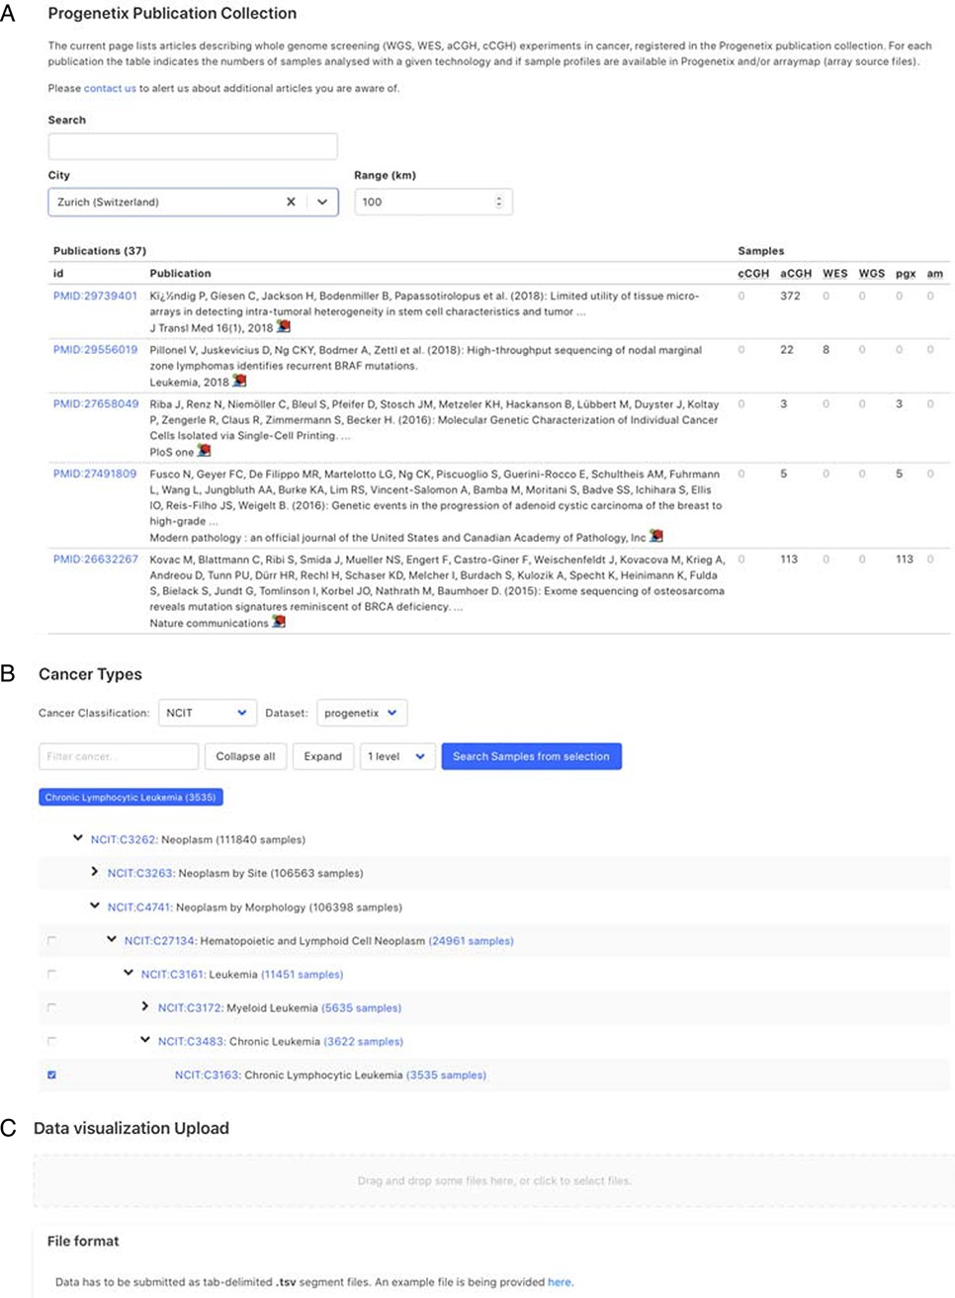
Figure 4. Demonstration of further functionality pages: A. Publication search; B. NCIt hierarchical tree navigation A: ...
Notes:
Figure 4. Demonstration of further functionality pages: A. Publication search; B. NCIt hierarchical tree navigation A: Cancer-genomics-associated publications are recorded with number of samples stratified by technology used. The publications can be filtered by keywords; B: Part of the sample subsets contained in Progenetix under the hierarchical NCIt classification tree. It allows for selection of sample subsets at different levels; C: User can upload custom segment files for data visualization.
Unless provided in the caption above, the following copyright applies to the content of this slide: © The Author(s) 2021. Published by Oxford University Press.This is an Open Access article distributed under the terms of the Creative Commons Attribution License (http://creativecommons.org/licenses/by/4.0/), which permits unrestricted reuse, distribution, and reproduction in any medium, provided the original work is properly cited.

