Slide 1
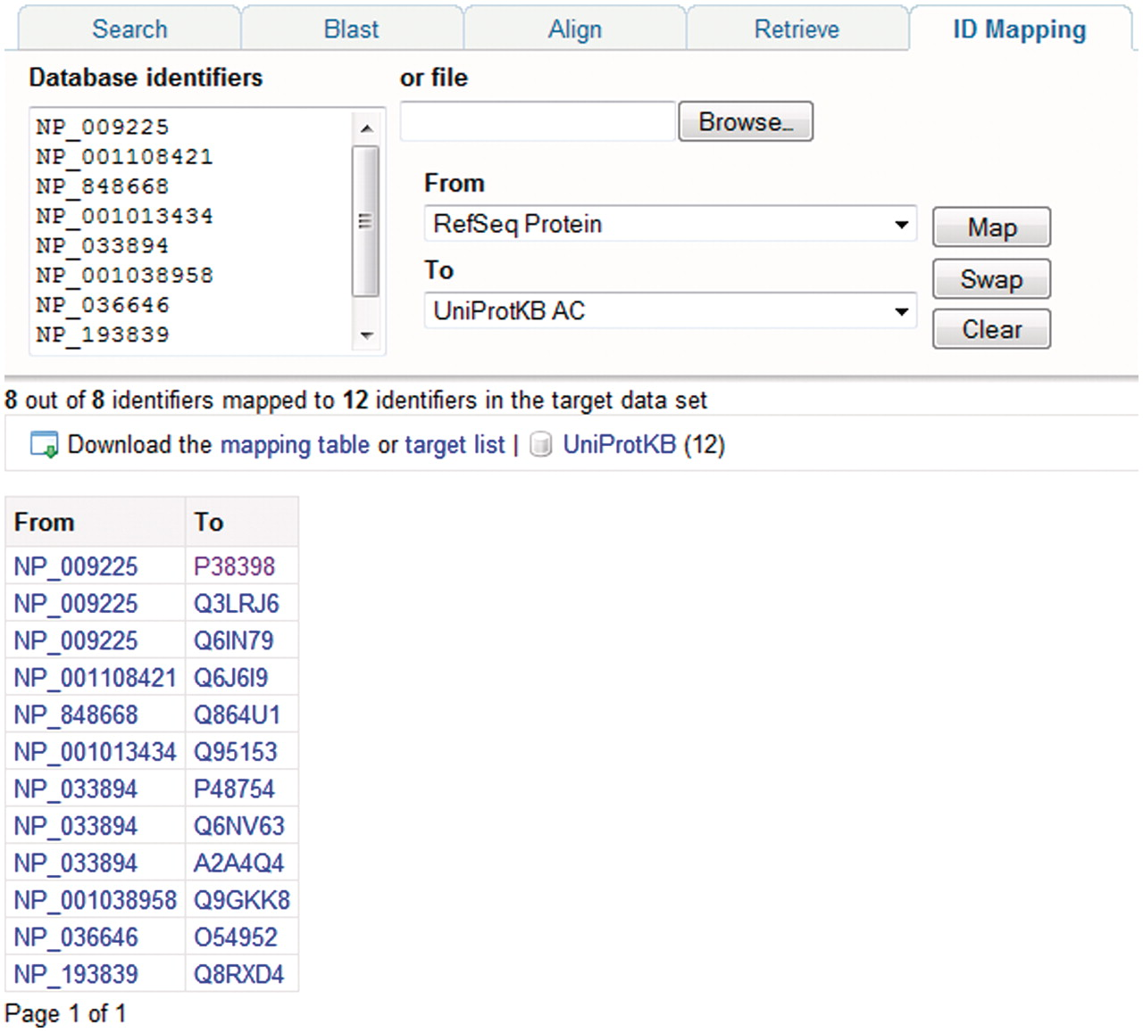
Figure 6. Mapping database identifiers using the identifier mapping tool on the UniProt website. The identifier mapping ...
Notes:
Figure 6. Mapping database identifiers using the identifier mapping tool on the UniProt website. The identifier mapping tool allows mapping of UniProt identifiers to identifiers in a database referenced from UniProt or vice versa. Here, a set of RefSeq identifiers are mapped to the corresponding UniProtKB entries.
Unless provided in the caption above, the following copyright applies to the content of this slide: © The Author(s) 2011. Published by Oxford University Press.This is Open Access article distributed under the terms of the Creative Commons Attribution Non-Commercial License (http://creativecommons.org/licenses/by-nc/2.5), which permits unrestricted non-commercial use, distribution, and reproduction in any medium, provided the original work is properly cited.

