Slide 1
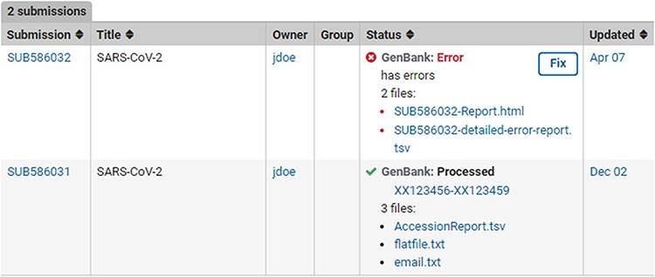
Figure 5. Post-submission processing reports. Example SUB586032 shows a (test) submission with errors with an error ...
Notes:
Figure 5. Post-submission processing reports. Example SUB586032 shows a (test) submission with errors with an error summary (SUB586032-Report.html) as well as a detailed VADR alert report (SUB586032-detailed-error-report.tsv). The error reports list the sequence_IDs with errors, instruction on how to correct the submission via the fix button or by contacting NLM/NCBI staff with more information. Example SUB586031 displays a successfully processed (test) submission with downloadable files containing GenBank Accessions, tab-delimited accession report with original sequence_IDs mapped to GenBank Accession numbers (AccessionReport.tsv), a copy of the fully processed annotated records (flatfile.txt) and a copy of the email sent upon successful processing (email.txt).
Unless provided in the caption above, the following copyright applies to the content of this slide: Published by Oxford University Press 2022. This work is written by (a) US Government employee(s) and is in the public domain in the US.This work is written by (a) US Government employee(s) and is in the public domain in the US.

