Slide 1
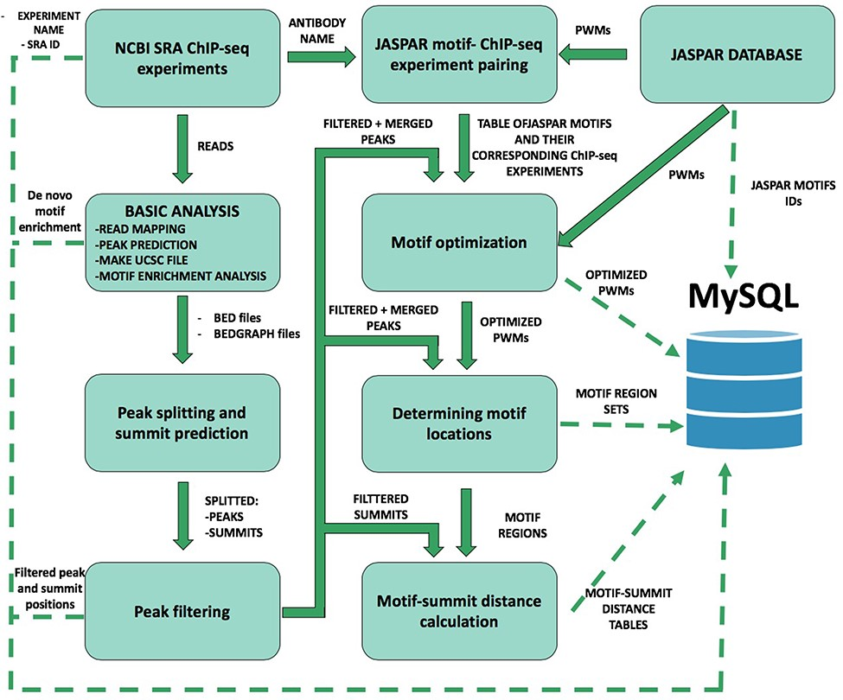
Figure 1 Schematic overview of ChIP-seq data processing and imported content from MySQL. The analysis steps and data ...
Notes:
Figure 1 Schematic overview of ChIP-seq data processing and imported content from MySQL. The analysis steps and data conversion are marked with thick arrows. The uploaded results/files are represented with dashed lines. A vast majority of processed data are available on ChIPSummitDB, including the predicted peak regions, optimized JASPAR CORE PWMs, identified TFBSs and calculated protein position information.
Unless provided in the caption above, the following copyright applies to the content of this slide: © The Author(s) 2020. Published by Oxford University Press.This is an Open Access article distributed under the terms of the Creative Commons Attribution License (http://creativecommons.org/licenses/by/4.0/), which permits unrestricted reuse, distribution, and reproduction in any medium, provided the original work is properly cited.

Slide 2
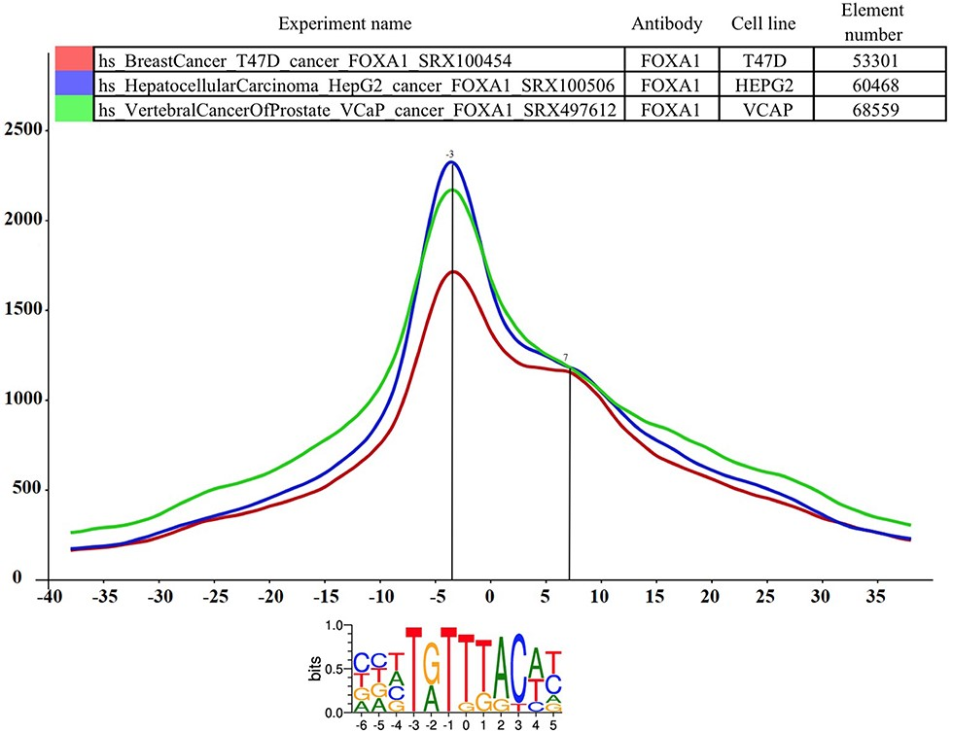
Figure 2 The distance distribution of FOXA1 summits relative to the motif centers of FOXA1 binding sites. The ...
Notes:
Figure 2 The distance distribution of FOXA1 summits relative to the motif centers of FOXA1 binding sites. The horizontal axis represents the distance of summits in different cell lines [T47D (SRA ID: SRX100454, red curve), HepG2 (SRA ID: SRX100506 blue curve) and VCaP (SRA ID: SRX497612, green curve)] relative to the FOXA1 motif center. The vertical axis represents the distance frequencies. A rolling mean with a 5 bp window was applied to smooth the frequency curves. The distance between the maxima (main summit, maxima at −3 bp) and the shoulder (7 bp) is ~10 bp. Element numbers in the table indicate the number of peak regions obtained in a ChIP-seq experiment, which overlap with a particular consensus motif binding site set. Figure is adapted from ChIPSummitDB website: http://summit.med.unideb.hu/summitdb/paired_shift_view.php?exp1=419&exp2=1960&exp3=3681&motive=FOXA1&motifid=77&limit=25&low_limit=-25&formminid=1&formmaxid=10000&mnelem=100&formmaxelem=120000.
Unless provided in the caption above, the following copyright applies to the content of this slide: © The Author(s) 2020. Published by Oxford University Press.This is an Open Access article distributed under the terms of the Creative Commons Attribution License (http://creativecommons.org/licenses/by/4.0/), which permits unrestricted reuse, distribution, and reproduction in any medium, provided the original work is properly cited.

Slide 3
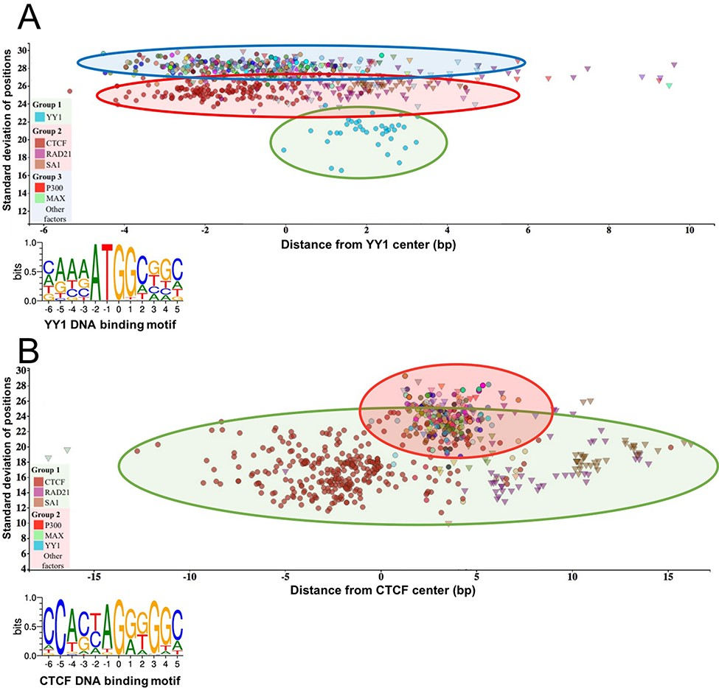
Figure 3 The standard deviation of the distances of the peak summit and binding site centers shows the DNA–protein ...
Notes:
Figure 3 The standard deviation of the distances of the peak summit and binding site centers shows the DNA–protein proximity. Each scatter represents average summit position from a single ChIP-seq experiment. The X-axis represents the distance from the binding site center, which position is marked by `0’ in the binding motif logo. The standard deviation of the summit-motif center distances is shown on the Y-axis. (A) The proteins, which show interaction with YY1 binding sites, are arranged in three groups. The lowest SD (between 16 and 22) belongs to YY1 protein, which binds directly to the YY1 DNA binding motifs. In the second layer, CTCF and cohesin subunit (RAD21, SA1) ChIP-seq signals are the most common. The third group with high SD, above 27, represents a diverse population, which consists of ChIP-seq experiments with different protein targets and more than 1000 overlapping peaks. The P300 and MAX proteins from Group 3 are labeled by red and green colors, respectively. The figure was slightly modified and adapted from ChIPSummitDB website: http://summit.med.unideb.hu/summitdb/motif_view.php?maxid=10000&minid=1&mnelem=1000&mxelem=120000&motive=YY1. (B) In the case of the CTCF binding sites, only two layers can be distinguished. In the first group, the directly interacting CTCF, RAD21 and SA1 proteins can be found, while the YY1, P300, MAX and other proteins are presented in the second group. Please note that the relative position of the YY1 and CTCF proteins to each other is the same on both plots. The figure was slightly modified and adapted from ChIPSummitDB website: http://summit.med.unideb.hu/summitdb/motif_view.php?maxid=10000&minid=1&mnelem=5000&mxelem=120000&motive=CTCF
Unless provided in the caption above, the following copyright applies to the content of this slide: © The Author(s) 2020. Published by Oxford University Press.This is an Open Access article distributed under the terms of the Creative Commons Attribution License (http://creativecommons.org/licenses/by/4.0/), which permits unrestricted reuse, distribution, and reproduction in any medium, provided the original work is properly cited.

Slide 4
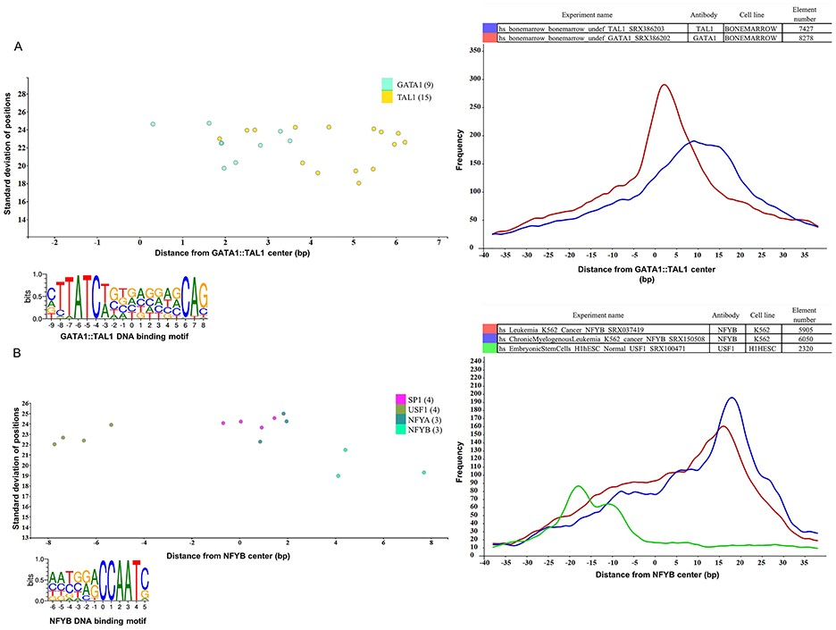
Figure 4 Binding sites based analysis of topological arrangements of TF–DNA complexes as visualized in MotifView and ...
Notes:
Figure 4 Binding sites based analysis of topological arrangements of TF–DNA complexes as visualized in MotifView and PairShiftView. The plots show the preferred positions of different proteins on (A) GATA1::TAL1 binding sites and on (B) NFYB binding sites. The scatterplot follows the same logic as shown on Figure 3. The figures derive from ChIPSummitDB, although the scatters were filtered to show only the presented factors. GATA1::TAL1: http://summit.med.unideb.hu/summitdb/motif_view.php?maxid=2000&minid=1&mnelem=1000&mxelem=120000&motive=GATA1%3A%3ATAL1 NFYB: http://summit.med.unideb.hu/summitdb/motif_view.php?maxid=2000&minid=1&mnelem=2000&mxelem=120000&motive=NFYB. The histograms (at right) show the distribution of the summits relative to the midpoint (motif centers). The horizontal axis shows the distance from motif center, measured in base pairs. The vertical axis displays the distance frequency of summits at the given positions. Each ChIP-seq experiment is represented by a frequency curve (A) GATA1:TAL1: blue—SRX386203, red—SRX386202; (B) NFYB: red—SRX037419, blue—SRX150508, and green—SRX100471, which are smoothed with a rolling mean with a 5 bp window. Element numbers in the tables indicate the number of peak regions obtained in a ChIP-seq experiment, which overlap with a particular consensus motif binding site set. Figures are adapted from ChIPSummitDB website: GATA1::TAL1: http://summit.med.unideb.hu/summitdb/paired_shift_view.php?exp1=218&exp2=220&exp3=undefined&motive=GATA1::TAL1&motifid=89&limit=40&low_limit=-40&formminid=1&formmaxid=2000&mnelem=500&formmaxelem=120000 NFYB: http://summit.med.unideb.hu/summitdb/paired_shift_view.php?exp1=2301&exp2=761&exp3=1597&motive=NFYB&motifid=175&limit=40&low_limit=-40&mnelem=2000.
Unless provided in the caption above, the following copyright applies to the content of this slide: © The Author(s) 2020. Published by Oxford University Press.This is an Open Access article distributed under the terms of the Creative Commons Attribution License (http://creativecommons.org/licenses/by/4.0/), which permits unrestricted reuse, distribution, and reproduction in any medium, provided the original work is properly cited.

