Slide 1
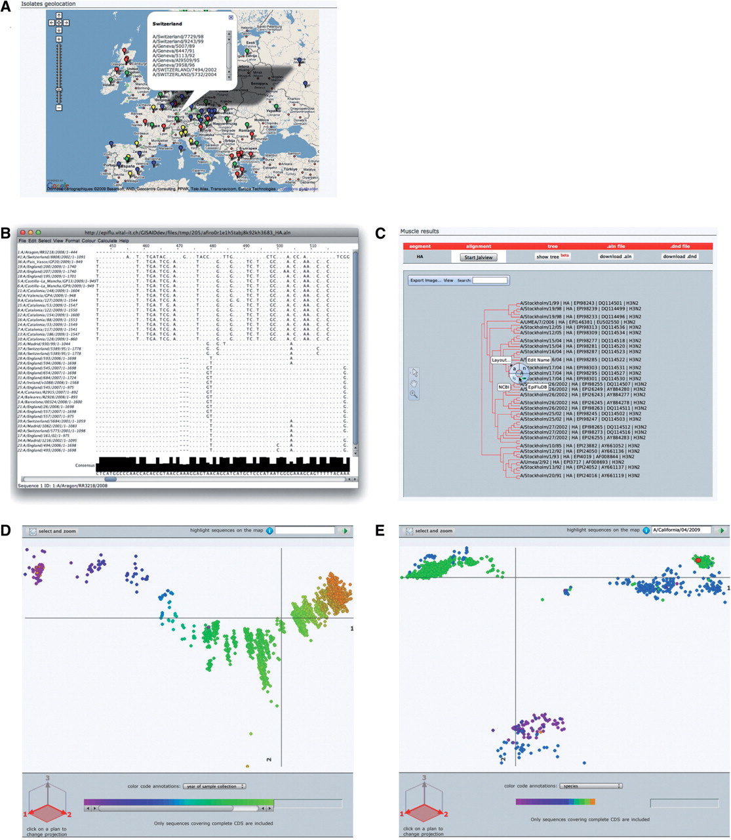
Figure 4. OpenFluDB analysis tools. (A) The Google Maps API is used to position sample collection on a world map. MSA ...
Notes:
Figure 4. OpenFluDB analysis tools. (A) The Google Maps API is used to position sample collection on a world map. MSA are computed with MUSCLE and displayed with Jalview (B) and as a tree with PhyloWidget (C). SSMs of hemaglutinin nucleotide sequences are computed by multidimensional scaling, and projections on the first two principal dimensions are displayed. (D) Human H3N2 sequences are colored based on year of sample collection revealing a genetic drift of the sequences. (E) H1 sequences are colored by host species. Three main clusters are revealed: human, swine and avian. Red highlighted sequences from the recent human swine H1N1 lineage are located near the swine cluster.
Unless provided in the caption above, the following copyright applies to the content of this slide: © The Author(s) 2010. Published by Oxford University Press.This is Open Access article distributed under the terms of the Creative Commons Attribution Non-Commercial License (http://creativecommons.org/licenses/by-nc/2.5), which permits unrestricted non-commercial use, distribution, and reproduction in any medium, provided the original work is properly cited.

