Slide 1
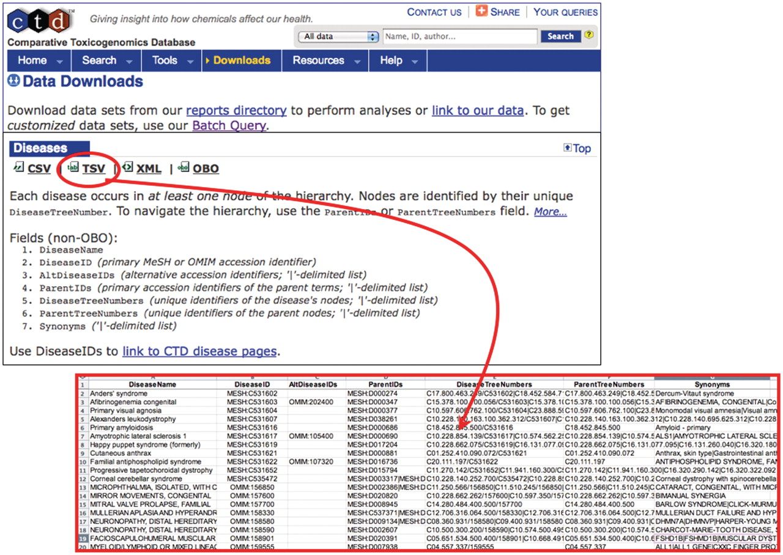
Figure 1. MEDIC is freely available from CTD. To obtain the most recent version of MEDIC, use the ‘Downloads’ menu tab. ...
Notes:
Figure 1. MEDIC is freely available from CTD. To obtain the most recent version of MEDIC, use the ‘Downloads’ menu tab. The vocabulary can be downloaded in various formats including CSV, TSV (red circle and inset), XML and OBO. We encourage other databases that use MEDIC to provide a direct link from their disease page to CTD’s equivalent disease page to promote interoperability between databases.
Unless provided in the caption above, the following copyright applies to the content of this slide: © The Author(s) 2012. Published by Oxford University Press.This is an Open Access article distributed under the terms of the Creative Commons Attribution Non-Commercial License (http://creativecommons.org/licenses/by-nc/3.0), which permits unrestricted non-commercial use, distribution, and reproduction in any medium, provided the original work is properly cited.

Slide 2
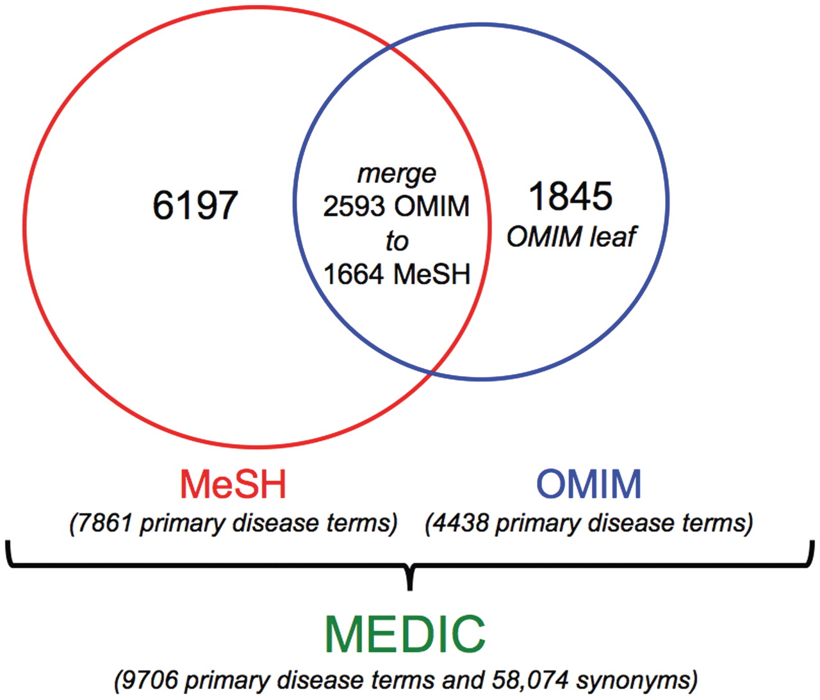
Figure 2. Components of MEDIC. As of October 2011, MEDIC contained 9706 unique disease primary terms and 58 074 ...
Notes:
Figure 2. Components of MEDIC. As of October 2011, MEDIC contained 9706 unique disease primary terms and 58 074 synonyms. It includes 6197 MeSH primary terms, 1845 OMIM primary terms (as leaf nodes) and 1664 MeSH primary terms (that have 2593 OMIM primary terms merged to them).
Unless provided in the caption above, the following copyright applies to the content of this slide: © The Author(s) 2012. Published by Oxford University Press.This is an Open Access article distributed under the terms of the Creative Commons Attribution Non-Commercial License (http://creativecommons.org/licenses/by-nc/3.0), which permits unrestricted non-commercial use, distribution, and reproduction in any medium, provided the original work is properly cited.

Slide 3
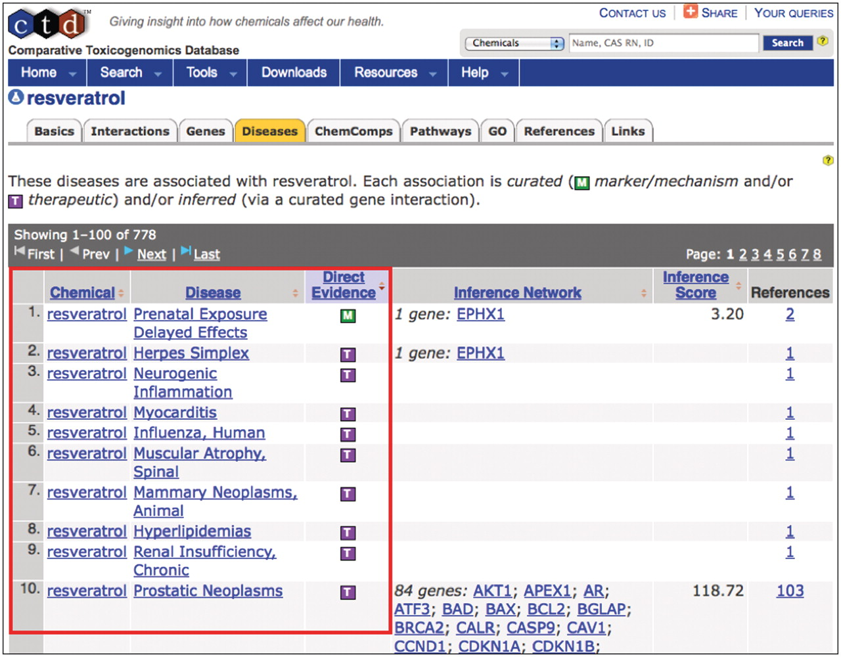
Figure 3. Curating to MEDIC. CTD biocurators use MEDIC as their disease vocabulary when curating chemical–disease and ...
Notes:
Figure 3. Curating to MEDIC. CTD biocurators use MEDIC as their disease vocabulary when curating chemical–disease and gene–disease data. The ‘Diseases’ tab (orange) on CTD's chemical page for resveratrol displays the curated relationships between the chemical and over 50 diseases (red box, partial screenshot). The green M icon indicates resveratrol is a marker for or plays a molecular role in the disease; the purple T icon indicates the chemical is a real or putative therapeutic for the disease. Every disease term is hyperlinked to its own disease page, allowing users to seamlessly explore chemical-gene-disease networks.
Unless provided in the caption above, the following copyright applies to the content of this slide: © The Author(s) 2012. Published by Oxford University Press.This is an Open Access article distributed under the terms of the Creative Commons Attribution Non-Commercial License (http://creativecommons.org/licenses/by-nc/3.0), which permits unrestricted non-commercial use, distribution, and reproduction in any medium, provided the original work is properly cited.

Slide 4
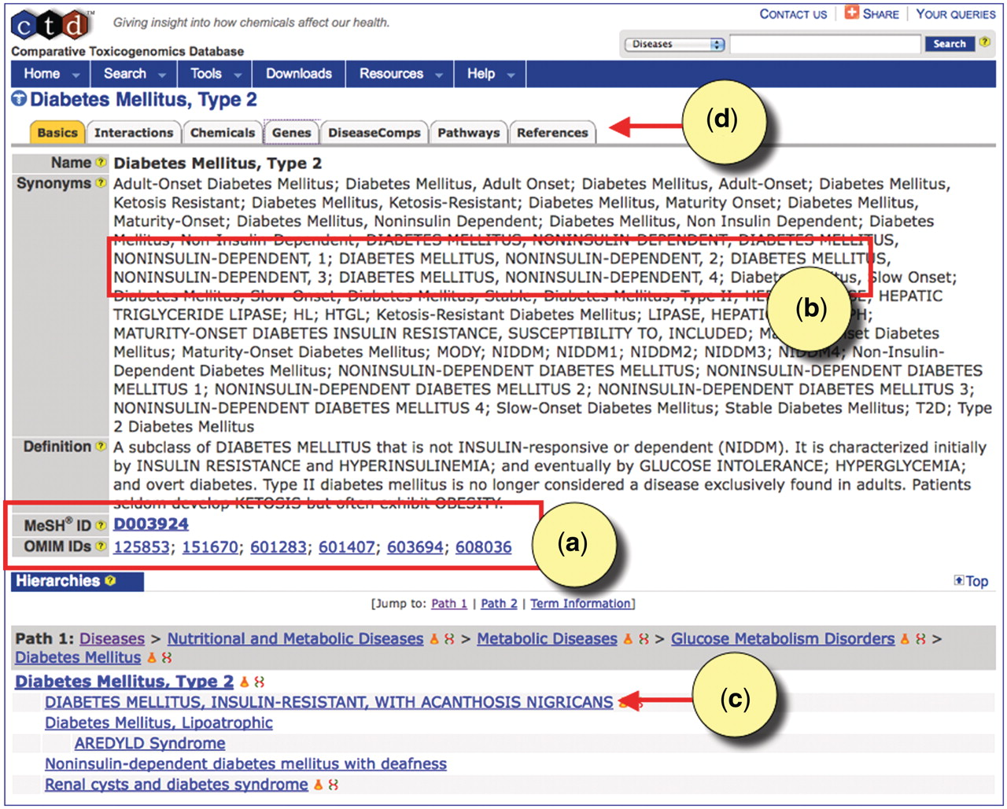
Figure 4. CTD's disease page for type 2 diabetes. (a) The disease page is anchored to the MeSH term ‘Diabetes Mellitus, ...
Notes:
Figure 4. CTD's disease page for type 2 diabetes. (a) The disease page is anchored to the MeSH term ‘Diabetes Mellitus, Type 2’ (MESH: D003924). Equivalent OMIM diseases are merged to the MeSH page in MEDIC. All accession IDs are hyperlinked to their respective databases. (b) Merged OMIM terms and synonyms are easily recognizable by their capitalization. (c) OMIM terms can be leaf nodes beneath MeSH terms, and users can see the hierarchy in which the terms fall by following the Paths. (d) CTD-curated data for type 2 diabetes can be seen by clicking on the appropriate data-tabs.
Unless provided in the caption above, the following copyright applies to the content of this slide: © The Author(s) 2012. Published by Oxford University Press.This is an Open Access article distributed under the terms of the Creative Commons Attribution Non-Commercial License (http://creativecommons.org/licenses/by-nc/3.0), which permits unrestricted non-commercial use, distribution, and reproduction in any medium, provided the original work is properly cited.

Slide 5
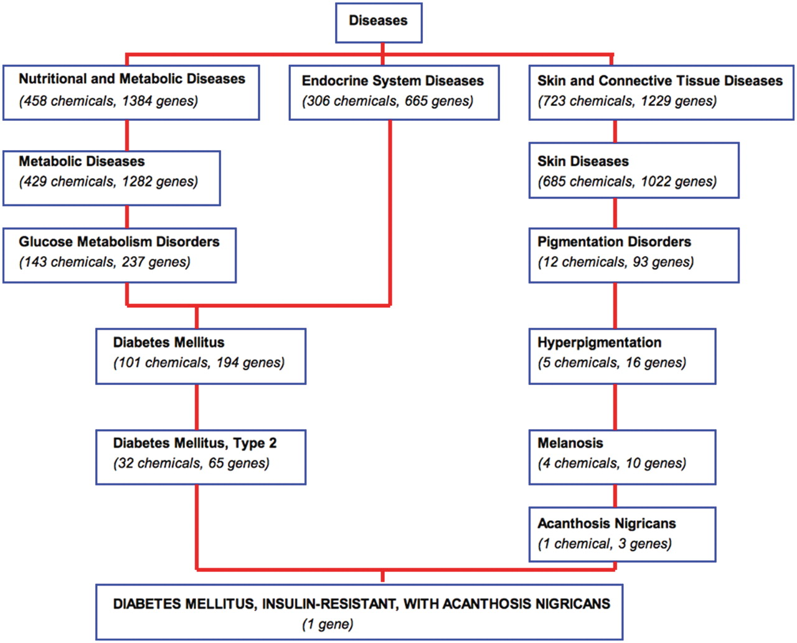
Figure 5. Navigating MEDIC and its curated data. A bird's eye view of a section of MEDIC provides users with the ...
Notes:
Figure 5. Navigating MEDIC and its curated data. A bird's eye view of a section of MEDIC provides users with the ability to navigate and explore disease terms, relationships, and their associated CTD data. The disease ‘DIABETES MELLITUS, INSULIN-RESISTANT, WITH ACANTHOSIS NIGRICANS’ (OMIM:610549) is a leaf of ‘Diabetes Mellitus, Type 2’ (MESH:D003924) and ‘Acanthosis Nigricans’ (MESH:D000052). Chemicals and genes annotated to each MEDIC term are cumulated as the user navigates up to more broad concepts.
Unless provided in the caption above, the following copyright applies to the content of this slide: © The Author(s) 2012. Published by Oxford University Press.This is an Open Access article distributed under the terms of the Creative Commons Attribution Non-Commercial License (http://creativecommons.org/licenses/by-nc/3.0), which permits unrestricted non-commercial use, distribution, and reproduction in any medium, provided the original work is properly cited.

Slide 6
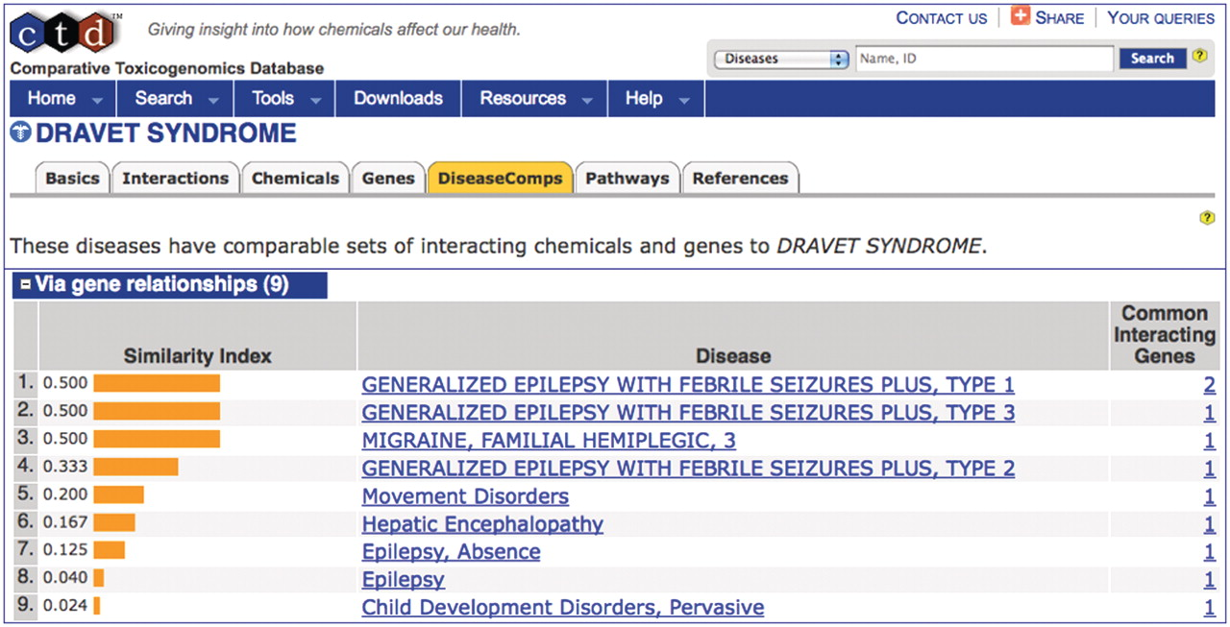
Figure 6. DiseaseComps use MEDIC. The DiseaseComps tab (orange) ranks diseases similar to ‘DRAVET SYNDROME’ based upon ...
Notes:
Figure 6. DiseaseComps use MEDIC. The DiseaseComps tab (orange) ranks diseases similar to ‘DRAVET SYNDROME’ based upon shared genes. DiseaseComps, which employs MEDIC as its disease vocabulary, ranks a mixture of both MeSH and OMIM terms (recognizable by its capitalization) based upon their similarity index. ‘DRAVET SYNDROME’ is discovered to share genes with epilepsy, migraines and hepatic encephalopathy.
Unless provided in the caption above, the following copyright applies to the content of this slide: © The Author(s) 2012. Published by Oxford University Press.This is an Open Access article distributed under the terms of the Creative Commons Attribution Non-Commercial License (http://creativecommons.org/licenses/by-nc/3.0), which permits unrestricted non-commercial use, distribution, and reproduction in any medium, provided the original work is properly cited.

