Slide 1
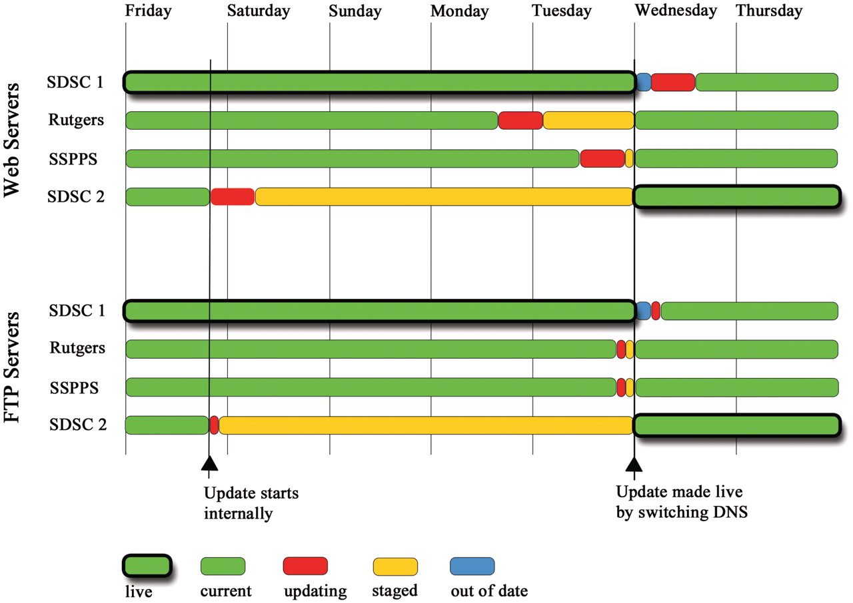
Figure 2. Staggered weekly update schedule of the Web and FTP servers. The overall aim is to balance the need for ...
Notes:
Figure 2. Staggered weekly update schedule of the Web and FTP servers. The overall aim is to balance the need for advanced staging of the update (red and orange) with as much failover to current data (green) as possible at any given time. The update cycle begins on Friday with the second SDSC cluster (SDSC 2). Two more clusters are updated on Monday and Tuesday. On Wednesday at 00:00 UTC, the update is made public by switching the DNS entry between the two SDSC clusters (thick outlines). A few hours are allowed for the DNS change to propagate until the update on the final and now out of date cluster (blue) is started. Green with thick outlines shows “live” clusters serving data to the public. Other clusters in green have the same current content. Clusters in red are being updated. Orange denotes a cluster with a finished update that contains “staged” data not yet available for public release. Blue shows a cluster whose data are out of date compared with the live public site.
Unless provided in the caption above, the following copyright applies to the content of this slide: © The Author(s) 2011. Published by Oxford University Press.This is Open Access article distributed under the terms of the Creative Commons Attribution Non-Commercial License (http://creativecommons.org/licenses/by-nc/2.5), which permits unrestricted non-commercial use, distribution, and reproduction in any medium, provided the original work is properly cited.

