Slide 1
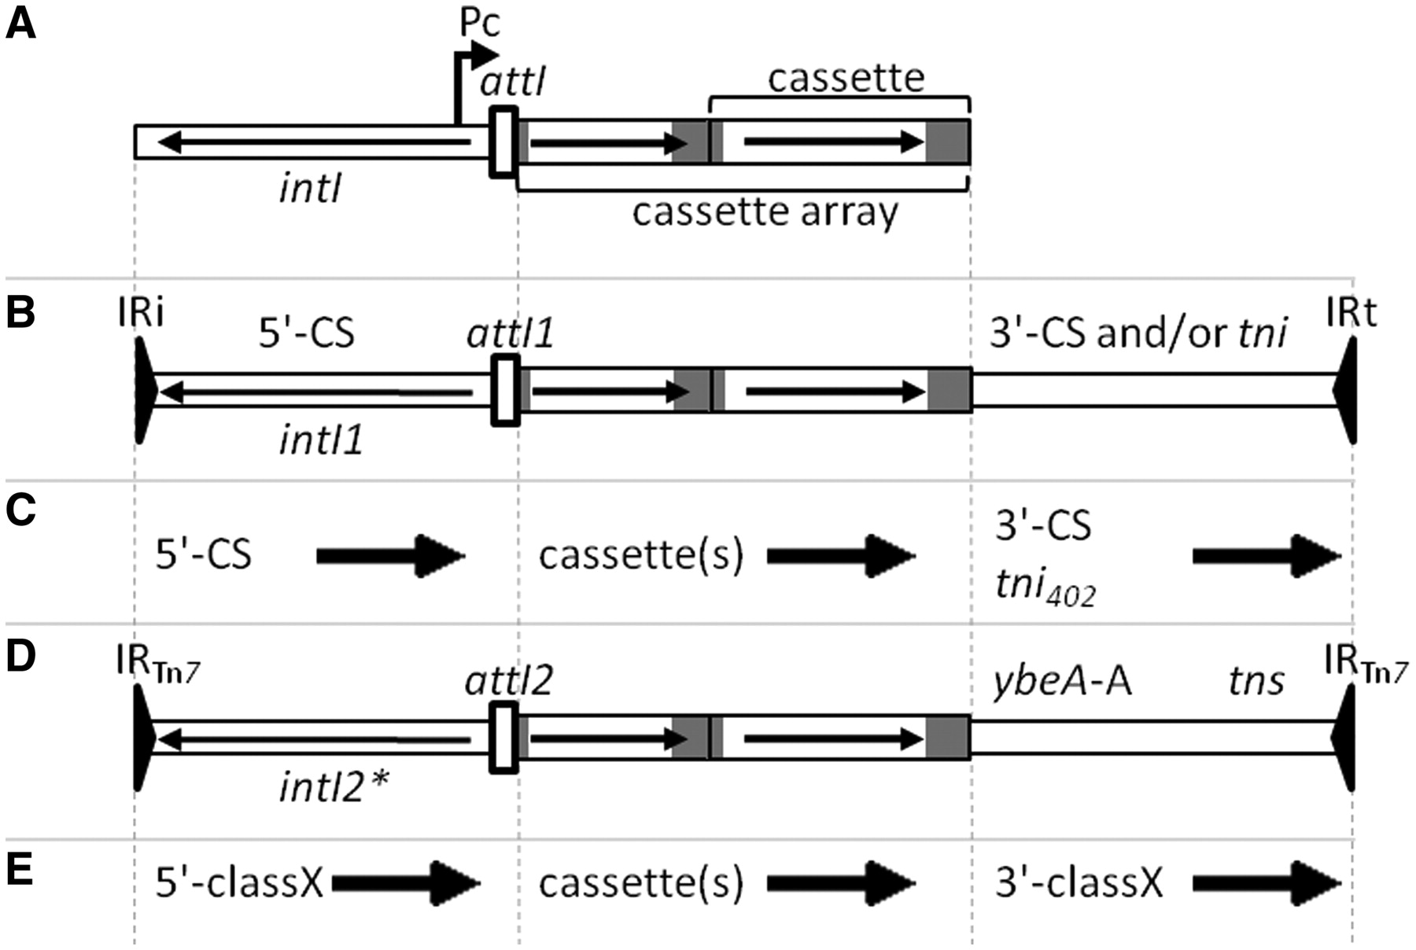
Figure 1. (A) General structure of an integron with intI, attI, Pc and a cassette array with two gene cassettes. ...
Notes:
Figure 1. (A) General structure of an integron with intI, attI, Pc and a cassette array with two gene cassettes. Horizontal arrows indicate the extent and direction of genes. Grey regions represent attC sites. (B) General structure of Class 1 MRI, which may include the 3'-CS and part of the tni region of Tn402 or a complete tni402 region. (C) Names used by RAC to indicate conserved regions flanking cassette arrays in the two types of Class 1 MRI. Arrows define the forward direction used in the RAC annotations, which in the case of the 5'-CS is opposite to that of intI1. (D) Structure of a Class 2 integron associated with Tn7. The intI2 gene is usually truncated, indicated by an asterisk. ybeA-A is a cassette remnant with a truncated attC site and is followed by the tns transposition genes of Tn7. (E) Names used by RAC to indicate regions flanking cassette arrays in a class X MRI, where X is 2–5.
Unless provided in the caption above, the following copyright applies to the content of this slide: © The Author(s) 2011. Published by Oxford University Press.This is an Open Access article distributed under the terms of the Creative Commons Attribution Non-Commercial License (http://creativecommons.org/licenses/by-nc/3.0), which permits unrestricted non-commercial use, distribution, and reproduction in any medium, provided the original work is properly cited.

Slide 2
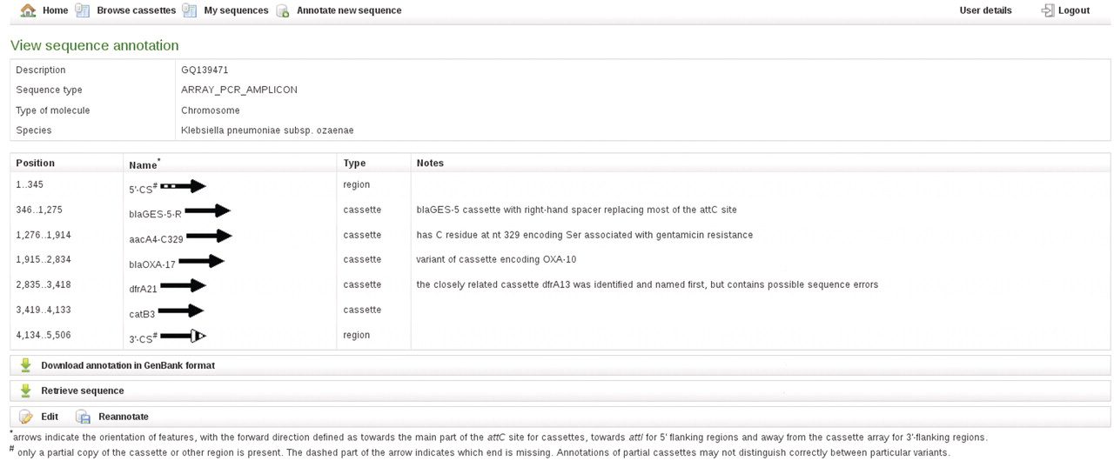
Figure 3. RAC annotation of an exemplar cassette array, including examples of partial features, a bla variant cassette, ...
Notes:
Figure 3. RAC annotation of an exemplar cassette array, including examples of partial features, a bla variant cassette, an aacA4 cassette and the type of additional information given in Notes.
Unless provided in the caption above, the following copyright applies to the content of this slide: © The Author(s) 2011. Published by Oxford University Press.This is an Open Access article distributed under the terms of the Creative Commons Attribution Non-Commercial License (http://creativecommons.org/licenses/by-nc/3.0), which permits unrestricted non-commercial use, distribution, and reproduction in any medium, provided the original work is properly cited.

Slide 3
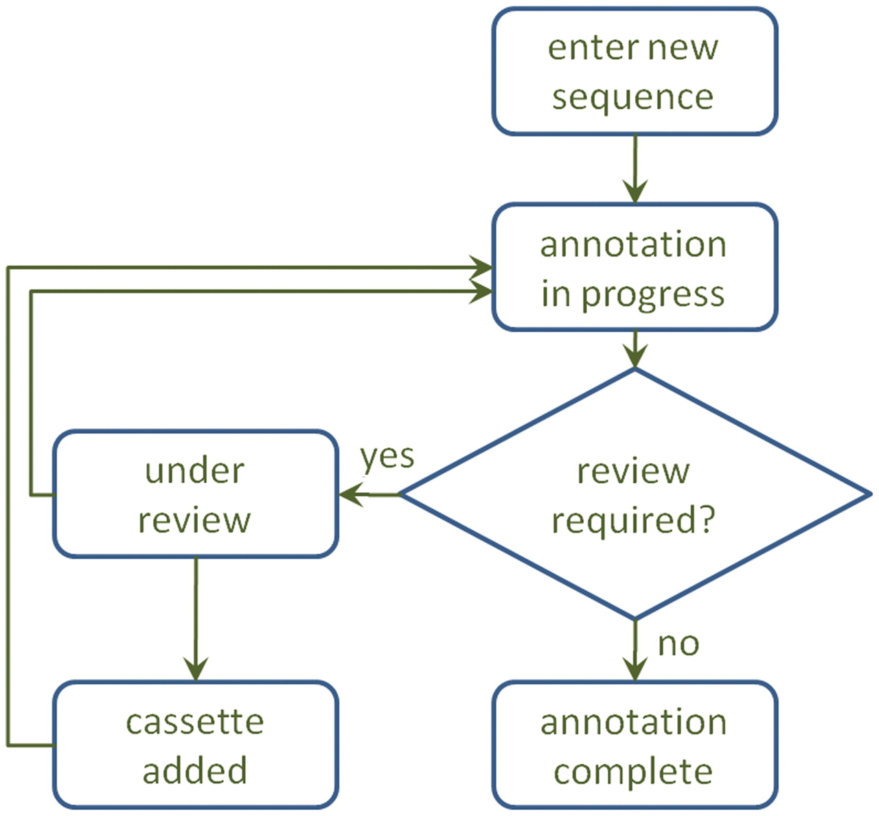
Figure 2. A diagram of the annotation process. After annotation, a sequence may be sent for review, which may result in ...
Notes:
Figure 2. A diagram of the annotation process. After annotation, a sequence may be sent for review, which may result in a manual adjustment to the annotation and/or inclusion of a new cassette in the database.
Unless provided in the caption above, the following copyright applies to the content of this slide: © The Author(s) 2011. Published by Oxford University Press.This is an Open Access article distributed under the terms of the Creative Commons Attribution Non-Commercial License (http://creativecommons.org/licenses/by-nc/3.0), which permits unrestricted non-commercial use, distribution, and reproduction in any medium, provided the original work is properly cited.

