Slide 1
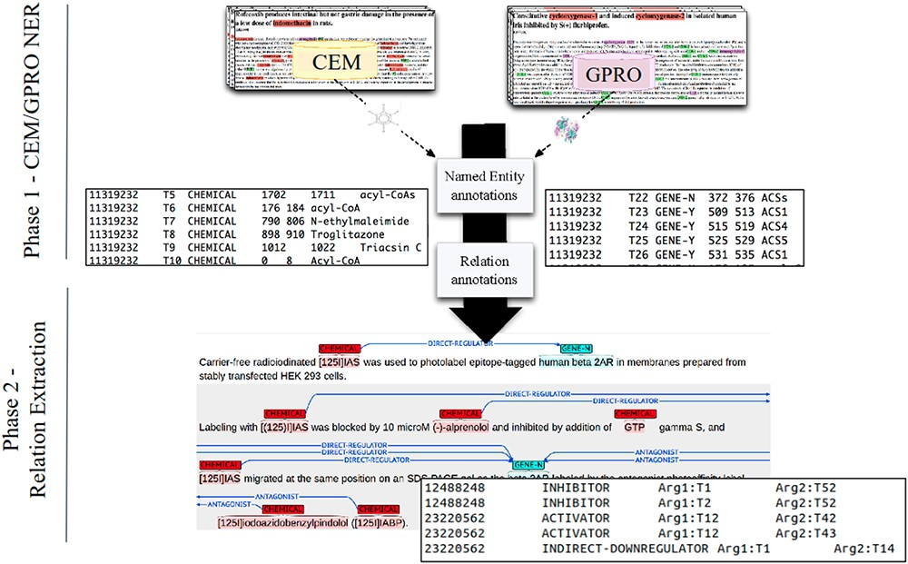
Figure 2. A DrugProt corpus annotation scheme in three independent phases: (1.1) CEM annotation, (1.2) GPRO annotation ...
Notes:
Figure 2. A DrugProt corpus annotation scheme in three independent phases: (1.1) CEM annotation, (1.2) GPRO annotation and (2) RE annotation. An example of the output of the annotation is visualized in Brat at the bottom of the figure.
Unless provided in the caption above, the following copyright applies to the content of this slide: © The Author(s) 2023. Published by Oxford University Press.This is an Open Access article distributed under the terms of the Creative Commons Attribution License (https://creativecommons.org/licenses/by/4.0/), which permits unrestricted reuse, distribution, and reproduction in any medium, provided the original work is properly cited.

