Slide 1
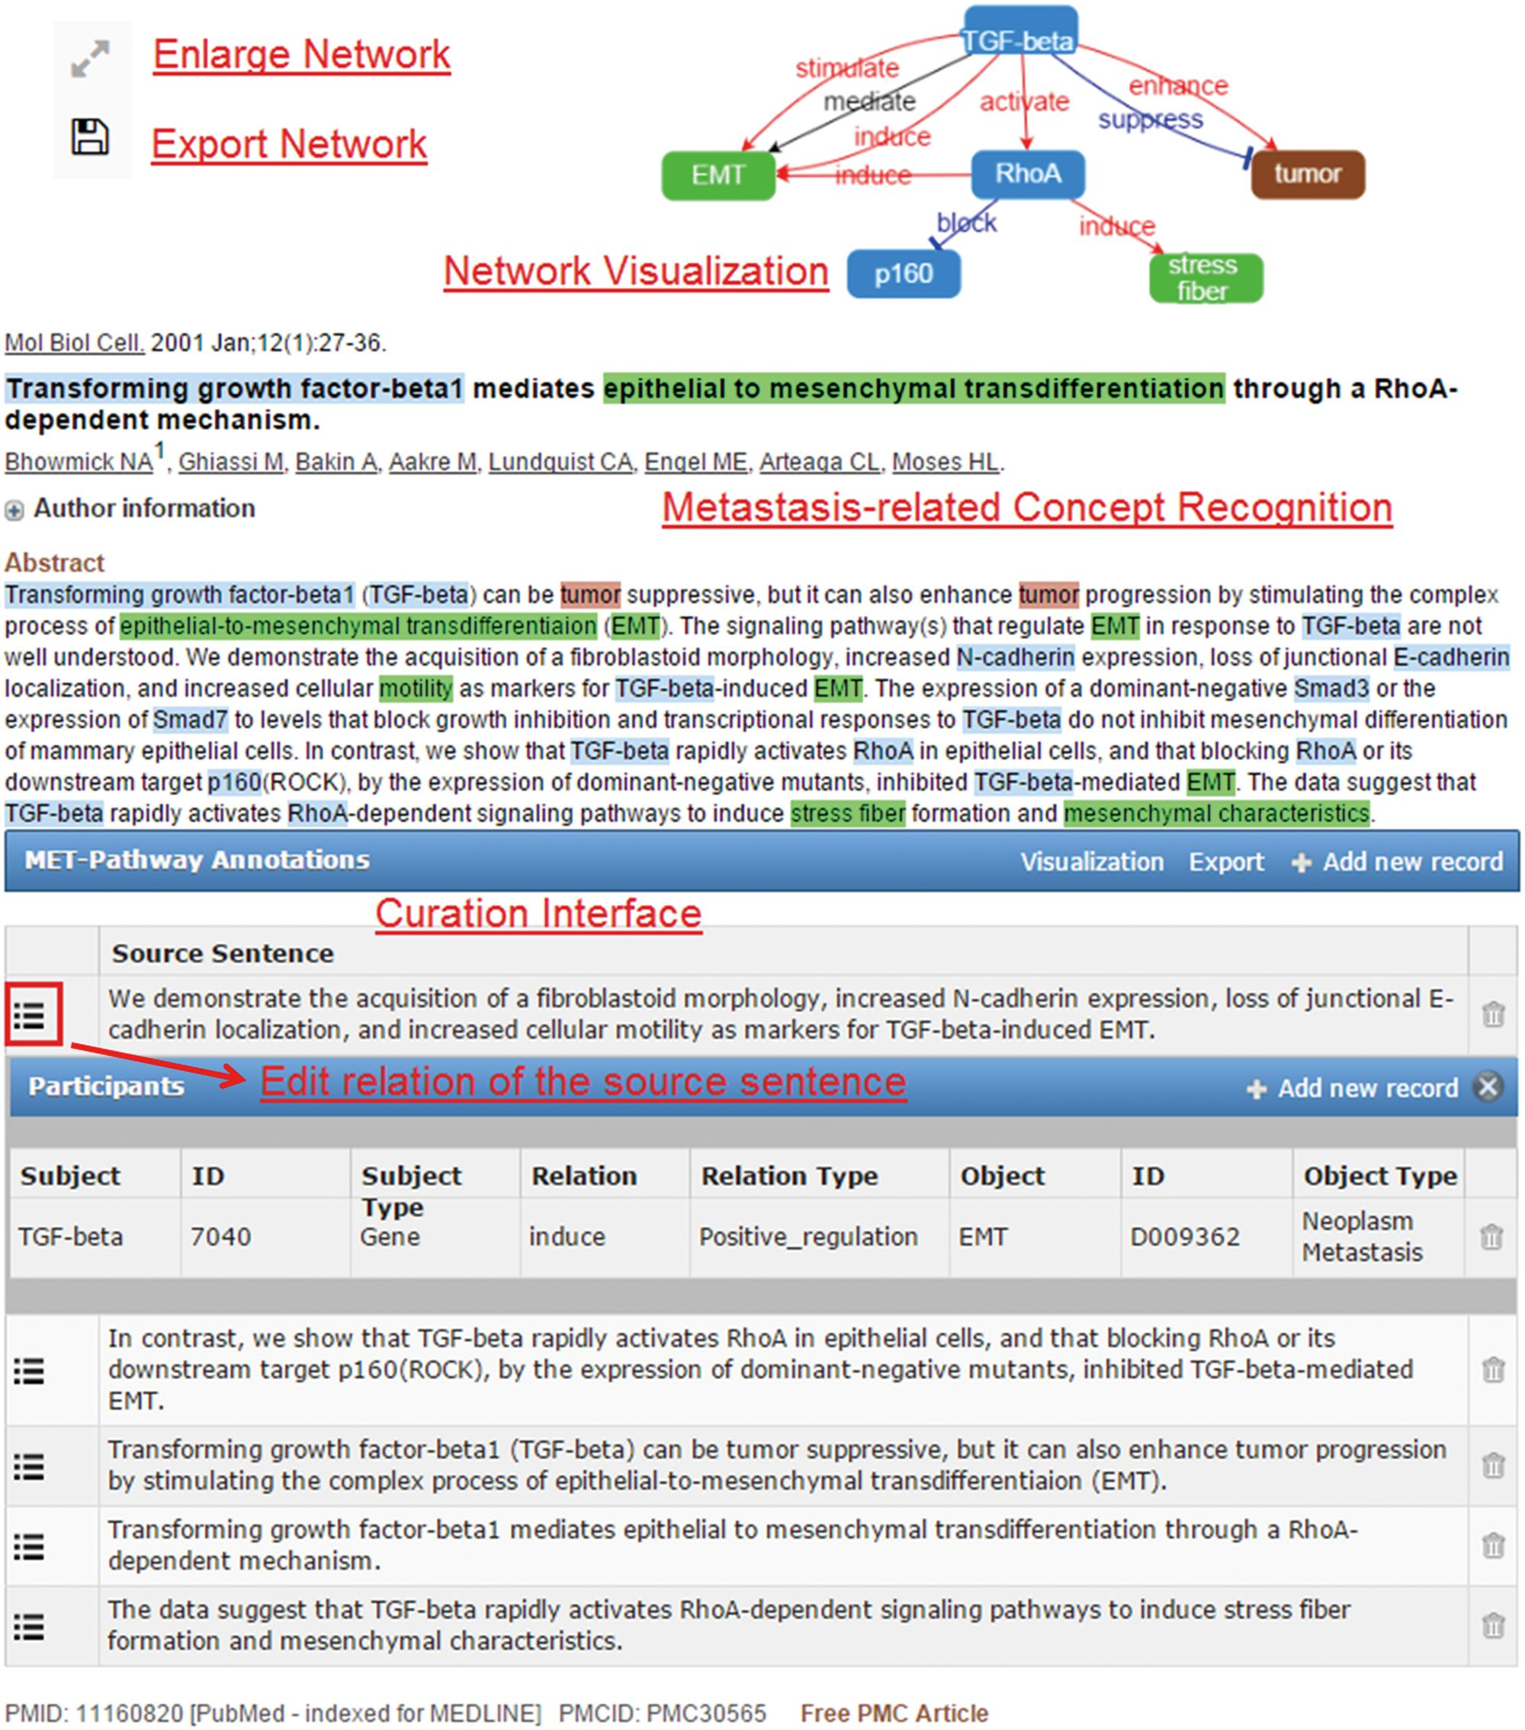
Figure 1. An article (PMID: 11160820) processed by MET.
Notes:
Figure 1. An article (PMID: 11160820) processed by MET.
Unless provided in the caption above, the following copyright applies to the content of this slide: © The Author(s) 2016. Published by Oxford University Press. This is an Open Access article distributed under the terms of the Creative Commons Attribution License ( http://creativecommons.org/licenses/by/4.0/ ), which permits unrestricted reuse, distribution, and reproduction in any medium, provided the original work is properly cited.

Slide 2
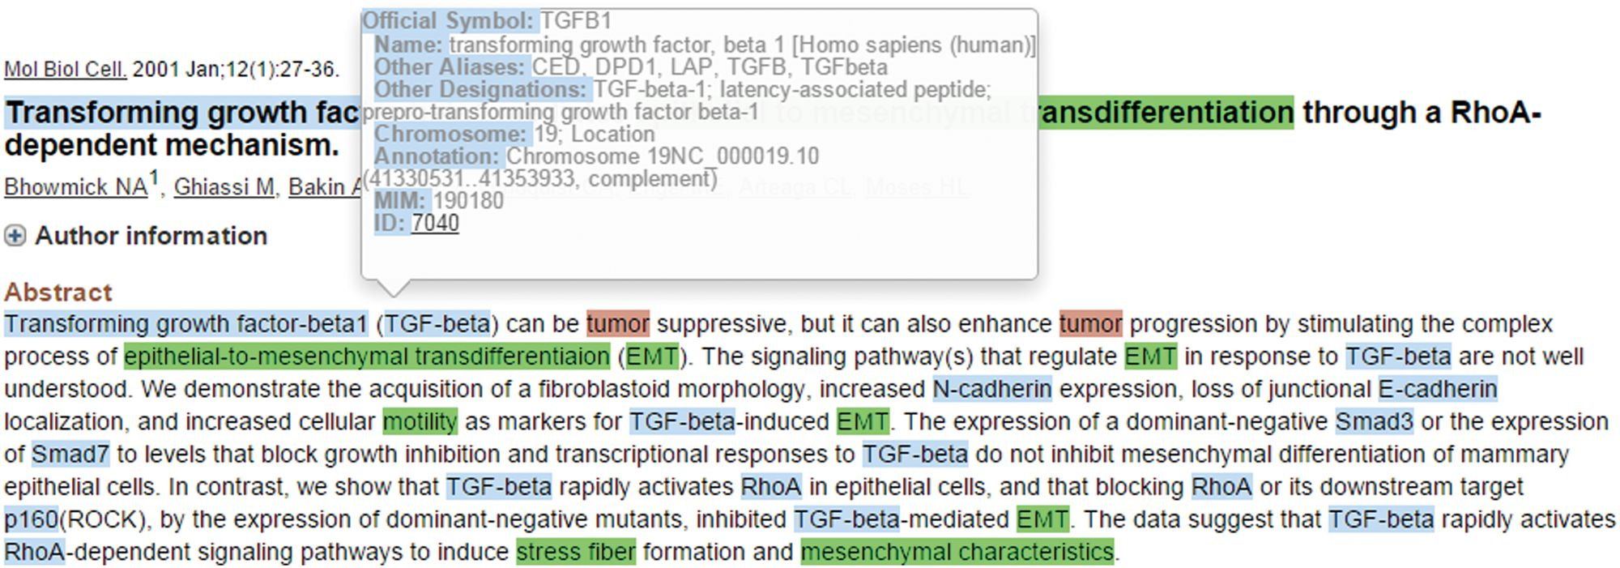
Figure 2. Summary information of the recognized TGF-beta gene.
Notes:
Figure 2. Summary information of the recognized TGF-beta gene.
Unless provided in the caption above, the following copyright applies to the content of this slide: © The Author(s) 2016. Published by Oxford University Press. This is an Open Access article distributed under the terms of the Creative Commons Attribution License ( http://creativecommons.org/licenses/by/4.0/ ), which permits unrestricted reuse, distribution, and reproduction in any medium, provided the original work is properly cited.

Slide 3
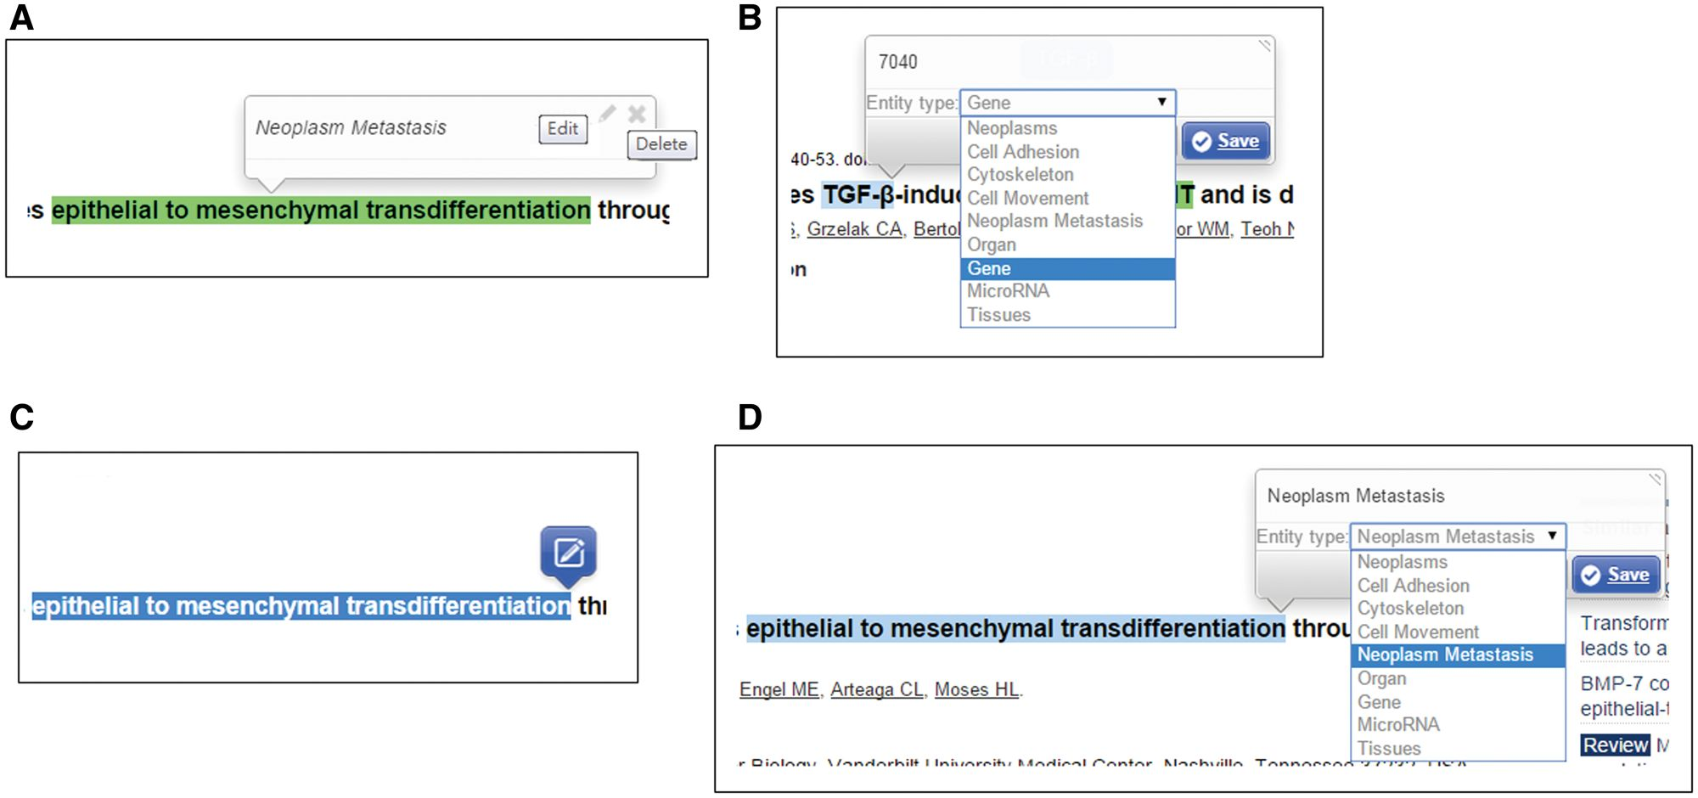
Figure 3. Curation interface for concept annotation.
Notes:
Figure 3. Curation interface for concept annotation.
Unless provided in the caption above, the following copyright applies to the content of this slide: © The Author(s) 2016. Published by Oxford University Press. This is an Open Access article distributed under the terms of the Creative Commons Attribution License ( http://creativecommons.org/licenses/by/4.0/ ), which permits unrestricted reuse, distribution, and reproduction in any medium, provided the original work is properly cited.

Slide 4
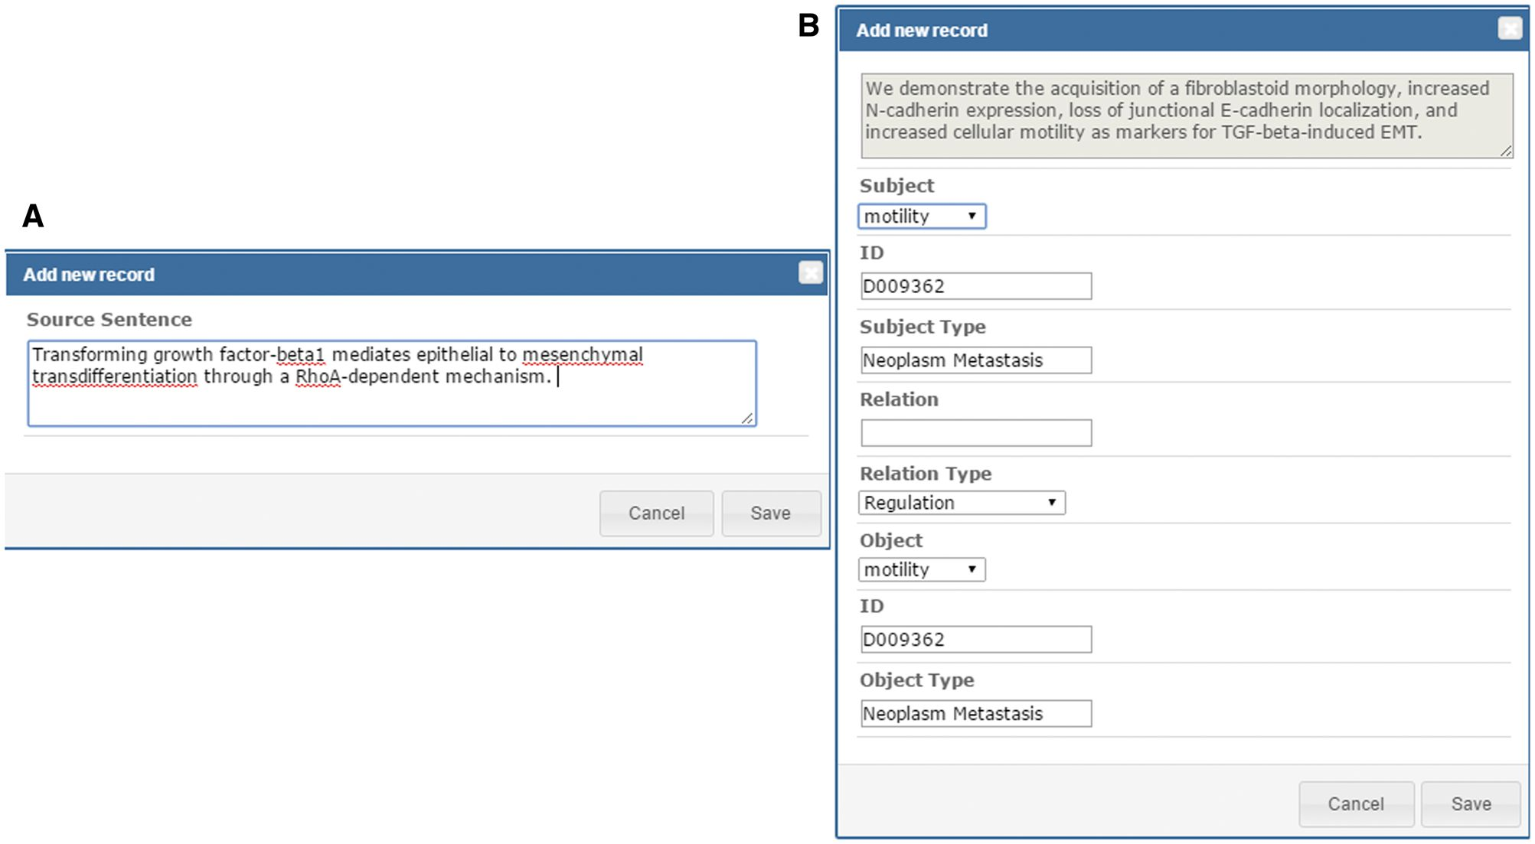
Figure 4. Curation interface for adding source sentences and relations.
Notes:
Figure 4. Curation interface for adding source sentences and relations.
Unless provided in the caption above, the following copyright applies to the content of this slide: © The Author(s) 2016. Published by Oxford University Press. This is an Open Access article distributed under the terms of the Creative Commons Attribution License ( http://creativecommons.org/licenses/by/4.0/ ), which permits unrestricted reuse, distribution, and reproduction in any medium, provided the original work is properly cited.

Slide 5
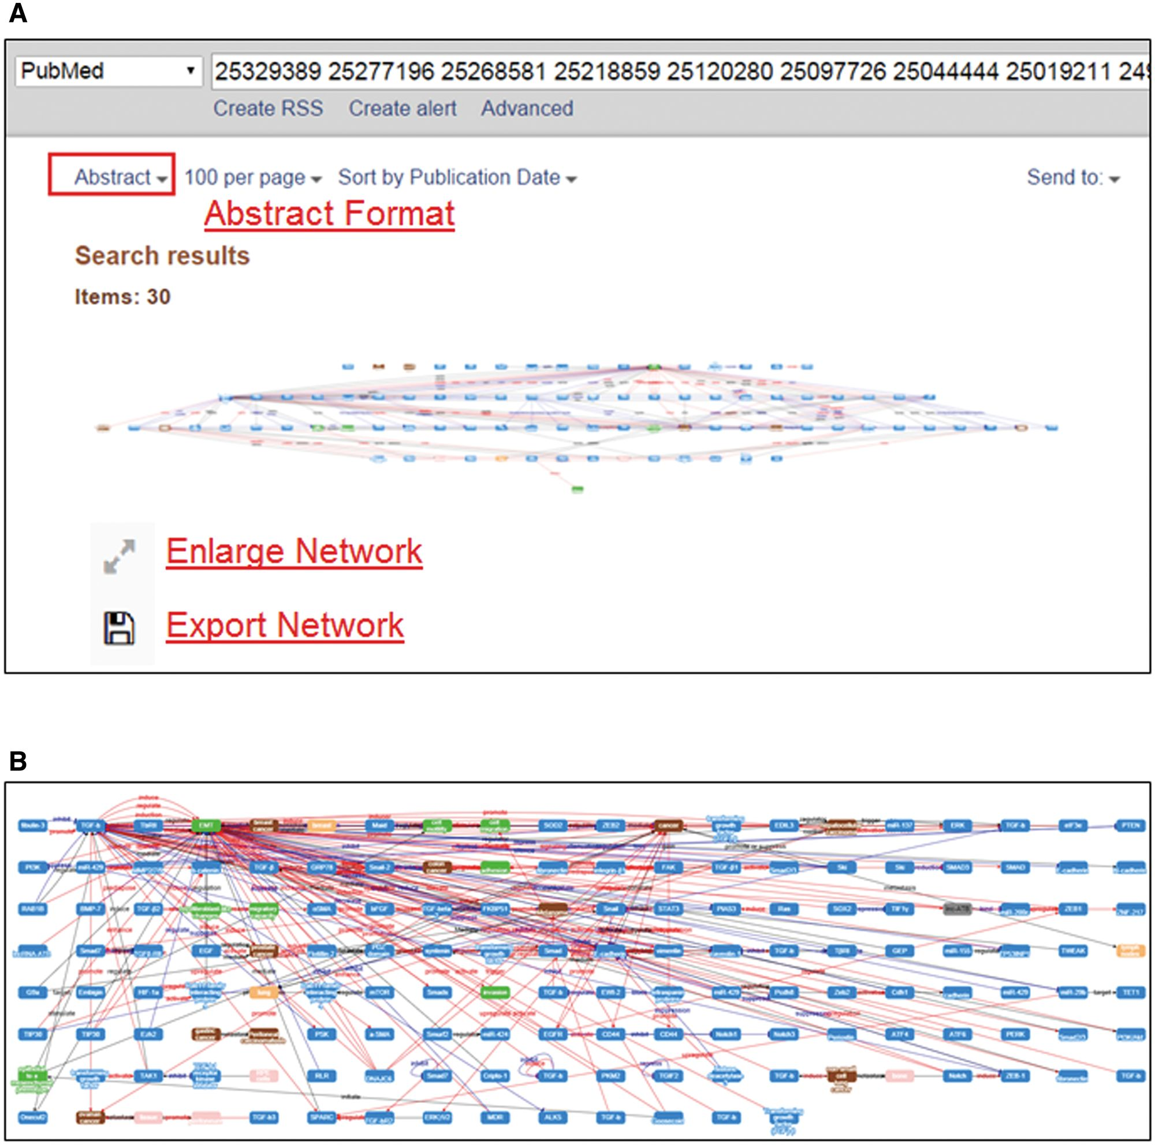
Figure 5. Integrated pathways of multiple abstracts by MET.
Notes:
Figure 5. Integrated pathways of multiple abstracts by MET.
Unless provided in the caption above, the following copyright applies to the content of this slide: © The Author(s) 2016. Published by Oxford University Press. This is an Open Access article distributed under the terms of the Creative Commons Attribution License ( http://creativecommons.org/licenses/by/4.0/ ), which permits unrestricted reuse, distribution, and reproduction in any medium, provided the original work is properly cited.

Slide 6
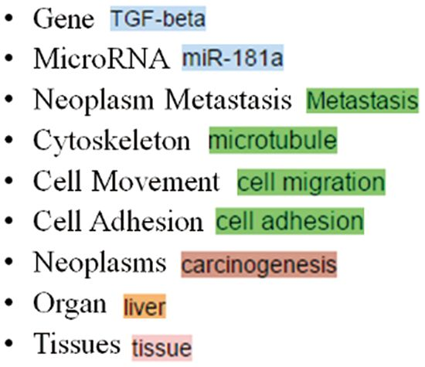
Figure 6. The colors used for different concept types in MET.
Notes:
Figure 6. The colors used for different concept types in MET.
Unless provided in the caption above, the following copyright applies to the content of this slide: © The Author(s) 2016. Published by Oxford University Press. This is an Open Access article distributed under the terms of the Creative Commons Attribution License ( http://creativecommons.org/licenses/by/4.0/ ), which permits unrestricted reuse, distribution, and reproduction in any medium, provided the original work is properly cited.

