Slide 1
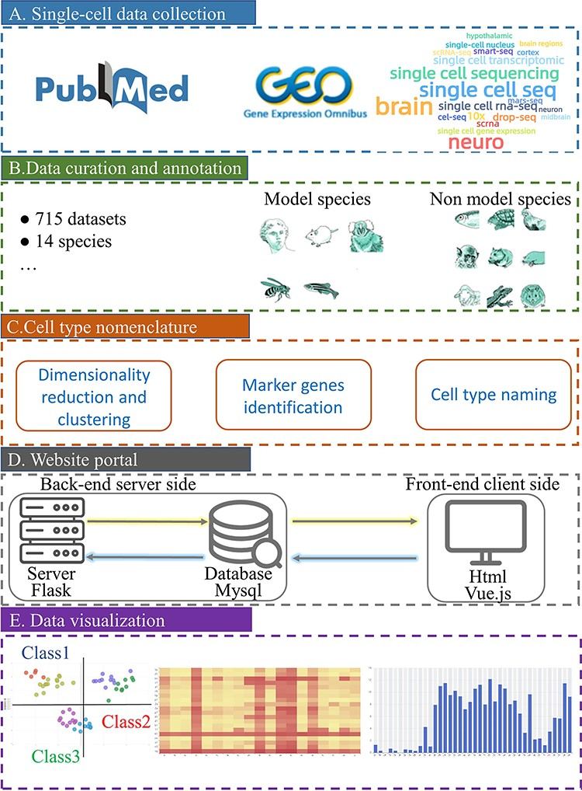
Figure 1. Schematic overview of scBrainMap database construction. (A) Literature search in PubMed and GEO with a list ...
Notes:
Figure 1. Schematic overview of scBrainMap database construction. (A) Literature search in PubMed and GEO with a list of well-defined keywords. (B) All datasets were manually curated for various species. (C) Cell-type clustering and naming were performed. (D) The database portal was built for both the front end and the back-end. (E) Convenient visual and interactive user interfaces were implemented.
Unless provided in the caption above, the following copyright applies to the content of this slide: © The Author(s) 2023. Published by Oxford University Press.This is an Open Access article distributed under the terms of the Creative Commons Attribution License (https://creativecommons.org/licenses/by/4.0/), which permits unrestricted reuse, distribution, and reproduction in any medium, provided the original work is properly cited.

