Slide 1
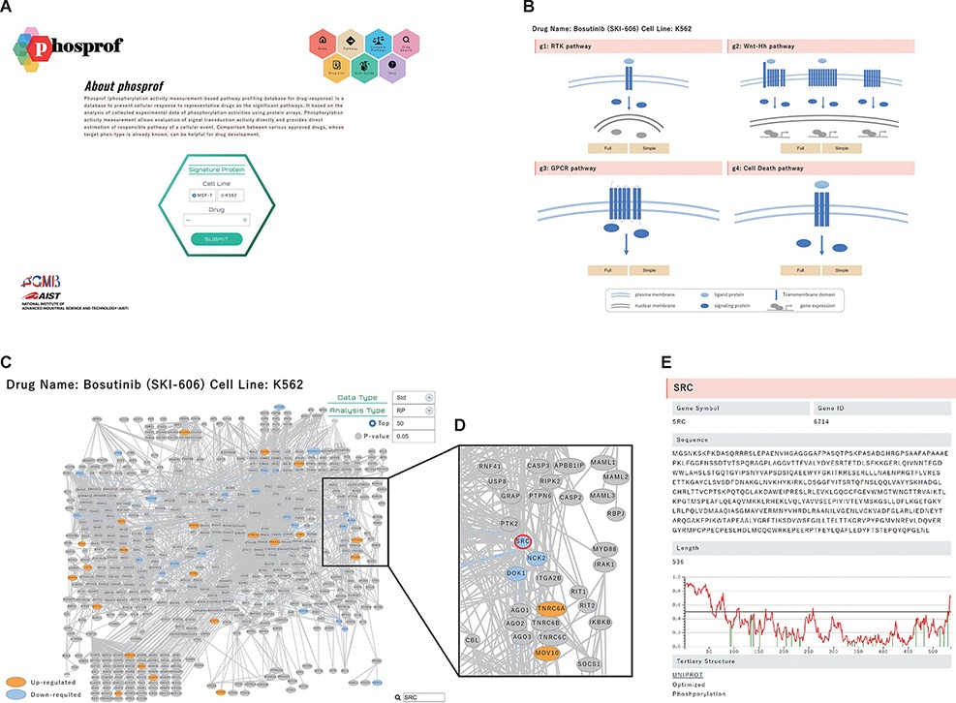
Figure 2. ‘Signature Protein’ section. (A) Phosprof top page. Proteins with significant change in phosphorylation level ...
Notes:
Figure 2. ‘Signature Protein’ section. (A) Phosprof top page. Proteins with significant change in phosphorylation level can be browsed by choosing the tested cell type (MCF7 or K562) and treated drug. (B) Signature proteins are highlighted on a pathway map. The 376 analyzed pathways were divided into four functional groups (g1: RTK pathway; g2: Wnt–Hh pathway; g3: GPCR pathway and g4: Cell Death pathway), according to the Reactome classification. (C) Signature proteins of K562 cells under treatment with the SRC inhibitor bosutinib. Data type (Std: standardized data or Raw: raw data), analysis type (RP: rank products or Pearson) and thresholds (Top 50/100/150/200 or P-value) can be selected. (D) Enlarged view after searching for SRC on the pathway map. (E) The nodes of the pathway map are linked to the ‘details of the protein’ page. Detailed information includes the gene symbols, amino acid sequences and the disorder scores. This page is also connected to the PDB web site and the protein tertiary structures.
Unless provided in the caption above, the following copyright applies to the content of this slide: © The Author(s) 2022. Published by Oxford University Press.This is an Open Access article distributed under the terms of the Creative Commons Attribution-NonCommercial License (https://creativecommons.org/licenses/by-nc/4.0/), which permits non-commercial re-use, distribution, and reproduction in any medium, provided the original work is properly cited. For commercial re-use, please contact journals.permissions@oup.com

