Slide 1
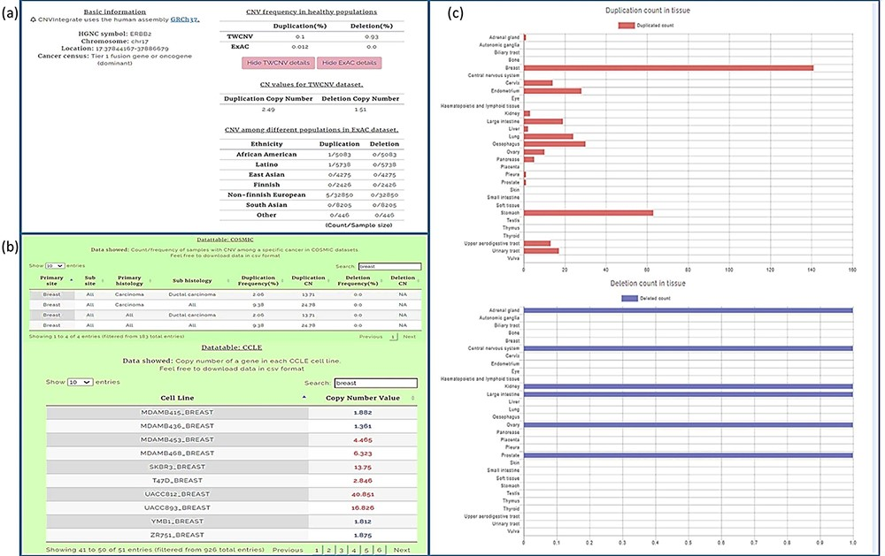
Figure 6. Query results for ERBB2 gene showing CNV frequencies in both healthy populations and cancer populations (a) ...
Notes:
Figure 6. Query results for ERBB2 gene showing CNV frequencies in both healthy populations and cancer populations (a) CNV frequency/counts of the ERBB2 gene in the TWCNV (healthy) dataset and CNV frequency of ERBB2 among different populations (healthy) in the ExAC dataset. (b) Count/frequency of breast cancer samples with CNV in the COSMIC dataset; CN of the ERBB2 gene in CCLE breast cell lines. (c) Duplication and deletion counts of the ERBB2 gene in different tissues.
Unless provided in the caption above, the following copyright applies to the content of this slide: © The Author(s) 2021. Published by Oxford University Press.This is an Open Access article distributed under the terms of the Creative Commons Attribution License (http://creativecommons.org/licenses/by/4.0/), which permits unrestricted reuse, distribution, and reproduction in any medium, provided the original work is properly cited.

