Slide 1
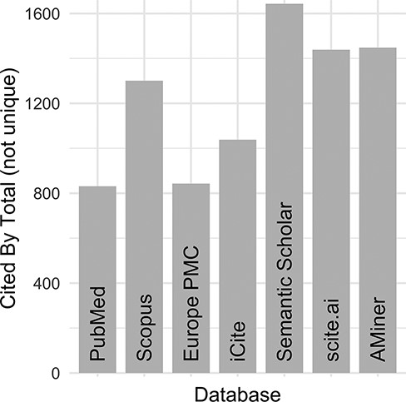
Figure 2. DO official publication ‘cited by’ counts. The total number of citations to each of the DO official ...
Notes:
Figure 2. DO official publication ‘cited by’ counts. The total number of citations to each of the DO official publications published by 2021 (total = 8, https://disease-ontology.org/community/publications) were manually obtained online from each provider in August 2021. Publications from Web of Science were excluded because the University of Maryland School of Medicine does not have institutional access.
Unless provided in the caption above, the following copyright applies to the content of this slide: © The Author(s) 2023. Published by Oxford University Press.This is an Open Access article distributed under the terms of the Creative Commons Attribution License (https://creativecommons.org/licenses/by/4.0/), which permits unrestricted reuse, distribution, and reproduction in any medium, provided the original work is properly cited.

