Slide 1
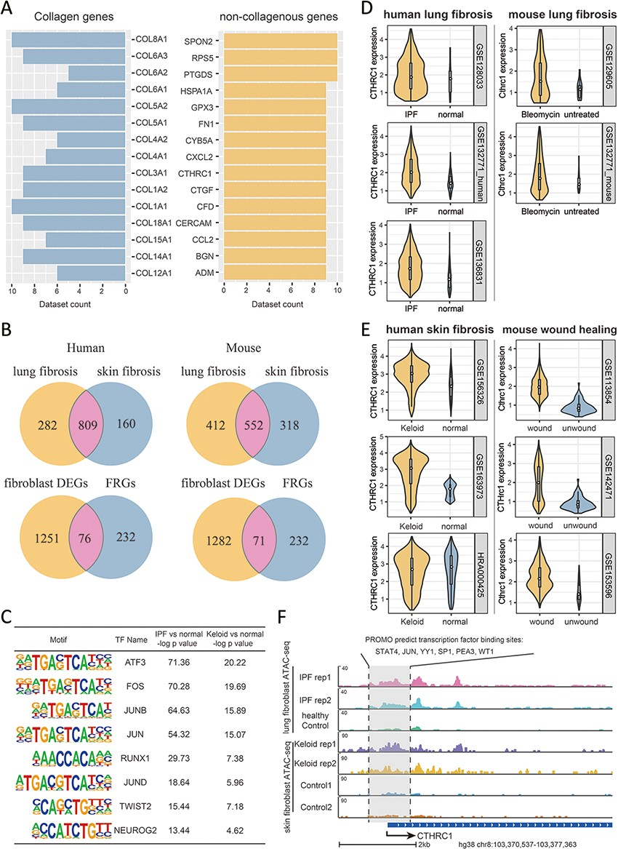
Figure 5. Multi-omics explorations with FibROAD indicate that CTHRC1 may be a potential candidate gene for skin ...
Notes:
Figure 5. Multi-omics explorations with FibROAD indicate that CTHRC1 may be a potential candidate gene for skin fibrosis. (A) Bar graphs showing the top 15 most extensively and differentially expressed collagenous and non-collagenous fibroblast genes in scRNAseq datasets as collected with FibROAD (filtered by Wilcoxon Rank Sum test with log fold-change cutoff of 0.5 and P < 0.05). (B) Venn plots showing intersections of differentially expressed genes (DEGs) between lung and skin fibroblasts, in humans and mouse respectively (upper 2 Venn plots), and the intersections between DEGs and FRGs in the two species (lower 2 Venn plots). (C) Transcription factor motif enrichment analysis of differential chromatin accessibility regions located in the promotor region of the 55 commonly differentially expressed FRGs with ATAC-seq fibroblast datasets. (D-E) Violin plots showing significant differences in CTHRC1 expressions within lung (D) and skin (E) fibroblasts between the fibrotic group and healthy controls, in humans (left panel) and mice (right panel). (F) Representative genome browser tracks comparing CTHRC1 ATAC-seq signals in fibroblasts between the fibrotic group and healthy controls.
Unless provided in the caption above, the following copyright applies to the content of this slide: © The Author(s) 2022. Published by Oxford University Press.This is an Open Access article distributed under the terms of the Creative Commons Attribution License (https://creativecommons.org/licenses/by/4.0/), which permits unrestricted reuse, distribution, and reproduction in any medium, provided the original work is properly cited.

