Slide 1
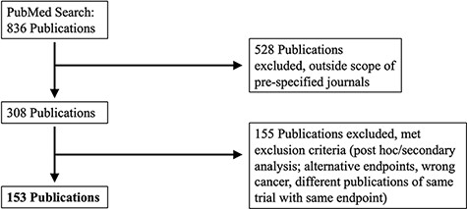
Figure 1. PRISMA selection of clinical trials included in KMDATA. The original PubMed search resulted in 836 total ...
Notes:
Figure 1. PRISMA selection of clinical trials included in KMDATA. The original PubMed search resulted in 836 total publications. Results were excluded based on prespecified criteria including cancer type and study endpoints. A total of 153 publications from clinical trials were included in the database.
Unless provided in the caption above, the following copyright applies to the content of this slide: © The Author(s) 2021. Published by Oxford University Press.This is an Open Access article distributed under the terms of the Creative Commons Attribution License (http://creativecommons.org/licenses/by/4.0/), which permits unrestricted reuse, distribution, and reproduction in any medium, provided the original work is properly cited.

Slide 2
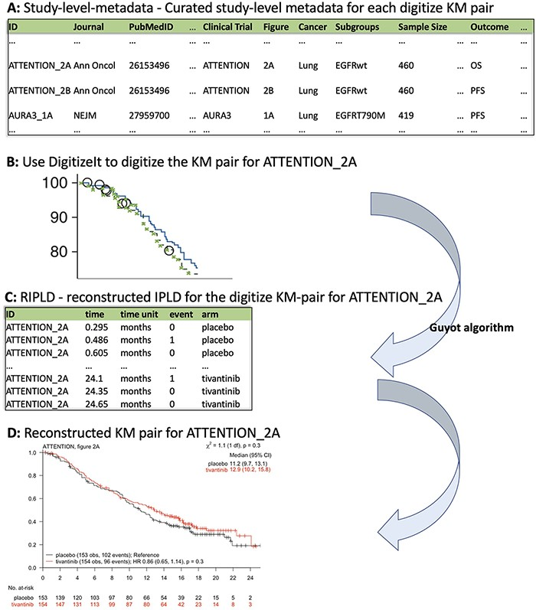
Figure 2. KMDATA structure. Each publication (A) was digitized (B) and processed using the Guyot algorithm to obtain ...
Notes:
Figure 2. KMDATA structure. Each publication (A) was digitized (B) and processed using the Guyot algorithm to obtain time-to-event reconstructed data (C). The digitalized figures are included in the kmdata package. (D) Example of the reconstructed figures.
Unless provided in the caption above, the following copyright applies to the content of this slide: © The Author(s) 2021. Published by Oxford University Press.This is an Open Access article distributed under the terms of the Creative Commons Attribution License (http://creativecommons.org/licenses/by/4.0/), which permits unrestricted reuse, distribution, and reproduction in any medium, provided the original work is properly cited.

