Slide 1
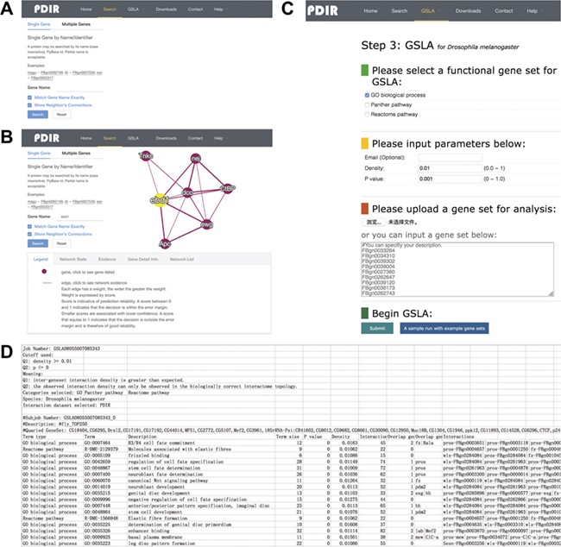
Figure 3 Interface of PDIR and GSLA. (A) Two search options in PDIR. (B) Search result page. A right click on the edge ...
Notes:
Figure 3 Interface of PDIR and GSLA. (A) Two search options in PDIR. (B) Search result page. A right click on the edge will show interaction details. (C) Interface of GSLA. (D) Results of a GSLA analysis job.
Unless provided in the caption above, the following copyright applies to the content of this slide: © The Author(s) 2020. Published by Oxford University Press.This article is published and distributed under the terms of the Oxford University Press, Standard Journals Publication Model (https://academic.oup.com/journals/pages/open_access/funder_policies/chorus/standard_publication_model)

