Slide 1
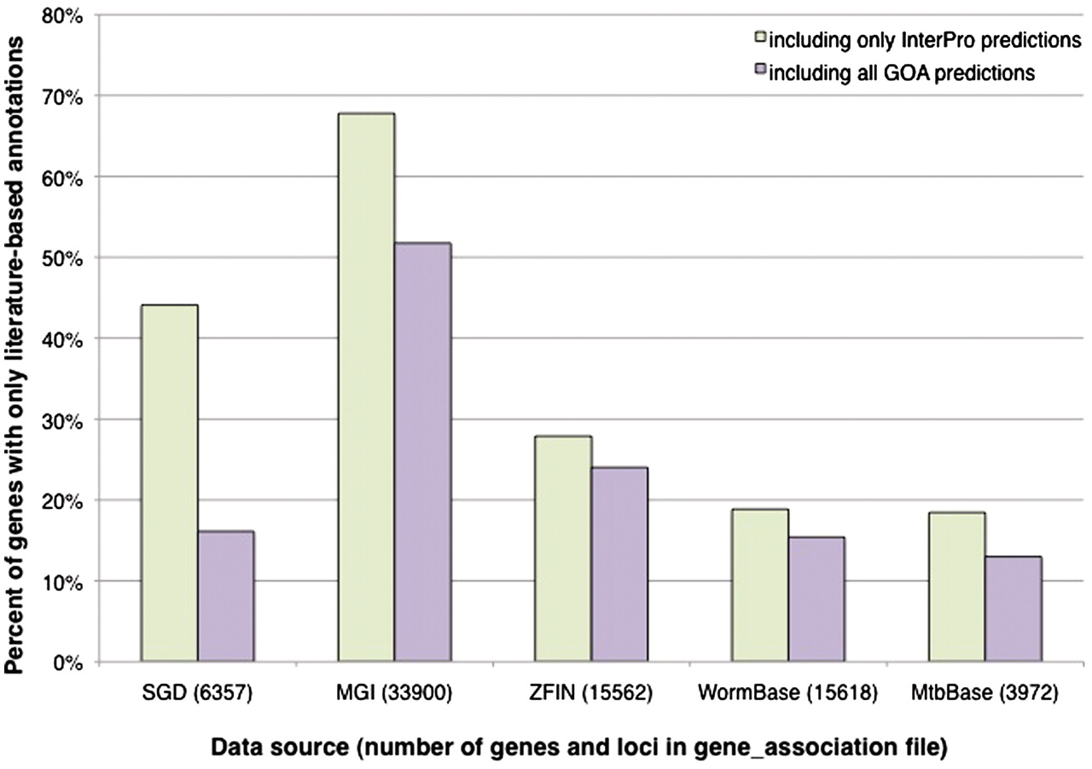
Figure 2. Percentage of genes with literature-based annotations and no computational predictions. Genes from each data ...
Notes:
Figure 2. Percentage of genes with literature-based annotations and no computational predictions. Genes from each data source were determined to have a literature-based annotation, a computational prediction from an InterPro signature, or a computational prediction from any of the methods used by the GOA project. All of the computational predictions were performed by the GOA project, using consistent methods and parameters, and are incorporated in their entirety by the various model organism databases. The graph displays the proportion of genes in each organism that have only literature-based annotations when compared to InterPro-based predictions only, or when compared with all predictions made by the GOA project (including those based on InterPro signatures). All data, including the total number of genes and loci listed for each data source, are based on computational annotations (identified as a GO annotation with an IEA evidence code) found in gene association files downloaded in November 2010.
Unless provided in the caption above, the following copyright applies to the content of this slide: © The Author(s) 2011. Published by Oxford University Press.This is Open Access article distributed under the terms of the Creative Commons Attribution Non-Commercial License (http://creativecommons.org/licenses/by-nc/2.5), which permits unrestricted non-commercial use, distribution, and reproduction in any medium, provided the original work is properly cited.

