Slide 1
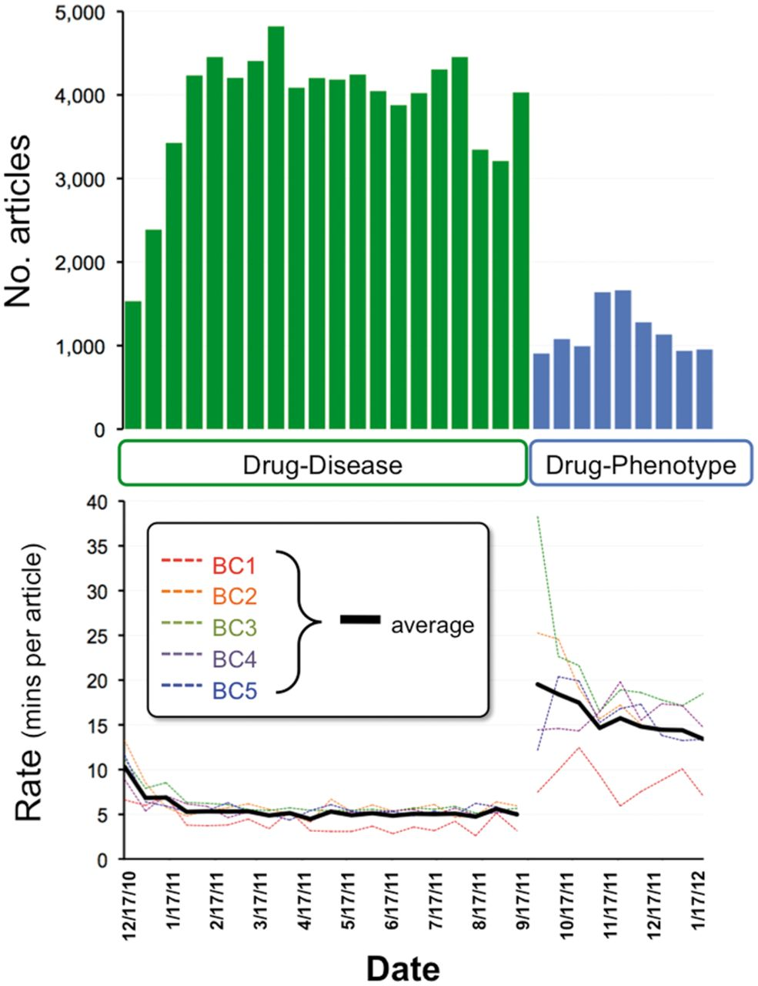
Figure 1. Project metrics. From December 2010 to September 2011, five CTD biocurators reviewed 78 263 articles for ...
Notes:
Figure 1. Project metrics. From December 2010 to September 2011, five CTD biocurators reviewed 78 263 articles for drug–disease information (top graph, green bars). Biocurators curated from just the abstract whenever possible, but examined the full text if necessary to resolve any relevant issues mentioned in the abstract. Review rates for each individual biocurator (bottom graph, BC1–BC5, dotted colored lines) were calculated based upon billing invoices, and the biweekly average of all five biocurators is also shown (solid black line). In September 2011, biocurators transitioned to reviewing 10366 articles for drug–phenotype information (top graph, blue bars). An increase in performance (as reflected by a decrease in rate) is seen as both projects progressed. For drug–disease curation, the average rate initiated at 10.3 min per article (17 December 2010) and ultimately improved to an average rate of 5.5 min per article over the entire period. For drug–phenotype curation, the average initial rate was 19.5 min per article (17 September 2011), improving to 13.4 min per article (13 January 2012), with an aggregate average rate of 15.9 min per article over the period.
Unless provided in the caption above, the following copyright applies to the content of this slide: © The Author(s) 2013. Published by Oxford University Press.This is an Open Access article distributed under the terms of the Creative Commons Attribution License (http://creativecommons.org/licenses/by/3.0/), which permits unrestricted reuse, distribution, and reproduction in any medium, provided the original work is properly cited.

