Slide 1
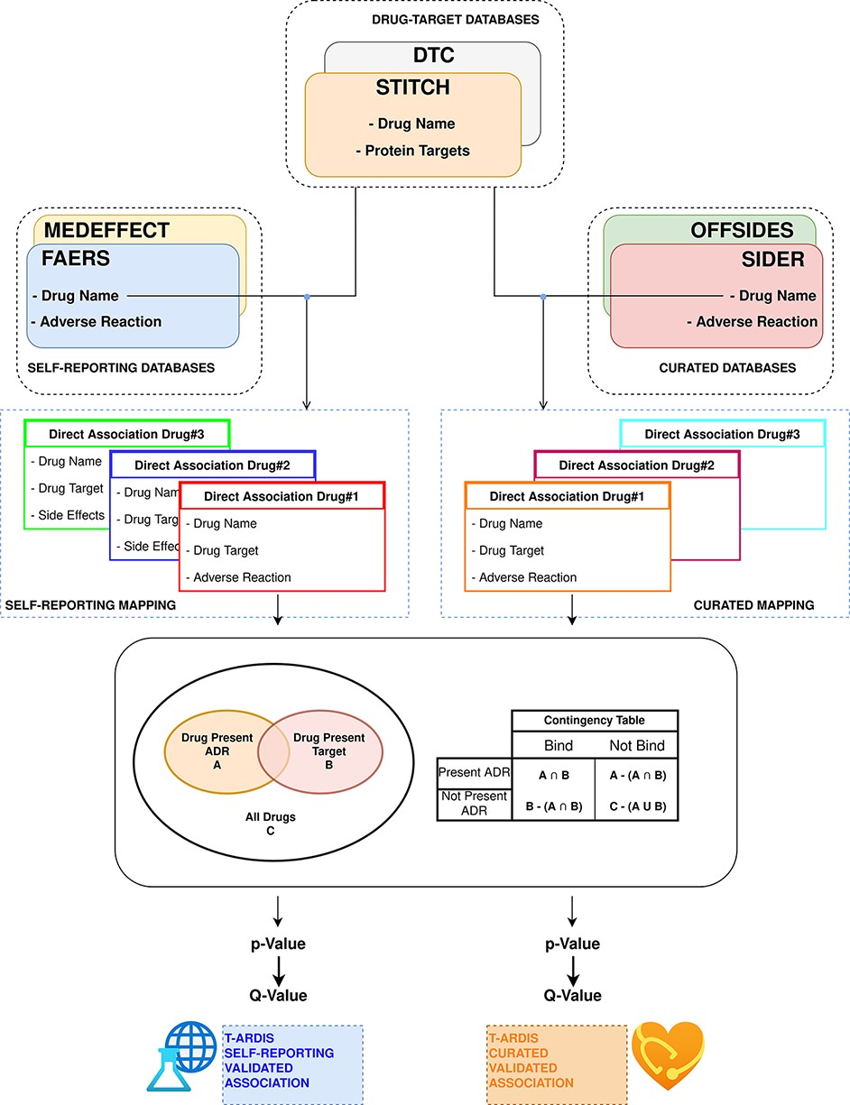
Figure 1. Workflow followed to combine and derive statistical associations between proteins and ADR. Drug–ADR and ...
Notes:
Figure 1. Workflow followed to combine and derive statistical associations between proteins and ADR. Drug–ADR and drug–target associations are retrieved from relevant databases. Subsequently, statistical association between proteins and ADRs is computed as described by Kuhn et al. (10).
Unless provided in the caption above, the following copyright applies to the content of this slide: © The Author(s) 2021. Published by Oxford University Press.This is an Open Access article distributed under the terms of the Creative Commons Attribution License (https://creativecommons.org/licenses/by/4.0/), which permits unrestricted reuse, distribution, and reproduction in any medium, provided the original work is properly cited.

