Slide 1
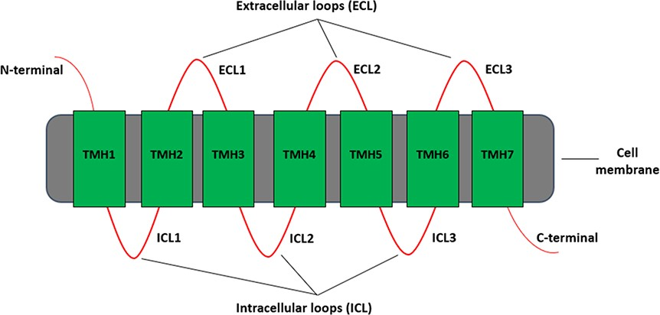
Figure 1. Different regions of a typical GPCR molecule. GPCR consists of a single polypeptide chain of amino acids ...
Notes:
Figure 1. Different regions of a typical GPCR molecule. GPCR consists of a single polypeptide chain of amino acids folded into seven transmembrane helices (TMH1–7) between an extracellular N-terminal and an intracellular C-terminal. The seven transmembrane helices are connected by three extracellular loops (ECL1–3) and three intracellular loops (ICL1–3).
Unless provided in the caption above, the following copyright applies to the content of this slide: © The Author(s) 2020. Published by Oxford University Press.This is an Open Access article distributed under the terms of the Creative Commons Attribution License (http://creativecommons.org/licenses/by/4.0/), which permits unrestricted reuse, distribution, and reproduction in any medium, provided the original work is properly cited.

Slide 2
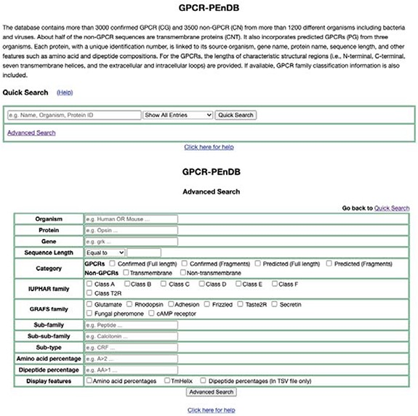
Figure 5. Web interface of GPCR-PEnDB, showing both Quick Search (top) and Advanced Search options (bottom).
Notes:
Figure 5. Web interface of GPCR-PEnDB, showing both Quick Search (top) and Advanced Search options (bottom).
Unless provided in the caption above, the following copyright applies to the content of this slide: © The Author(s) 2020. Published by Oxford University Press.This is an Open Access article distributed under the terms of the Creative Commons Attribution License (http://creativecommons.org/licenses/by/4.0/), which permits unrestricted reuse, distribution, and reproduction in any medium, provided the original work is properly cited.

Slide 3
Figure 2. G protein-coupled receptor Prediction Ensemble Database (GPCR-PEnDB) overview showing the tables in the ...
Notes:
Figure 2. G protein-coupled receptor Prediction Ensemble Database (GPCR-PEnDB) overview showing the tables in the database, number of sequence entries, available web-server search options, and different types of algorithms for GPCR prediction and classification.
Unless provided in the caption above, the following copyright applies to the content of this slide: © The Author(s) 2020. Published by Oxford University Press.This is an Open Access article distributed under the terms of the Creative Commons Attribution License (http://creativecommons.org/licenses/by/4.0/), which permits unrestricted reuse, distribution, and reproduction in any medium, provided the original work is properly cited.

Slide 4
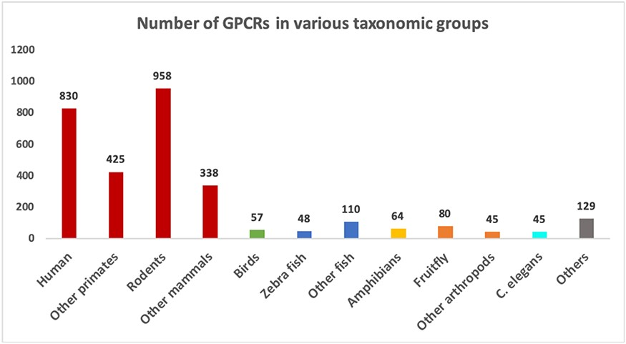
Figure 3. Number of sequences in different groups of organisms in the GPCR datasets. Groups with more than 40 sequences ...
Notes:
Figure 3. Number of sequences in different groups of organisms in the GPCR datasets. Groups with more than 40 sequences are shown as separate bars. The remaining ones are grouped as “Others”.
Unless provided in the caption above, the following copyright applies to the content of this slide: © The Author(s) 2020. Published by Oxford University Press.This is an Open Access article distributed under the terms of the Creative Commons Attribution License (http://creativecommons.org/licenses/by/4.0/), which permits unrestricted reuse, distribution, and reproduction in any medium, provided the original work is properly cited.

Slide 5
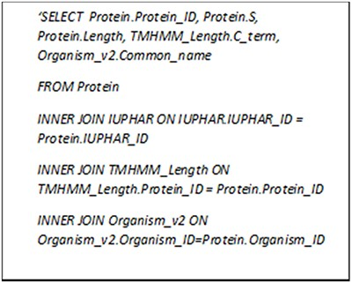
Figure 4. MySQL query asking for GPCRs in Class A with more than 10% serine and C-terminal longer than 300 amino acid ...
Notes:
Figure 4. MySQL query asking for GPCRs in Class A with more than 10% serine and C-terminal longer than 300 amino acid residues.
Unless provided in the caption above, the following copyright applies to the content of this slide: © The Author(s) 2020. Published by Oxford University Press.This is an Open Access article distributed under the terms of the Creative Commons Attribution License (http://creativecommons.org/licenses/by/4.0/), which permits unrestricted reuse, distribution, and reproduction in any medium, provided the original work is properly cited.

Slide 6
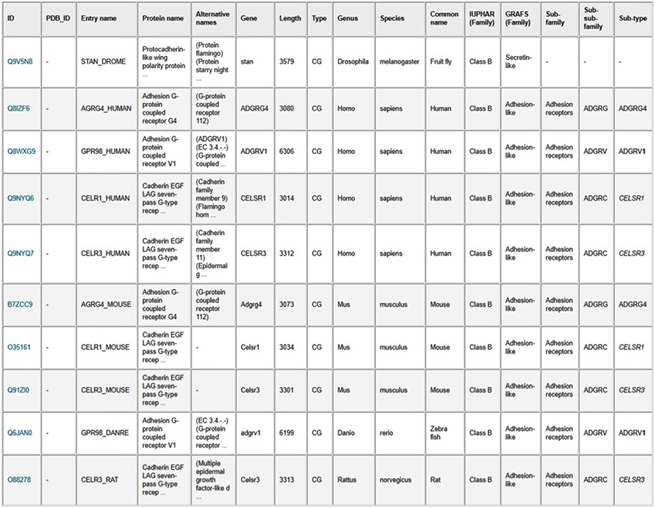
Figure 6. Results table from the search of GPCR sequences longer than 3000 amino acids using the web server. The table ...
Notes:
Figure 6. Results table from the search of GPCR sequences longer than 3000 amino acids using the web server. The table entries can be downloaded in CSV format by clicking on the “Result table” link, and the corresponding protein sequences can be downloaded in FASTA format by clicking on the “FASTA file” link.
Unless provided in the caption above, the following copyright applies to the content of this slide: © The Author(s) 2020. Published by Oxford University Press.This is an Open Access article distributed under the terms of the Creative Commons Attribution License (http://creativecommons.org/licenses/by/4.0/), which permits unrestricted reuse, distribution, and reproduction in any medium, provided the original work is properly cited.

