Slide 1
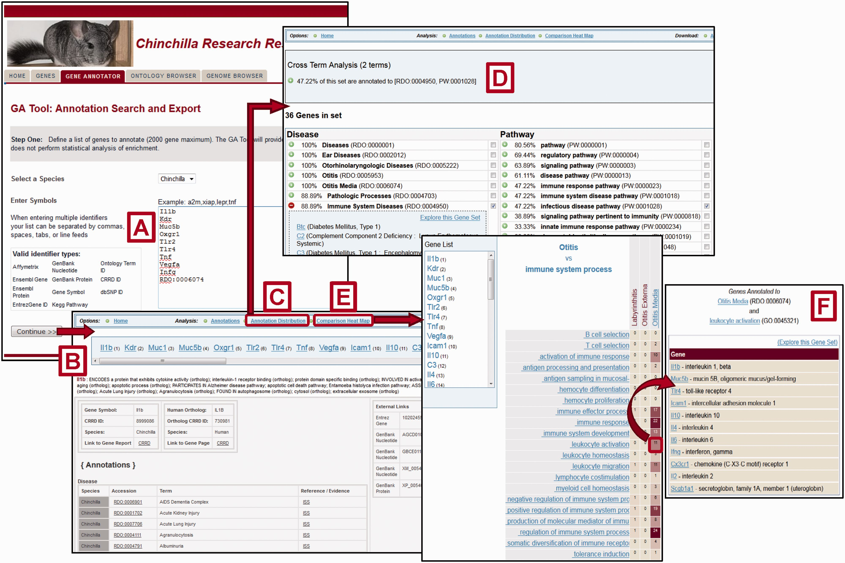
Figure 4. Gene Annotator Tool. The CRRD Gene Annotator (GA) Tool takes a list of gene symbols, CRRD IDs, nucleotide ...
Notes:
Figure 4. Gene Annotator Tool. The CRRD Gene Annotator (GA) Tool takes a list of gene symbols, CRRD IDs, nucleotide and protein accession numbers, NCBI Gene IDs or Ontology IDs ( A ) and returns the corresponding list of chinchilla or human genes. Results are shown as reports for individual genes ( B ), including functional annotations for the gene and its ortholog, and a list of external database IDs with links to the information at those sites. The Annotation Distribution function ( C ) displays the percentage of genes from the input list which have annotations to categories and/or specific terms in each functional domain (i.e. disease, pathway, biological process, etc.). Select a term, such as ‘Immune System Diseases’, to see the genes from your list that are annotated to that term or to a more specific child term, or select multiple terms to see the genes annotated to all selected terms. Here the terms ‘Immune System Diseases’ and ‘infectious disease pathway’ were selected using the check boxes in the term lists. The Cross Term Analysis results ( D ) show that 47.22% of the list (17/36 genes) are annotated to both. Options are given to explore these gene subsets further. The GA Tool's Comparison Heat Map function ( E ) allows users to browse through two ontologies to see the genes at the intersection of these ontologies at multiple levels. The darker the square in the display, the more genes in the list which have annotations from the ontology branches represented by that column and row. Click a square to see the list of genes represented. The example here shows the list of 11 chinchilla genes which are annotated to both the disease term ‘Otitis Media’ and the Gene Ontology term ‘leukocyte activation’ ( F ).
Unless provided in the caption above, the following copyright applies to the content of this slide: © The Author(s) 2016. Published by Oxford University Press. This is an Open Access article distributed under the terms of the Creative Commons Attribution License ( http://creativecommons.org/licenses/by/4.0/ ), which permits unrestricted reuse, distribution, and reproduction in any medium, provided the original work is properly cited.

