Slide 1
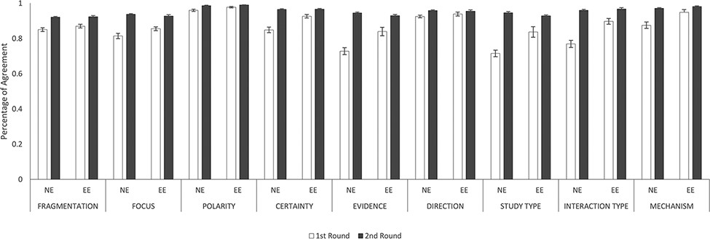
Figure 6. IAAs between novice and experienced annotators and between two experienced annotators. This figure shows the ...
Notes:
Figure 6. IAAs between novice and experienced annotators and between two experienced annotators. This figure shows the IAAs (mean ± SEM) between novice and experienced annotators (NE) and between two experienced annotators (EE), in fragmentation and eight annotation dimensions. The IAAs of Round 1 are shown as white bars and Round 2 IAAs are black bars. Error bar represents standard error of mean. The x-axis labels the eight annotation dimensions, and y-axis represents the IAA.
Unless provided in the caption above, the following copyright applies to the content of this slide: © The Author(s) 2022. Published by Oxford University Press.This is an Open Access article distributed under the terms of the Creative Commons Attribution-NonCommercial License (https://creativecommons.org/licenses/by-nc/4.0/), which permits non-commercial re-use, distribution, and reproduction in any medium, provided the original work is properly cited. For commercial re-use, please contact journals.permissions@oup.com

