Slide 1
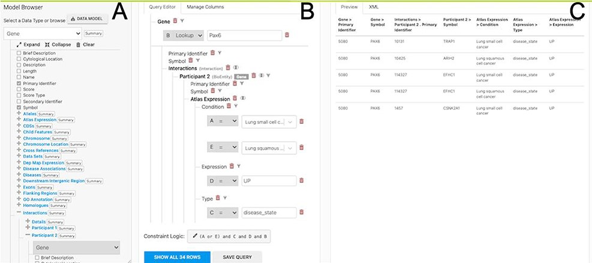
Figure 6. The Query Builder. The query builder consists of three main panels—the model Browser (A), the query editor ...
Notes:
Figure 6. The Query Builder. The query builder consists of three main panels—the model Browser (A), the query editor (B) and the query preview (C). The ‘Gene(s) + Disease Interactors + Disease Expression’ search is shown with an extra constraint for ‘condition = Lung squamous cell cancer’ added. Each constraint in the query editor is labelled with a letter enabling the constraint logic to be edited here to give ((A or E) and C and D and B).
Unless provided in the caption above, the following copyright applies to the content of this slide: © The Author(s) 2022. Published by Oxford University Press.This is an Open Access article distributed under the terms of the Creative Commons Attribution-NonCommercial License (https://creativecommons.org/licenses/by-nc/4.0/), which permits non-commercial re-use, distribution, and reproduction in any medium, provided the original work is properly cited. For commercial re-use, please contact journals.permissions@oup.com

