Slide 1
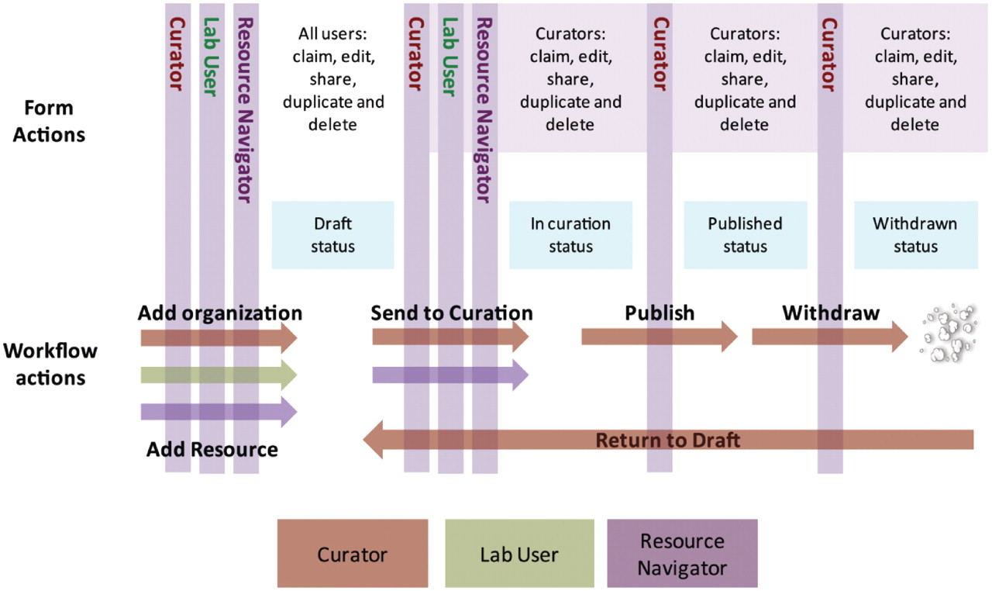
Figure 1. Workflow of the eagle-i team. The role of the Resource Navigators is to collect and add data to the system, ...
Notes:
Figure 1. Workflow of the eagle-i team. The role of the Resource Navigators is to collect and add data to the system, such as organizations or resources. All users (Curators, Lab Users and Resource Navigators) can enter data into the Data Collection tool in draft state. To edit a record, it must be ‘claimed’ by the user and then ‘shared’ after editing. Curators and Resource Navigators can send resources to curation. Data ‘in curation’ is managed by the Curation team and subsequently published, where it is visible in the Search interface. After a record is published, a Curator can withdraw, duplicate or delete the record, or return the record to draft for further editing.
Unless provided in the caption above, the following copyright applies to the content of this slide: © The Author(s) 2012. Published by Oxford University Press.This is an Open Access article distributed under the terms of the Creative Commons Attribution Non-Commercial License (http://creativecommons.org/licenses/by-nc/3.0), which permits unrestricted non-commercial use, distribution, and reproduction in any medium, provided the original work is properly cited.

