Slide 1
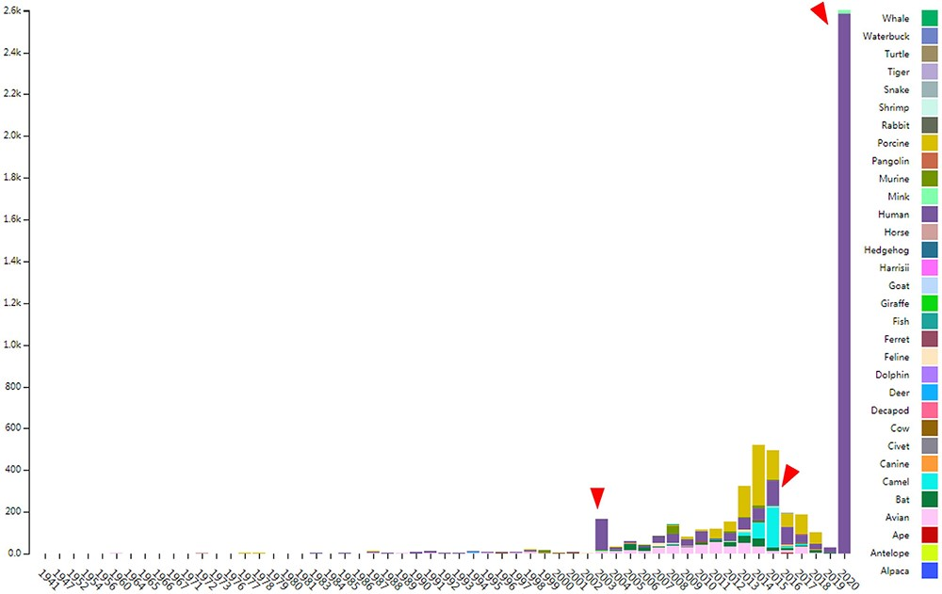
Figure 1. The distribution of documented coronavirus strains in CoVdb according to collection date (X-axis) and hosts ...
Notes:
Figure 1. The distribution of documented coronavirus strains in CoVdb according to collection date (X-axis) and hosts (colored by different colors). Y is the number of coronavirus isolated from some organism. Red triangles points to peaks in the distribution of human coronavirus in years.
Unless provided in the caption above, the following copyright applies to the content of this slide: © The Author(s) 2020. Published by Oxford University Press.This is an Open Access article distributed under the terms of the Creative Commons Attribution License (http://creativecommons.org/licenses/by/4.0/), which permits unrestricted reuse, distribution, and reproduction in any medium, provided the original work is properly cited.

