Slide 1
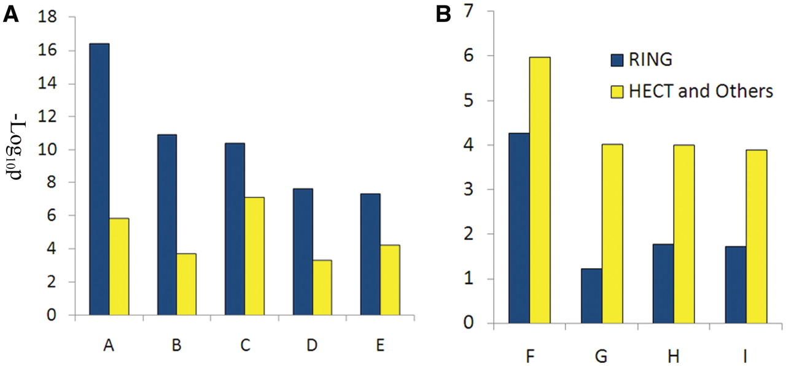
Figure 2. Functional analysis of RING E3s, HECT and other E3s. (A) Biological processes enriched by RING E3s; (B) ...
Notes:
Figure 2. Functional analysis of RING E3s, HECT and other E3s. (A) Biological processes enriched by RING E3s; (B) biological processed enriched by HECT and other E3s. A, regulation of apoptosis; B, apoptosis; C, cellular response to stress; D, cell cycle; E: response to DNA damage stimulus; F: positive regulation of macromolecule metabolic process; G: positive regulation of transcription; H: positive regulation of RNA metabolic process; I: positive regulation of gene expression.
Unless provided in the caption above, the following copyright applies to the content of this slide: © The Author(s) 2011. Published by Oxford University Press.This is an Open Access article distributed under the terms of the Creative Commons Attribution Non-Commercial License (http://creativecommons.org/licenses/by-nc/3.0), which permits unrestricted non-commercial use, distribution, and reproduction in any medium, provided the original work is properly cited.

