Slide 1
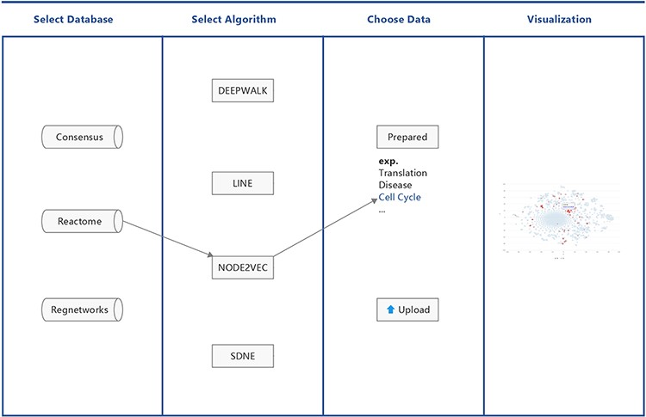
Figure 1. Workflow of BENviewer.
Notes:
Figure 1. Workflow of BENviewer.
Unless provided in the caption above, the following copyright applies to the content of this slide: © The Author(s) 2021. Published by Oxford University Press.This is an Open Access article distributed under the terms of the Creative Commons Attribution License (http://creativecommons.org/licenses/by/4.0/), which permits unrestricted reuse, distribution, and reproduction in any medium, provided the original work is properly cited.

Slide 2
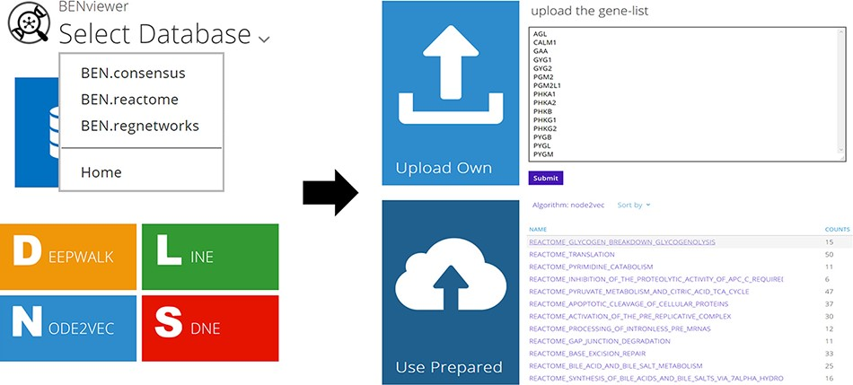
Figure 2. Operation process and related pages.
Notes:
Figure 2. Operation process and related pages.
Unless provided in the caption above, the following copyright applies to the content of this slide: © The Author(s) 2021. Published by Oxford University Press.This is an Open Access article distributed under the terms of the Creative Commons Attribution License (http://creativecommons.org/licenses/by/4.0/), which permits unrestricted reuse, distribution, and reproduction in any medium, provided the original work is properly cited.

Slide 3
Figure 3. One approach using Linux commands to acquire the raw data.
Notes:
Figure 3. One approach using Linux commands to acquire the raw data.
Unless provided in the caption above, the following copyright applies to the content of this slide: © The Author(s) 2021. Published by Oxford University Press.This is an Open Access article distributed under the terms of the Creative Commons Attribution License (http://creativecommons.org/licenses/by/4.0/), which permits unrestricted reuse, distribution, and reproduction in any medium, provided the original work is properly cited.

Slide 4
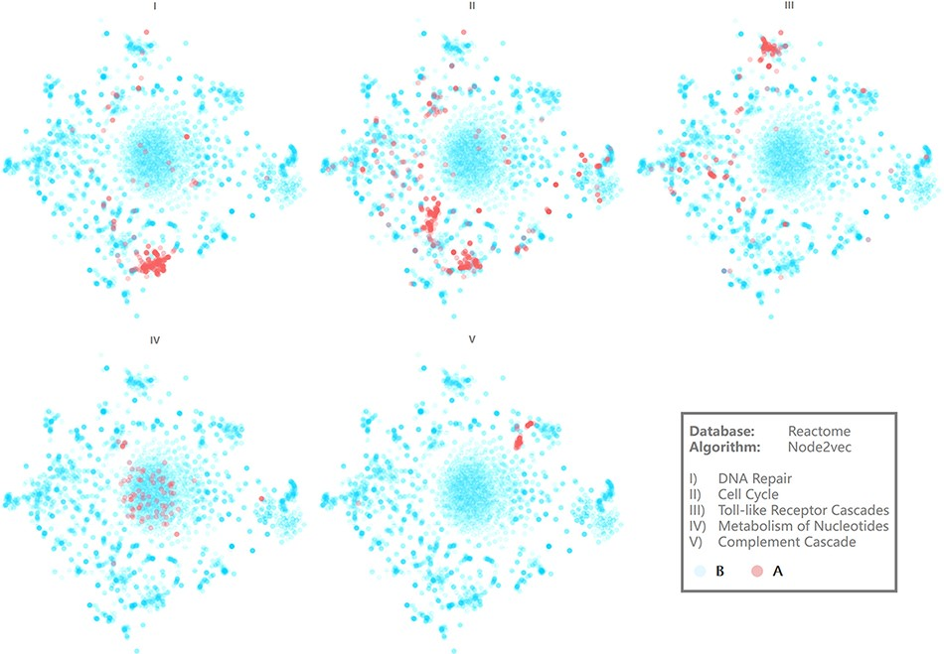
Figure 4. Visualization results of several pathways. Axis is hidden for more intuitive demonstration.
Notes:
Figure 4. Visualization results of several pathways. Axis is hidden for more intuitive demonstration.
Unless provided in the caption above, the following copyright applies to the content of this slide: © The Author(s) 2021. Published by Oxford University Press.This is an Open Access article distributed under the terms of the Creative Commons Attribution License (http://creativecommons.org/licenses/by/4.0/), which permits unrestricted reuse, distribution, and reproduction in any medium, provided the original work is properly cited.

Slide 5
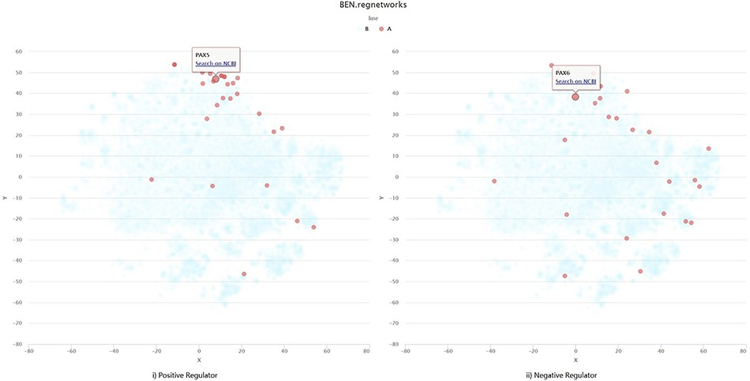
Figure 5. Visualization example of self-uploading data.
Notes:
Figure 5. Visualization example of self-uploading data.
Unless provided in the caption above, the following copyright applies to the content of this slide: © The Author(s) 2021. Published by Oxford University Press.This is an Open Access article distributed under the terms of the Creative Commons Attribution License (http://creativecommons.org/licenses/by/4.0/), which permits unrestricted reuse, distribution, and reproduction in any medium, provided the original work is properly cited.

