Slide 1
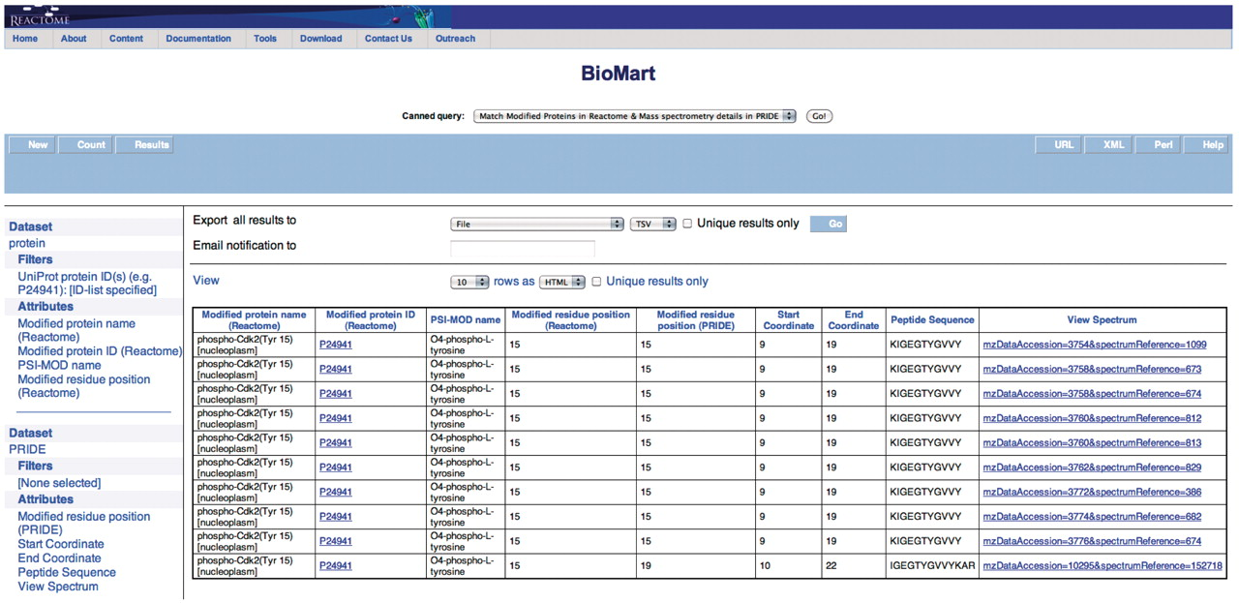
Figure 5. Results of matching modified proteins in Reactome with the MS details available in PRIDE. The peptide ...
Notes:
Figure 5. Results of matching modified proteins in Reactome with the MS details available in PRIDE. The peptide sequence and the option to view the spectrum (Supplementary Figure S8) are returned in addition to the columns returned in Figure 4.
Unless provided in the caption above, the following copyright applies to the content of this slide: © The Author(s) 2011. Published by Oxford University Press.This is Open Access article distributed under the terms of the Creative Commons Attribution Non-Commercial License (http://creativecommons.org/licenses/by-nc/2.5), which permits unrestricted non-commercial use, distribution, and reproduction in any medium, provided the original work is properly cited.

