Slide 1
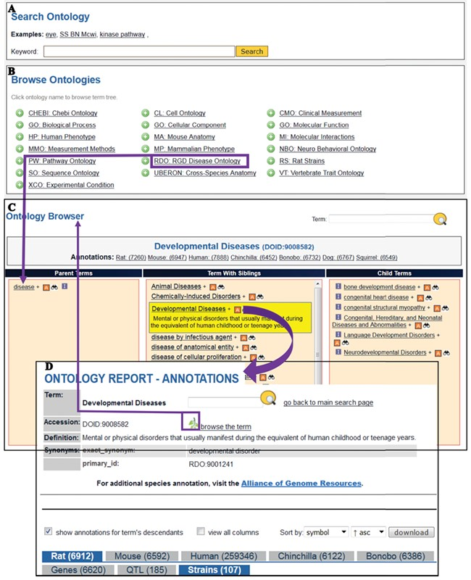
Figure 5 The Search Ontology (A) and Browse Ontologies (B) functions allow users to retrieve all strains annotated to ...
Notes:
Figure 5 The Search Ontology (A) and Browse Ontologies (B) functions allow users to retrieve all strains annotated to a particular term. (C) The selected term ‘Developmental Diseases’ and its definition are highlighted in yellow in the center column with its child terms listed in the right column. The ‘A’ icon is a link to the ontology report page (D) listing all RGD objects annotated to the disease term ‘Developmental Diseases’ and its child terms. The links provided in the browser page and the ontology report page allow users to navigate between the terms and annotations. Strains associated with developmental diseases can be downloaded from the download button above the species tabs.
Unless provided in the caption above, the following copyright applies to the content of this slide: © The Author(s) 2019. Published by Oxford University Press.This is an Open Access article distributed under the terms of the Creative Commons Attribution License (http://creativecommons.org/licenses/by/4.0/), which permits unrestricted reuse, distribution, and reproduction in any medium, provided the original work is properly cited.

