Slide 1
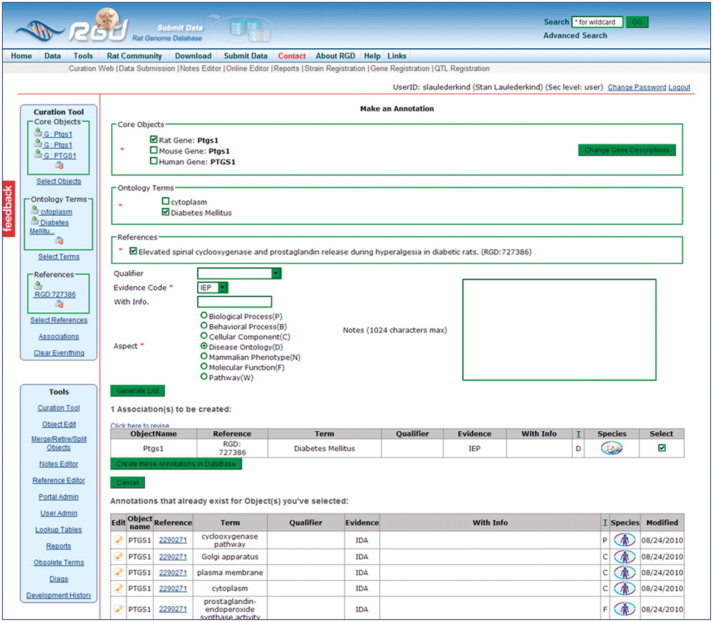
Figure 5. This intermediate annotation page holds the currently constructed annotation for Ptgs1, all existing ...
Notes:
Figure 5. This intermediate annotation page holds the currently constructed annotation for Ptgs1, all existing annotations for objects in the Core Objects bucket (PTGS1/Ptgs1 for human, mouse and rat), and options for editing. The current annotation can be edited by reselecting items above the annotation and re-clicking the ‘Generate List’ button. Any pre-existing annotation at the bottom of the frame can be edited by clicking the edit icon to the left of the annotation.
Unless provided in the caption above, the following copyright applies to the content of this slide: © The Author(s) 2011. Published by Oxford University Press.This is Open Access article distributed under the terms of the Creative Commons Attribution Non-Commercial License (http://creativecommons.org/licenses/by-nc/2.5), which permits unrestricted non-commercial use, distribution, and reproduction in any medium, provided the original work is properly cited.

