Slide 1
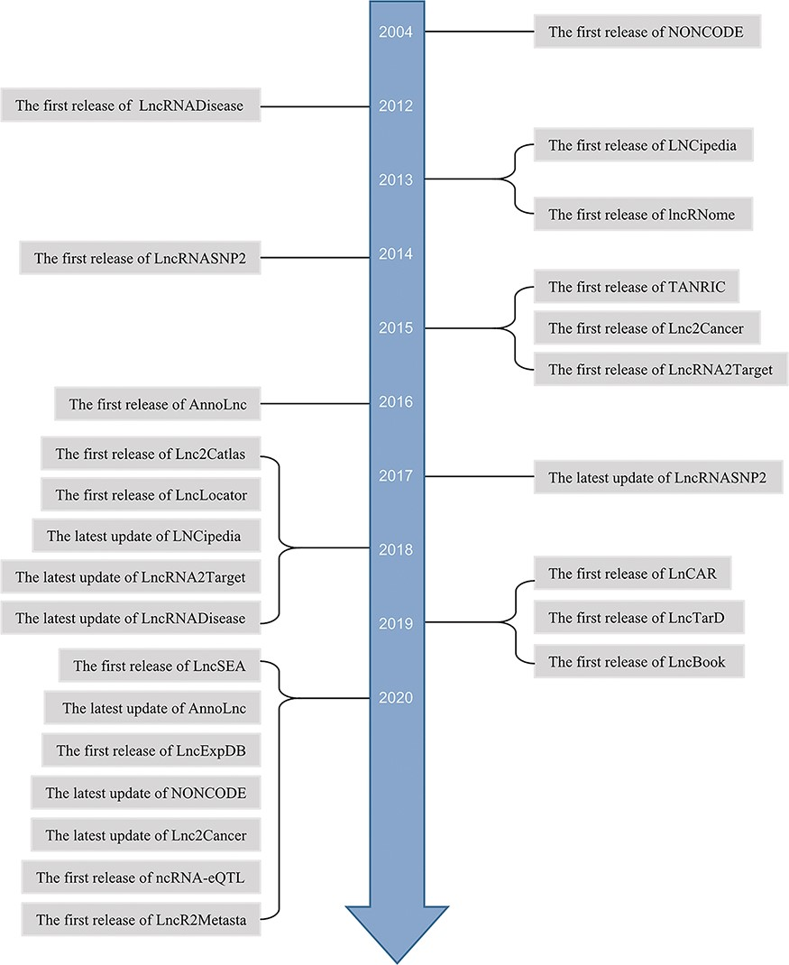
Figure 1. Timeline of lncRNA-related databases.
Notes:
Figure 1. Timeline of lncRNA-related databases.
Unless provided in the caption above, the following copyright applies to the content of this slide: © The Author(s) 2021. Published by Oxford University Press.This is an Open Access article distributed under the terms of the Creative Commons Attribution License (http://creativecommons.org/licenses/by/4.0/), which permits unrestricted reuse, distribution, and reproduction in any medium, provided the original work is properly cited.

Slide 2
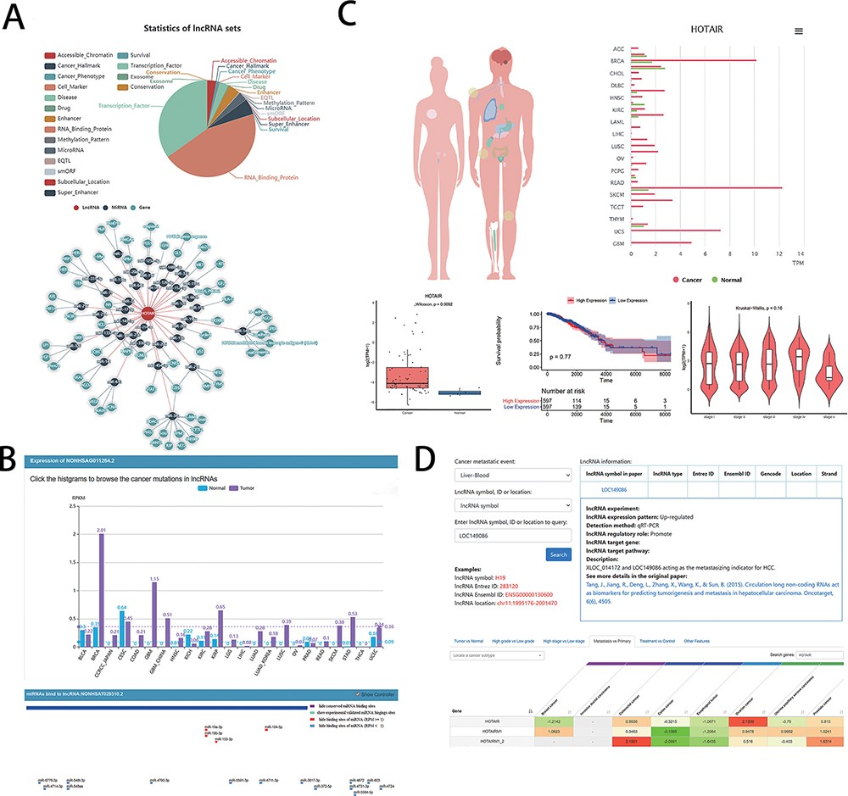
Figure 2. Examples of graphical analysis outputs generated for the LncRNA HOTAIR in cancers using web platforms: (A) ...
Notes:
Figure 2. Examples of graphical analysis outputs generated for the LncRNA HOTAIR in cancers using web platforms: (A) Functions (i) and relevant ceRNA network diagram (ii) of HOTAIR was analyzed by LncSEA in 18 kinds of reference data sets, including Accessible chromatin, Cancer hallmark, Cancer phenotype, Cell marker, Disease, Drug, Enhancer, RNA-binding protein, Methylation pattern, MicroRNA, EQTL, smORF, Subcellular localization, Super enhancer, Survival, TF, Exosome and Conservation. (B) The expression differences of HOTAIR in 21 types of cancer and normal tissues was shown in histogram (i) by LncRNASNP2. And the scatter diagram (ii) was shown the binding sites of miRNAs predicted by LncRNASNP2. (C). Lnc2Cancer output an overview of the statistics of lncRNA HOTAIR based on the human map and expression charts of cancer tissues (i). Box plot (ii) was used to compare the expression of HOTAIR between specific cancer and normal samples. (iii) Kaplan–Meier plot showing overall survival in higher (shown in red) and lower (shown in blue) HOTAIR expression groups in of COAD patients. (iv)Violin plots showing lncRNA expressing levels among stage I, II, III and IV COAD samples. D. LncR2Metasta (i) displayed the cancer metastasis events in which lncRNA HOTAIR may involve in and provided supported information such as expression patterns, detection methods and origin research paper. LnCAR (ii) shows the degree of metastasis expression of HOTAIR in different cancers by heat map, where green transition red represents the transition from low expression to high expression.
Unless provided in the caption above, the following copyright applies to the content of this slide: © The Author(s) 2021. Published by Oxford University Press.This is an Open Access article distributed under the terms of the Creative Commons Attribution License (http://creativecommons.org/licenses/by/4.0/), which permits unrestricted reuse, distribution, and reproduction in any medium, provided the original work is properly cited.

Slide 3
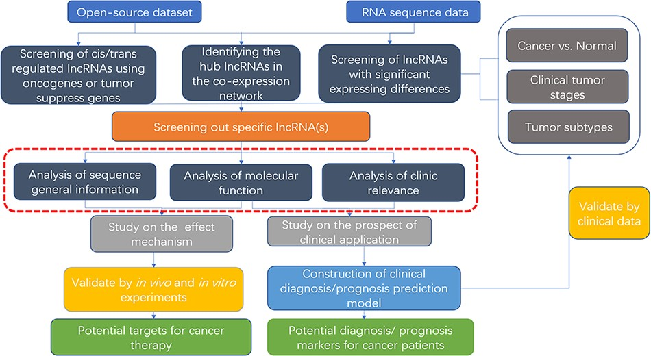
Figure 3. Flow chart of lncRNA in silico analysis and validation in oncology research. This flow chart indicates the ...
Notes:
Figure 3. Flow chart of lncRNA in silico analysis and validation in oncology research. This flow chart indicates the general process of lncRNA analysis and validation in cancer research, the purpose of which are searching for characteristic markers of diagnosis/prognosis or potential molecular targets for treatment. Both data from open-source datasets or high-throughput sequencing results of clinical samples can be utilized. The specific lncRNA can be screened out by analysis of expressing differences, co-expressing network or cis/trans regulating of oncogenes or tumor suppressors. To clarify its roles, researchers can use web tools (the red dotted line area, which is described detailed in Table 2) to analysis the specific functions, including sequence general information, molecular function, and clinic relevance. It is essential to verify the results of the functional analysis by molecular experiments and animal models. For the establishment of diagnostic/prognostic markers, in addition to validation, lncRNAs also need to be compared with the existing clinical criteria to evaluation.
Unless provided in the caption above, the following copyright applies to the content of this slide: © The Author(s) 2021. Published by Oxford University Press.This is an Open Access article distributed under the terms of the Creative Commons Attribution License (http://creativecommons.org/licenses/by/4.0/), which permits unrestricted reuse, distribution, and reproduction in any medium, provided the original work is properly cited.

