Slide 1
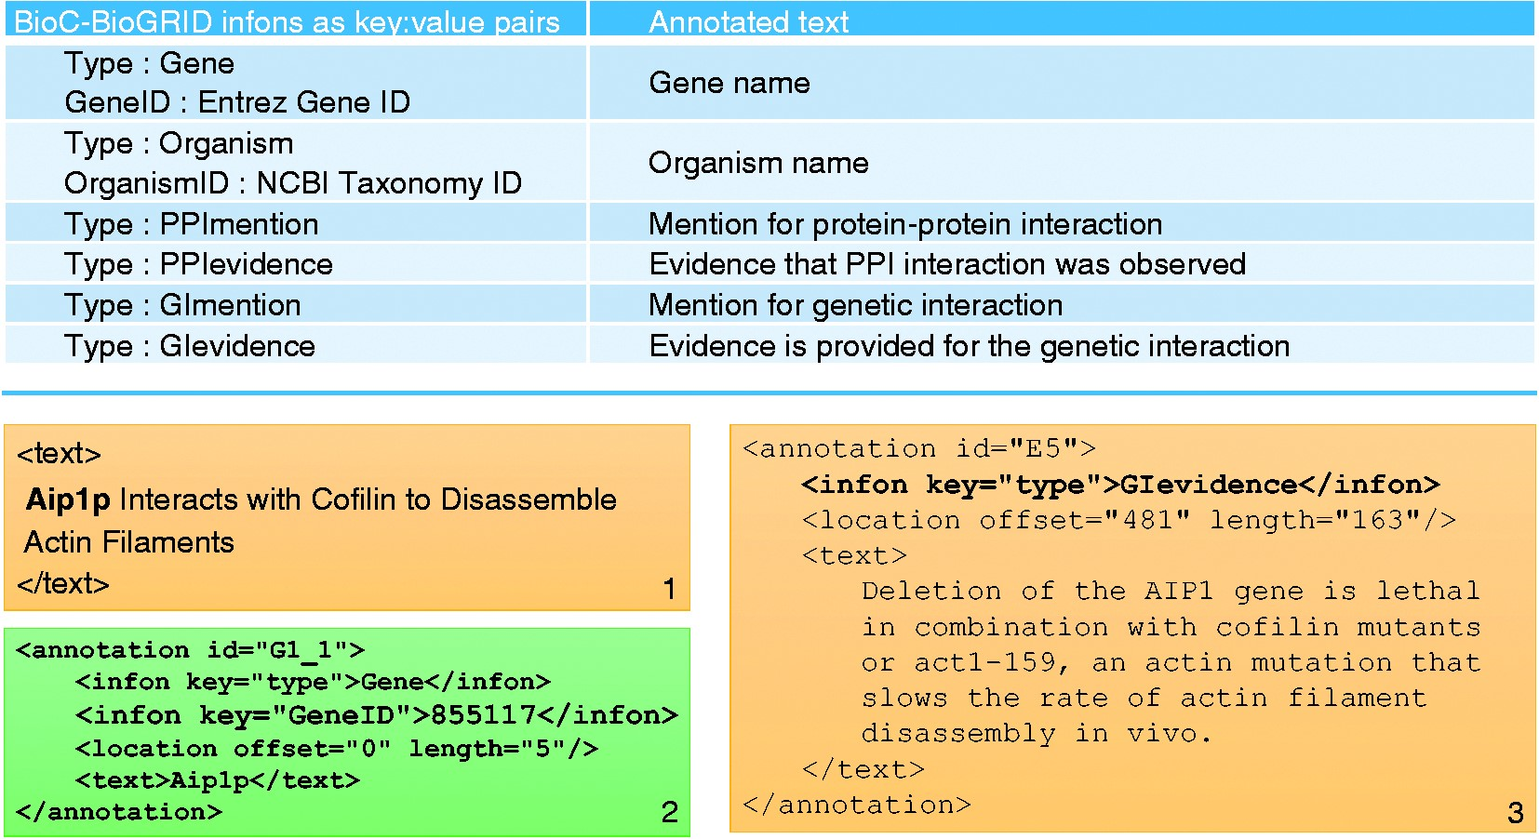
Figure 2. Summary of annotations in the BioC-BioGRID corpus. The table in the top panel lists all types of annotation ...
Notes:
Figure 2. Summary of annotations in the BioC-BioGRID corpus. The table in the top panel lists all types of annotation infons as key:value pairs, along with a short description of what each annotation describes. The bottom panel consists of three text boxes. Text box number 1 contains an example of text from a passage in a document from the corpus. Text box number 2 shows an annotation in that passage for the gene name and its GeneID. Text box number 3 contains an annotation for a GI evidence passage.
Unless provided in the caption above, the following copyright applies to the content of this slide: Published by Oxford University Press 2017. This work is written by US Government employees and is in the public domain in the US.

