Slide 1
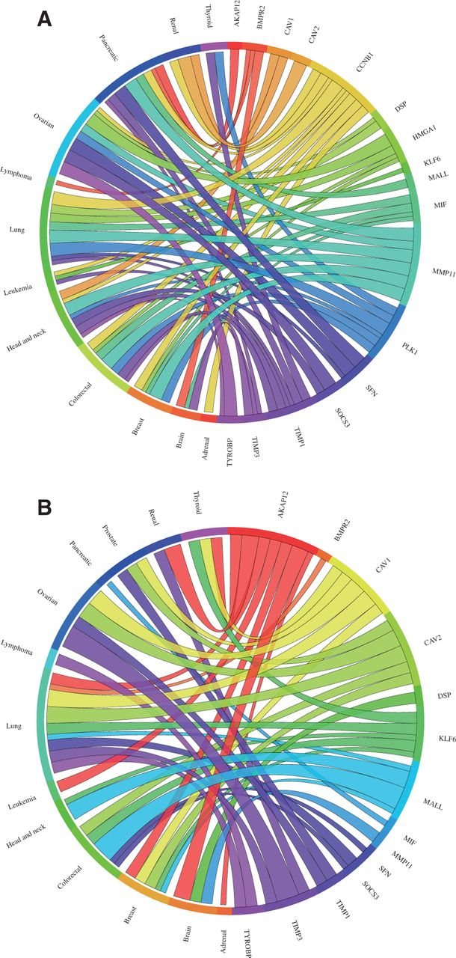
Figure 2 Circos plots showing the meta-change in gene expression in relation to corresponding cancer types. The plot ...
Notes:
Figure 2 Circos plots showing the meta-change in gene expression in relation to corresponding cancer types. The plot shows the meta-up- and meta-downregulated genes of the validation dataset from Kettunen et al. (29): (A) The expression of the genes DSP, CCNB1, PLK1, MIF, HMGA1, SFN, TIMP1 and MMP11 was found to be upregulated, whereas (B) the expression of the genes AKAP12, BMPR2, COPEB/KLF6, SOCS3, BENE/MALL, TIMP3, CAV1, CAV2 and TYROBP was found to be downregulated in lung cancer consistent with the published results. Each connection between a gene and a cancer type indicates a statistically significant mean up- or downregulation for that cancer type derived from a number of combined array studies for cancer tissue versus normal tissue. The weight of the connection corresponds to the magnitude of the meta-change in gene expression.
Unless provided in the caption above, the following copyright applies to the content of this slide: © The Author(s) 2012. Published by Oxford University Press.This is an Open Access article distributed under the terms of the Creative Commons Attribution Non-Commercial License (http://creativecommons.org/licenses/by-nc/3.0/), which permits unrestricted non-commercial use, distribution, and reproduction in any medium, provided the original work is properly cited.

