Slide 1
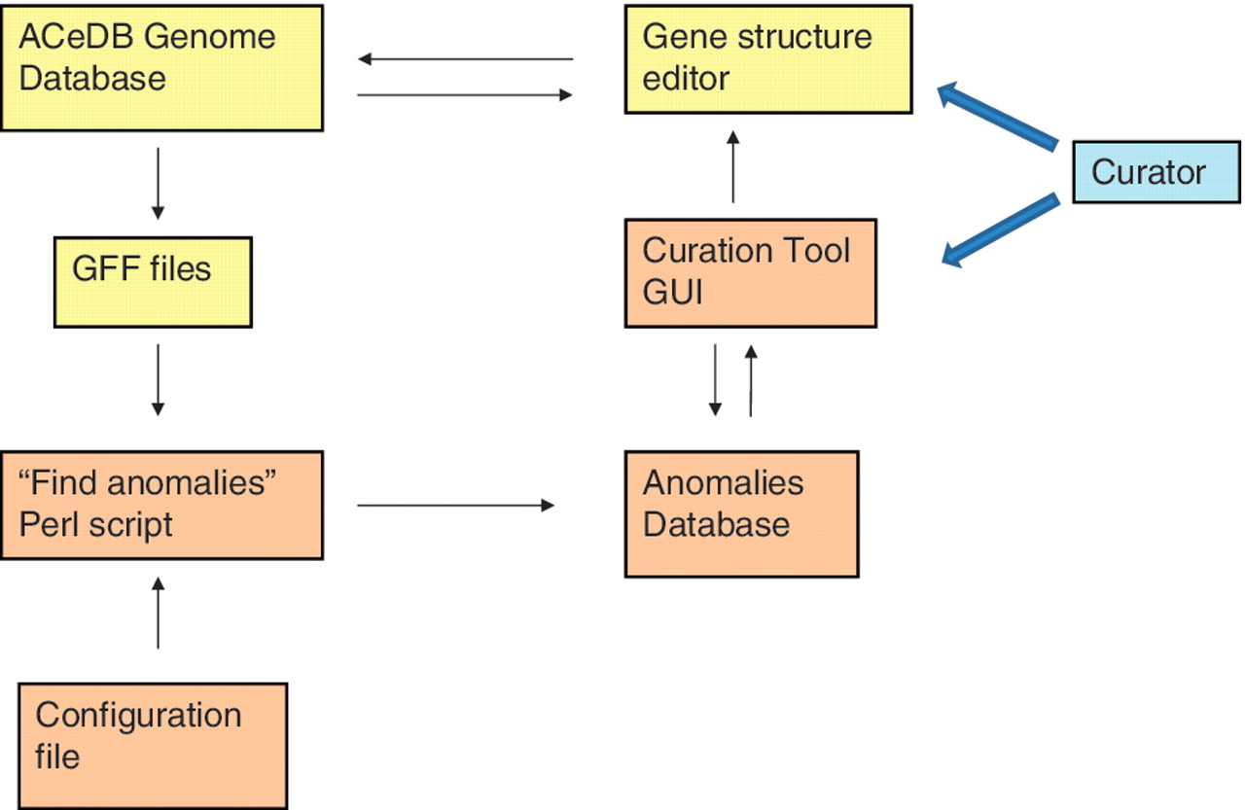
Figure 3. Relationships of the various components of the curation tool and the genome database. The components of the ...
Notes:
Figure 3. Relationships of the various components of the curation tool and the genome database. The components of the ACeDB database are shown in yellow and the components of the curation tool are shown in brown. The curator interacts with both the curation tool GUI to find regions with anomalies and the ACeDB FMAP genome editor to correct those regions.
Unless provided in the caption above, the following copyright applies to the content of this slide: © The Author(s) 2011. Published by Oxford University Press.This is Open Access article distributed under the terms of the Creative Commons Attribution Non-Commercial License (http://creativecommons.org/licenses/by-nc/2.5), which permits unrestricted non-commercial use, distribution, and reproduction in any medium, provided the original work is properly cited.

