Slide 1
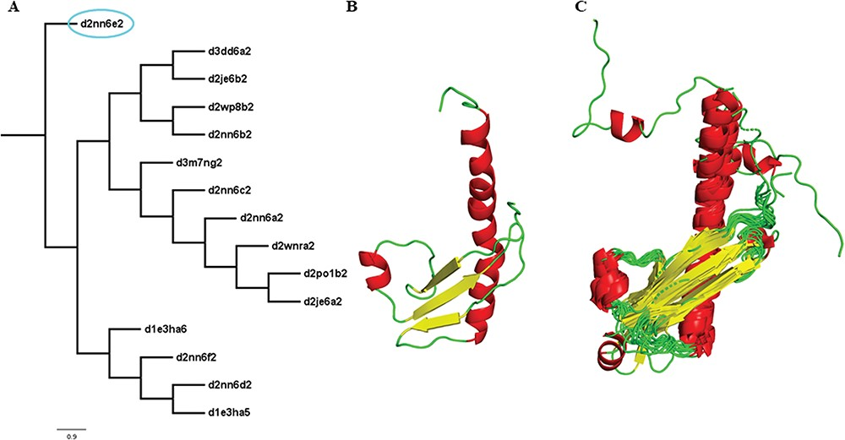
Figure 3 Illustration of a PASS2 superfamily with an extreme structural outlier domain. (A) Structural phylogeny of ...
Notes:
Figure 3 Illustration of a PASS2 superfamily with an extreme structural outlier domain. (A) Structural phylogeny of the members of the Ribonuclease PH domain 2-like superfamily (SCOPe superfamily ID: 55666) showing extreme structural outlier (d2nn6e2, circled in cyan). (B) Structure of the extreme structural outlier, d2nn6e2, and (C) the final superposed structure of remaining members after removal of extreme structural outlier.
Unless provided in the caption above, the following copyright applies to the content of this slide: © The Author(s) 2019. Published by Oxford University Press.This is an Open Access article distributed under the terms of the Creative Commons Attribution License (http://creativecommons.org/licenses/by/4.0/), which permits unrestricted reuse, distribution, and reproduction in any medium, provided the original work is properly cited.

