Slide 1
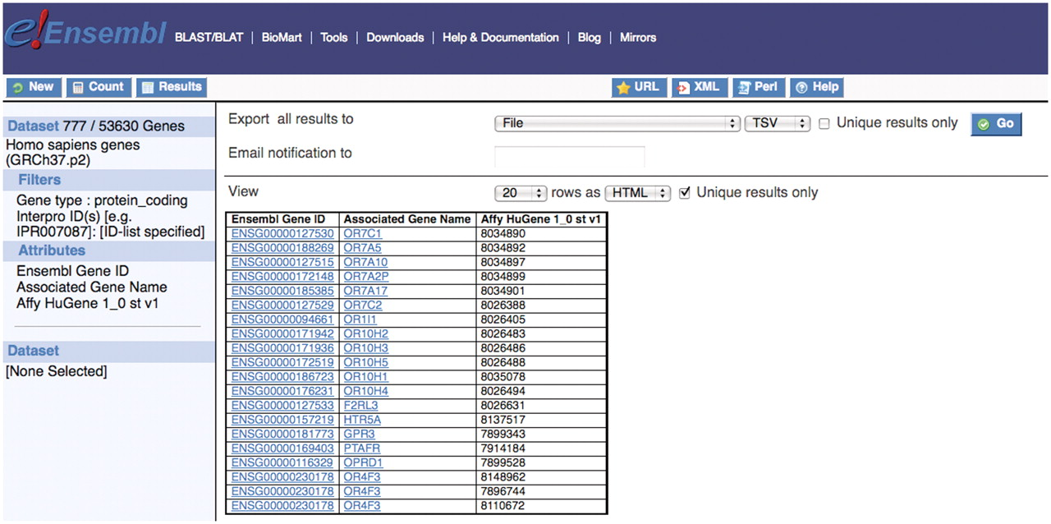
Figure 1. There are 777 Ensembl protein coding genes that code for the GPCR domain with InterPro ID (IPR000276) and ...
Notes:
Figure 1. There are 777 Ensembl protein coding genes that code for the GPCR domain with InterPro ID (IPR000276) and that are detectable with the Affy HuGene 1_0 st v1 array 25.
Unless provided in the caption above, the following copyright applies to the content of this slide: © The Author(s) 2011. Published by Oxford University Press.This is Open Access article distributed under the terms of the Creative Commons Attribution Non-Commercial License (http://creativecommons.org/licenses/by-nc/2.5), which permits unrestricted non-commercial use, distribution, and reproduction in any medium, provided the original work is properly cited.

Slide 2
Figure 2. The esv263 structural variation from DGVa occurs between 16 265 092 and 16 446 378 bp on chromosome 12.
Notes:
Figure 2. The esv263 structural variation from DGVa occurs between 16 265 092 and 16 446 378 bp on chromosome 12.
Unless provided in the caption above, the following copyright applies to the content of this slide: © The Author(s) 2011. Published by Oxford University Press.This is Open Access article distributed under the terms of the Creative Commons Attribution Non-Commercial License (http://creativecommons.org/licenses/by-nc/2.5), which permits unrestricted non-commercial use, distribution, and reproduction in any medium, provided the original work is properly cited.

Slide 3
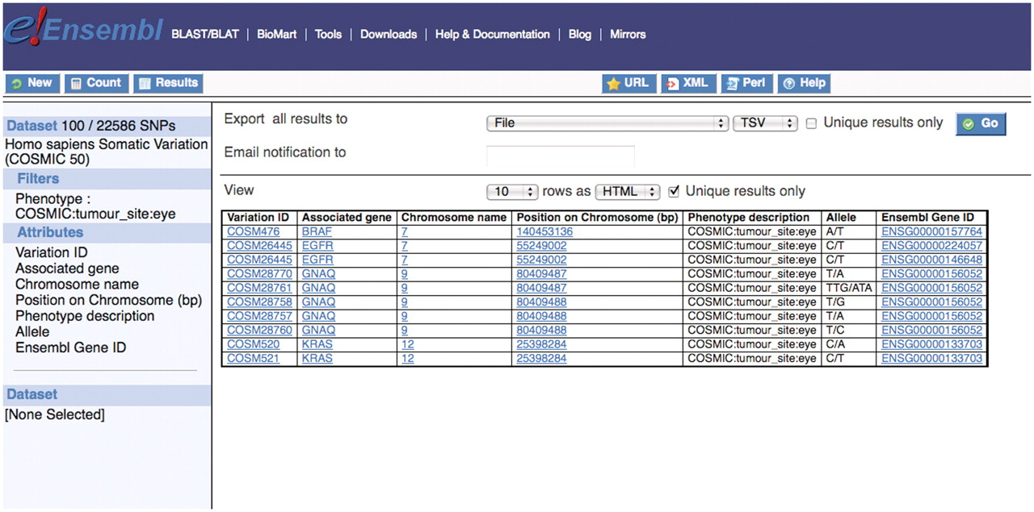
Figure 3. Shows that there are 100 single nucleotide polymorphisms in the human somatic variation data set associated ...
Notes:
Figure 3. Shows that there are 100 single nucleotide polymorphisms in the human somatic variation data set associated with tumors in the eye and the list of Ensembl gene IDs containing these variations can be downloaded for further study or one can click on an entry in the Ensembl Gene ID column on the interface which links to the main Ensembl website.
Unless provided in the caption above, the following copyright applies to the content of this slide: © The Author(s) 2011. Published by Oxford University Press.This is Open Access article distributed under the terms of the Creative Commons Attribution Non-Commercial License (http://creativecommons.org/licenses/by-nc/2.5), which permits unrestricted non-commercial use, distribution, and reproduction in any medium, provided the original work is properly cited.

Slide 4
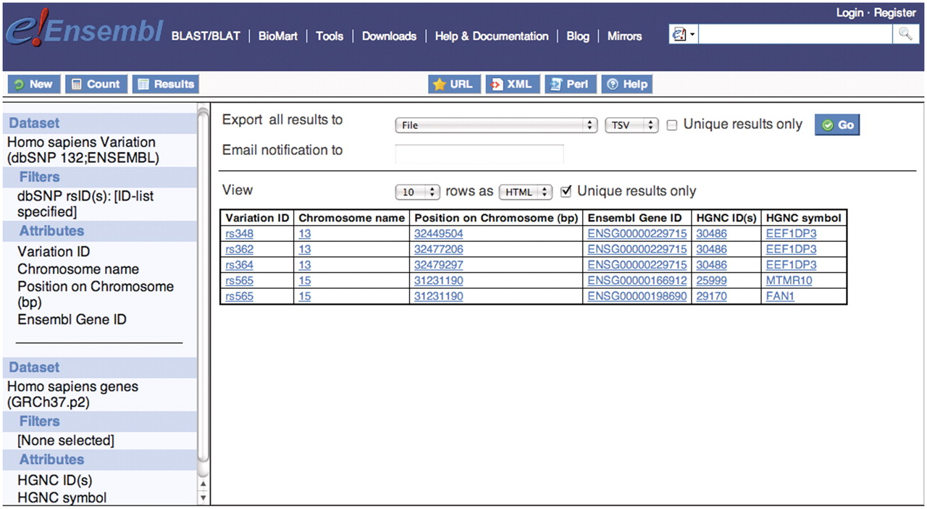
Figure 4. Five dbSNP rs IDs were used to filter the human variation data set and Ensembl gene IDs containing these five ...
Notes:
Figure 4. Five dbSNP rs IDs were used to filter the human variation data set and Ensembl gene IDs containing these five variations were selected in the attributes. Then linking to the second data set, human gene data set from Ensembl Genes database, the HGNC ID and symbol were selected in the attribute section to retrieve the corresponding gene names from HGNC. They are FAN1, MTMR10 and EEF1DP3.
Unless provided in the caption above, the following copyright applies to the content of this slide: © The Author(s) 2011. Published by Oxford University Press.This is Open Access article distributed under the terms of the Creative Commons Attribution Non-Commercial License (http://creativecommons.org/licenses/by-nc/2.5), which permits unrestricted non-commercial use, distribution, and reproduction in any medium, provided the original work is properly cited.

Slide 5
Figure 5. The genes in the filtered region were lacA, lacY and lacZ and we can see that there are no orthologs for the ...
Notes:
Figure 5. The genes in the filtered region were lacA, lacY and lacZ and we can see that there are no orthologs for the lacZ gene in the E. coli DH10B strain.
Unless provided in the caption above, the following copyright applies to the content of this slide: © The Author(s) 2011. Published by Oxford University Press.This is Open Access article distributed under the terms of the Creative Commons Attribution Non-Commercial License (http://creativecommons.org/licenses/by-nc/2.5), which permits unrestricted non-commercial use, distribution, and reproduction in any medium, provided the original work is properly cited.

Slide 6
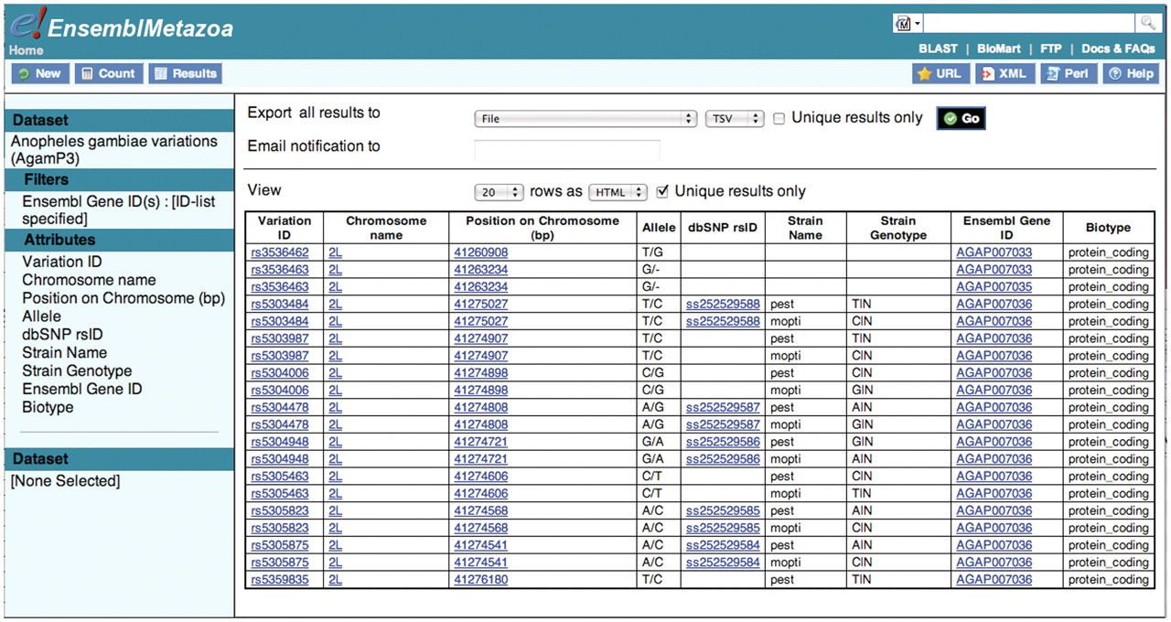
Figure 6. Having first retrieved the Ensembl gene IDs for the three APL1 genes, these are used to filter the A. gambiae ...
Notes:
Figure 6. Having first retrieved the Ensembl gene IDs for the three APL1 genes, these are used to filter the A. gambiae data set. Fifty variations were retrieved that lie within the three genes of the APL1 locus.
Unless provided in the caption above, the following copyright applies to the content of this slide: © The Author(s) 2011. Published by Oxford University Press.This is Open Access article distributed under the terms of the Creative Commons Attribution Non-Commercial License (http://creativecommons.org/licenses/by-nc/2.5), which permits unrestricted non-commercial use, distribution, and reproduction in any medium, provided the original work is properly cited.

Slide 7
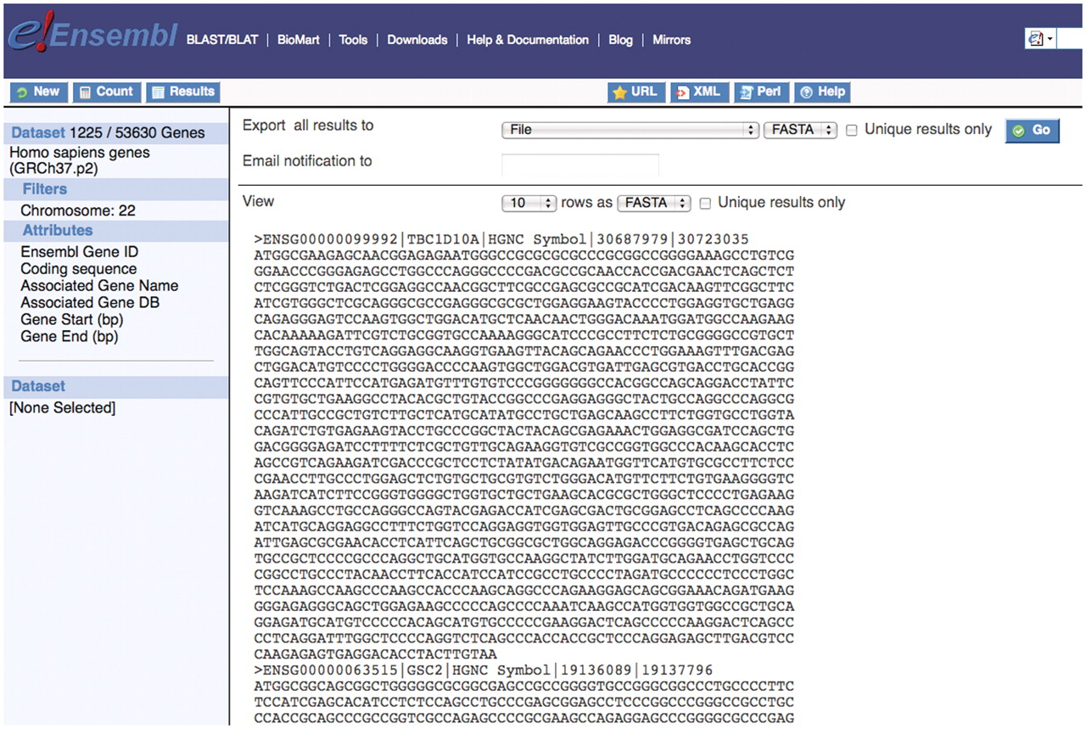
Figure 7. The ability to retrieve sequence information for genes of interest is a powerful feature of the BioMart tool. ...
Notes:
Figure 7. The ability to retrieve sequence information for genes of interest is a powerful feature of the BioMart tool. Here a user can download the coding sequence for all genes on chromosome 22 as well as additional information about each gene and this can be exported in a useful format.
Unless provided in the caption above, the following copyright applies to the content of this slide: © The Author(s) 2011. Published by Oxford University Press.This is Open Access article distributed under the terms of the Creative Commons Attribution Non-Commercial License (http://creativecommons.org/licenses/by-nc/2.5), which permits unrestricted non-commercial use, distribution, and reproduction in any medium, provided the original work is properly cited.

