Slide 1
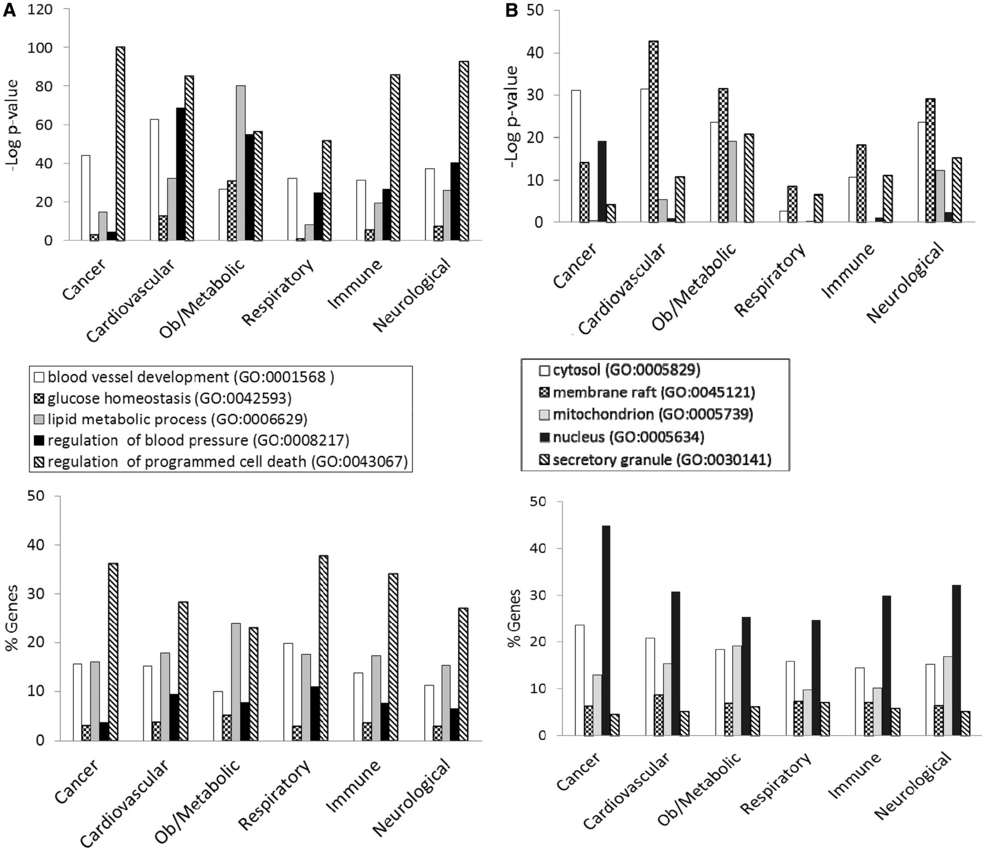
Figure 4. (A) The BP annotations of the disease-associated genes at RGD were subjected to enrichment analysis using ...
Notes:
Figure 4. (A) The BP annotations of the disease-associated genes at RGD were subjected to enrichment analysis using RatMine. The enrichment P-values, presented as ‘–Log P-value’ are shown in the top panel, and the percentages of genes annotated with the relevant GO term and its children are shown in the bottom panel. The six RGD disease portals—cancer portal (cancer), cardiovascular disease portal (cardiovascular), obesity/metabolic syndrome portal (ob/metabolic), respiratory disease portal (respiratory), immune and inflammatory disease portal (immune) and neurological disease portal (neurological)—are listed across the x axis. (B) The CC annotations of the disease-associated genes at RGD were subjected to enrichment analysis using RatMine. The enrichment P-values, presented as ‘–Log P-value’ are shown in the top panel, and the percentages of genes annotated with the relevant GO term and its children are shown in the bottom panel. The six RGD disease portals—cancer portal (cancer), cardiovascular disease portal (cardiovascular), obesity/metabolic syndrome portal (ob/metabolic), respiratory disease portal (respiratory), immune and inflammatory disease portal (immune) and neurological disease portal (neurological)—are listed across the x axis. (C) The MF annotations of the disease-associated genes at RGD were subjected to enrichment analysis using RatMine. The enrichment P-values, presented as ‘–Log P-value’ are shown in the top panel, and the percentages of genes annotated with the relevant GO term and its children are shown in the bottom panel. The six RGD disease portals—cancer portal (cancer), cardiovascular disease portal (cardiovascular), obesity/metabolic syndrome portal (ob/metabolic), respiratory disease portal (respiratory), immune and inflammatory disease portal (immune) and neurological disease portal (neurological)—are listed across the x axis.
Unless provided in the caption above, the following copyright applies to the content of this slide: © The Author(s) 2013. Published by Oxford University Press.This is an Open Access article distributed under the terms of the Creative Commons Attribution License (http://creativecommons.org/licenses/by/3.0/), which permits unrestricted reuse, distribution, and reproduction in any medium, provided the original work is properly cited.

