Slide 1
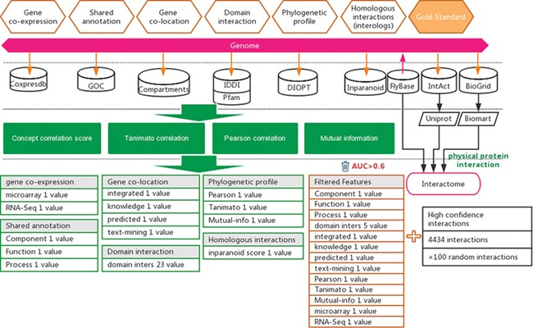
Figure 1 Workflow for the inference of functional interactions between Drosophila genes. High-quality experimental ...
Notes:
Figure 1 Workflow for the inference of functional interactions between Drosophila genes. High-quality experimental reported protein interactions were integrated from three databases and were used as positive examples. Six types of functional association evidence from 10 databases were collected to infer putative functional interactions. A total of 17 high-quality feature values were selected from 36 feature values that characterize this evidence with different mathematical representations. Random gene pairs after removing positive examples were used as negative examples. The number of negative examples was 100 times that of the positive examples.
Unless provided in the caption above, the following copyright applies to the content of this slide: © The Author(s) 2020. Published by Oxford University Press.This article is published and distributed under the terms of the Oxford University Press, Standard Journals Publication Model (https://academic.oup.com/journals/pages/open_access/funder_policies/chorus/standard_publication_model)

