Slide 1
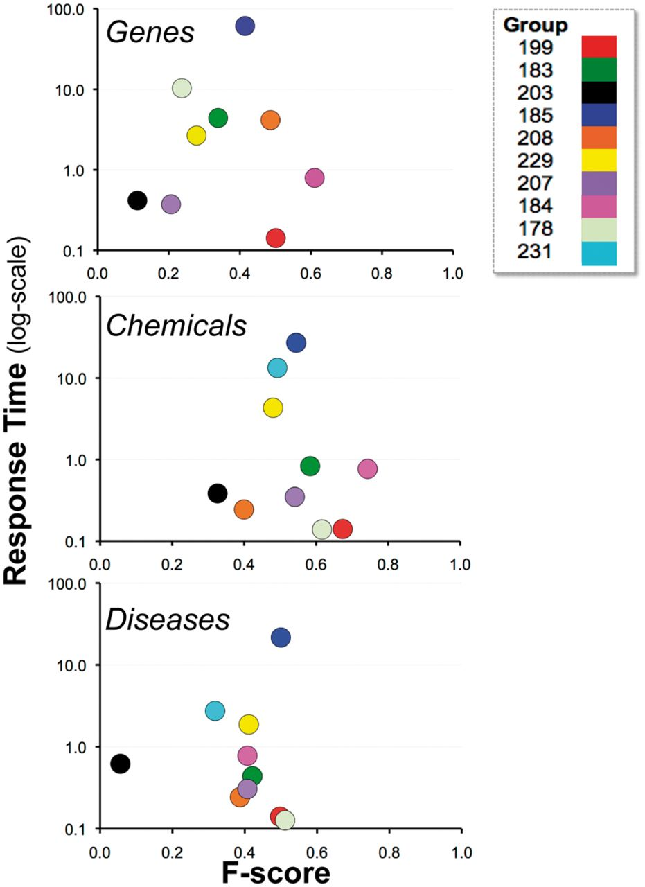
Figure 11. Balanced F-score and response time. Combined average balanced F-score (x-axis) and response time (y-axis) ...
Notes:
Figure 11. Balanced F-score and response time. Combined average balanced F-score (x-axis) and response time (y-axis) results are shown for each participating group (color-coded by group number) within major NER category. There was no clear relationship between response time and F-score. Note : the response time in seconds (y-axis) uses a logarithmic scale.
Unless provided in the caption above, the following copyright applies to the content of this slide: © The Author(s) 2014. Published by Oxford University Press.This is an Open Access article distributed under the terms of the Creative Commons Attribution License (http://creativecommons.org/licenses/by/3.0/), which permits unrestricted reuse, distribution, and reproduction in any medium, provided the original work is properly cited.

