Slide 1
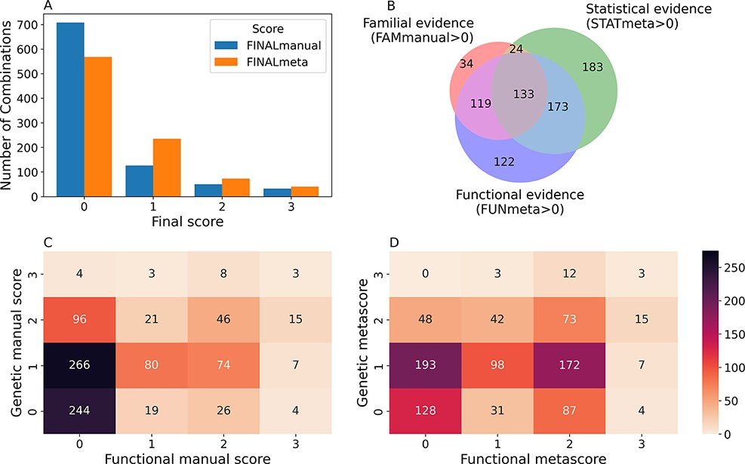
Figure 3. Confidence scores and types of evidence present in the OLIDA combinations. (A) Distribution of the ...
Notes:
Figure 3. Confidence scores and types of evidence present in the OLIDA combinations. (A) Distribution of the FINALmanual and FINALmeta scores. (B) Venn diagram of the number of oligogenic combinations carrying a score of 1 or higher in the different main types of evidence metascores. The 130 oligogenic combinations whose FAMmanual, STATmeta and FUNmeta scores are all 0 are not shown in this diagram. (C) Heatmap of the number of combinations and their confidence functional and genetic scores based on the evidence collected via manual curation (Manual scores) only and (D) when adjusted using the external database information (Meta scores). The genetic score here represents the maximum score between the FAMmanual and STAT (manual or meta for plots a and b, respectively) and the functional score is the FUN (manual or meta for plots a and b, respectively), which are described in the Materials and Methods.
Unless provided in the caption above, the following copyright applies to the content of this slide: © The Author(s) 2022. Published by Oxford University Press.This is an Open Access article distributed under the terms of the Creative Commons Attribution License (https://creativecommons.org/licenses/by/4.0/), which permits unrestricted reuse, distribution, and reproduction in any medium, provided the original work is properly cited.

