Slide 1
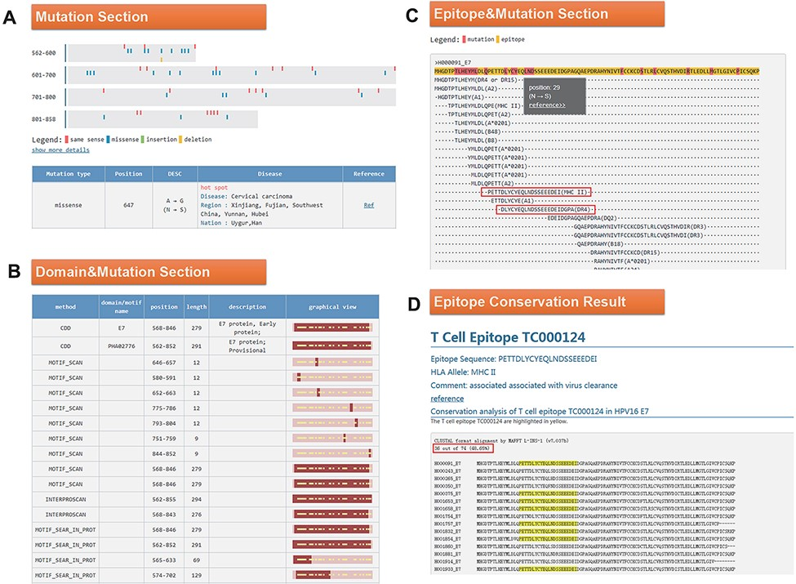
Figure 4. (A) Mutation section in ‘Detail’ page: Use visualization techniques to show the position and type of ...
Notes:
Figure 4. (A) Mutation section in ‘Detail’ page: Use visualization techniques to show the position and type of mutations; related diseases, races, regional information and literature links are also listed; (B) Domain section in detail page: In the graphical view, bar represents the entire sequence, dark part represents the domain or motif and dots represent the mutation; (C) Epitope section in detail page: The second line shows the entire sequence, light part highlights the epitope and dark part highlights the mutation; inside two boxes are the epitopes containing N29S; (D) Epitope conservation result page: The query epitope TC000124 are highlighted; the conservation rate is 48.65%.
Unless provided in the caption above, the following copyright applies to the content of this slide: © The Author(s) 2022. Published by Oxford University Press.This is an Open Access article distributed under the terms of the Creative Commons Attribution License (https://creativecommons.org/licenses/by/4.0/), which permits unrestricted reuse, distribution, and reproduction in any medium, provided the original work is properly cited.

