Slide 1
Figure 6 SymGenDB’s new MetaDAGs module’s output where users can not only see the reactions included in their graph of ...
Notes:
Figure 6 SymGenDB’s new MetaDAGs module’s output where users can not only see the reactions included in their graph of interest in detail but also contextualize the reaction within the KEGG metabolic map. We have included a feature to highlight the reaction(s) of interest for this purpose.
Unless provided in the caption above, the following copyright applies to the content of this slide: © The Author(s) 2020. Published by Oxford University Press.This is an Open Access article distributed under the terms of the Creative Commons Attribution License (http://creativecommons.org/licenses/by/4.0/), which permits unrestricted reuse, distribution, and reproduction in any medium, provided the original work is properly cited.

Slide 2
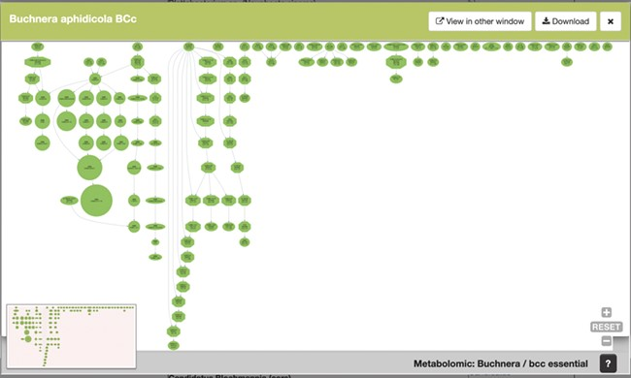
Figure 5 SymGenDB’s new MetaDAGs module’s output. In this example, we search for the symbionts of the genus ...
Notes:
Figure 5 SymGenDB’s new MetaDAGs module’s output. In this example, we search for the symbionts of the genus ‘Buchnera’. The output is a preview of a graphical display of the MetaDAG you get by choosing Buchnera aphidicola from Cinara tujafilina. This dynamic display can be viewed in another window, downloaded as a PDF and all the information of the reaction(s) included in each node(s) is available by clicking on the node(s) of interest.
Unless provided in the caption above, the following copyright applies to the content of this slide: © The Author(s) 2020. Published by Oxford University Press.This is an Open Access article distributed under the terms of the Creative Commons Attribution License (http://creativecommons.org/licenses/by/4.0/), which permits unrestricted reuse, distribution, and reproduction in any medium, provided the original work is properly cited.

Slide 3
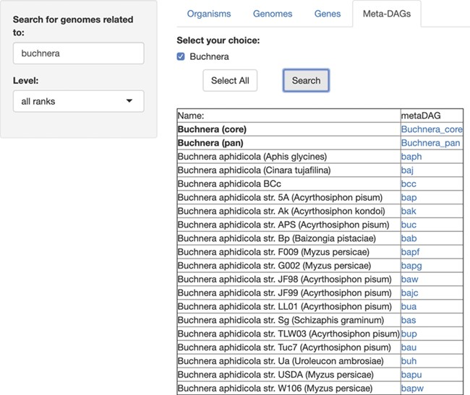
Figure 4 SymGenDB’s new MetaDAGs module. In this example, we search for the symbionts of the genus ‘Buchnera’. The ...
Notes:
Figure 4 SymGenDB’s new MetaDAGs module. In this example, we search for the symbionts of the genus ‘Buchnera’. The output is a list of organisms as bacterial strains, as well as the joint (pan) or intersecting (core) metabolism of the strains resulted in the search, included in the taxonomic level ‘genus’ (in bold). It is important to denote that in the case of the ‘pan’ and ‘core’ interacting metabolism, not only the genomes of the bacterial strains resulting from the search are presented. The complete set of strains of the same genus available in SymGenDB constitutes these MetaDAGs.
Unless provided in the caption above, the following copyright applies to the content of this slide: © The Author(s) 2020. Published by Oxford University Press.This is an Open Access article distributed under the terms of the Creative Commons Attribution License (http://creativecommons.org/licenses/by/4.0/), which permits unrestricted reuse, distribution, and reproduction in any medium, provided the original work is properly cited.

Slide 4
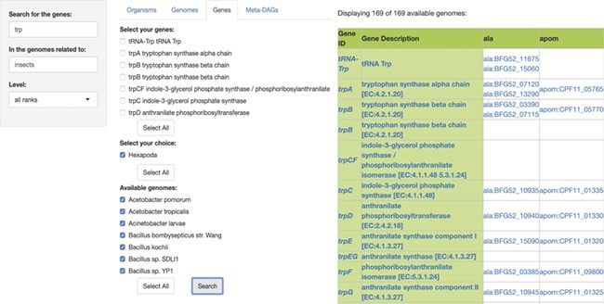
Figure 3 SymGen’s gene module. For this example, we searched for all the genes containing the letters ‘trp’ in the ...
Notes:
Figure 3 SymGen’s gene module. For this example, we searched for all the genes containing the letters ‘trp’ in the genomes of symbionts of insects. We selected all of the 169 available genomes. The resulting table is a list in a presence/absence format, where all the present genes are shown with their KEGG id and a link to their KEGG gene web page. The ‘Gene ID’ and the ‘Gene Description’ features are both linked to their KEGG orthology web page.
Unless provided in the caption above, the following copyright applies to the content of this slide: © The Author(s) 2020. Published by Oxford University Press.This is an Open Access article distributed under the terms of the Creative Commons Attribution License (http://creativecommons.org/licenses/by/4.0/), which permits unrestricted reuse, distribution, and reproduction in any medium, provided the original work is properly cited.

Slide 5
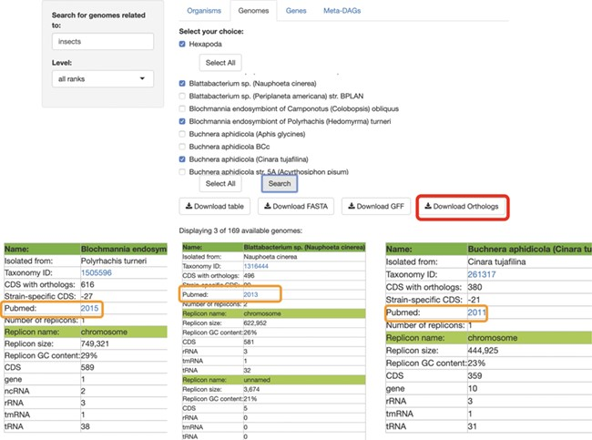
Figure 2 SymGenDB’s Genomes module. Continuing with the example on symbionts of insects, we searched for those genomes ...
Notes:
Figure 2 SymGenDB’s Genomes module. Continuing with the example on symbionts of insects, we searched for those genomes and selected 3 of the 169 available in SymGenDB’s. The resulting table (viewed horizontally for spacing purposes, although it is presented vertically in the database), consists of all the metadata of the genomes of our choice, with a link to the host’s taxonomy id from NCBI. It is important to show that one of the downloads available in this module is the orthology table of the chosen genomes (shown in red) which is very helpful for evolutionary research. Furthermore, the literature where this genome was first described is also made available to users (shown in orange).
Unless provided in the caption above, the following copyright applies to the content of this slide: © The Author(s) 2020. Published by Oxford University Press.This is an Open Access article distributed under the terms of the Creative Commons Attribution License (http://creativecommons.org/licenses/by/4.0/), which permits unrestricted reuse, distribution, and reproduction in any medium, provided the original work is properly cited.

Slide 6
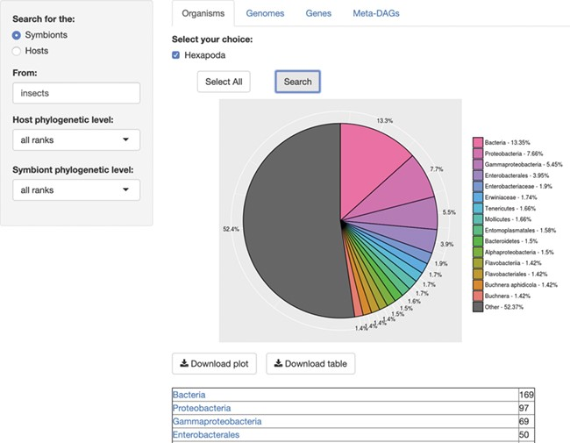
Figure 1 SymGenDB’s Organisms module. For this example, we searched for the symbionts of insects included in SymGenDB. ...
Notes:
Figure 1 SymGenDB’s Organisms module. For this example, we searched for the symbionts of insects included in SymGenDB. It is worth noting that we used the term ‘insects’ and the output shows the scientific name ‘Hexapoda’ because the database includes a hefty list of synonyms so users do not have to know/search only for scientific names. We searched for both the host and the symbiont’s phylogenetic level as default, and the result shows an abundance chart (only the first 15 most abundant hits are displayed in color, the rest are encompassed in grey) and a list of organisms showing all the hits. Each resulting ‘organism’ (or family, genus, class, etc.) is a link to its NCBI taxonomy page. The resulting list shown in this figure is cut short for spacing purposes.
Unless provided in the caption above, the following copyright applies to the content of this slide: © The Author(s) 2020. Published by Oxford University Press.This is an Open Access article distributed under the terms of the Creative Commons Attribution License (http://creativecommons.org/licenses/by/4.0/), which permits unrestricted reuse, distribution, and reproduction in any medium, provided the original work is properly cited.

