Slide 1
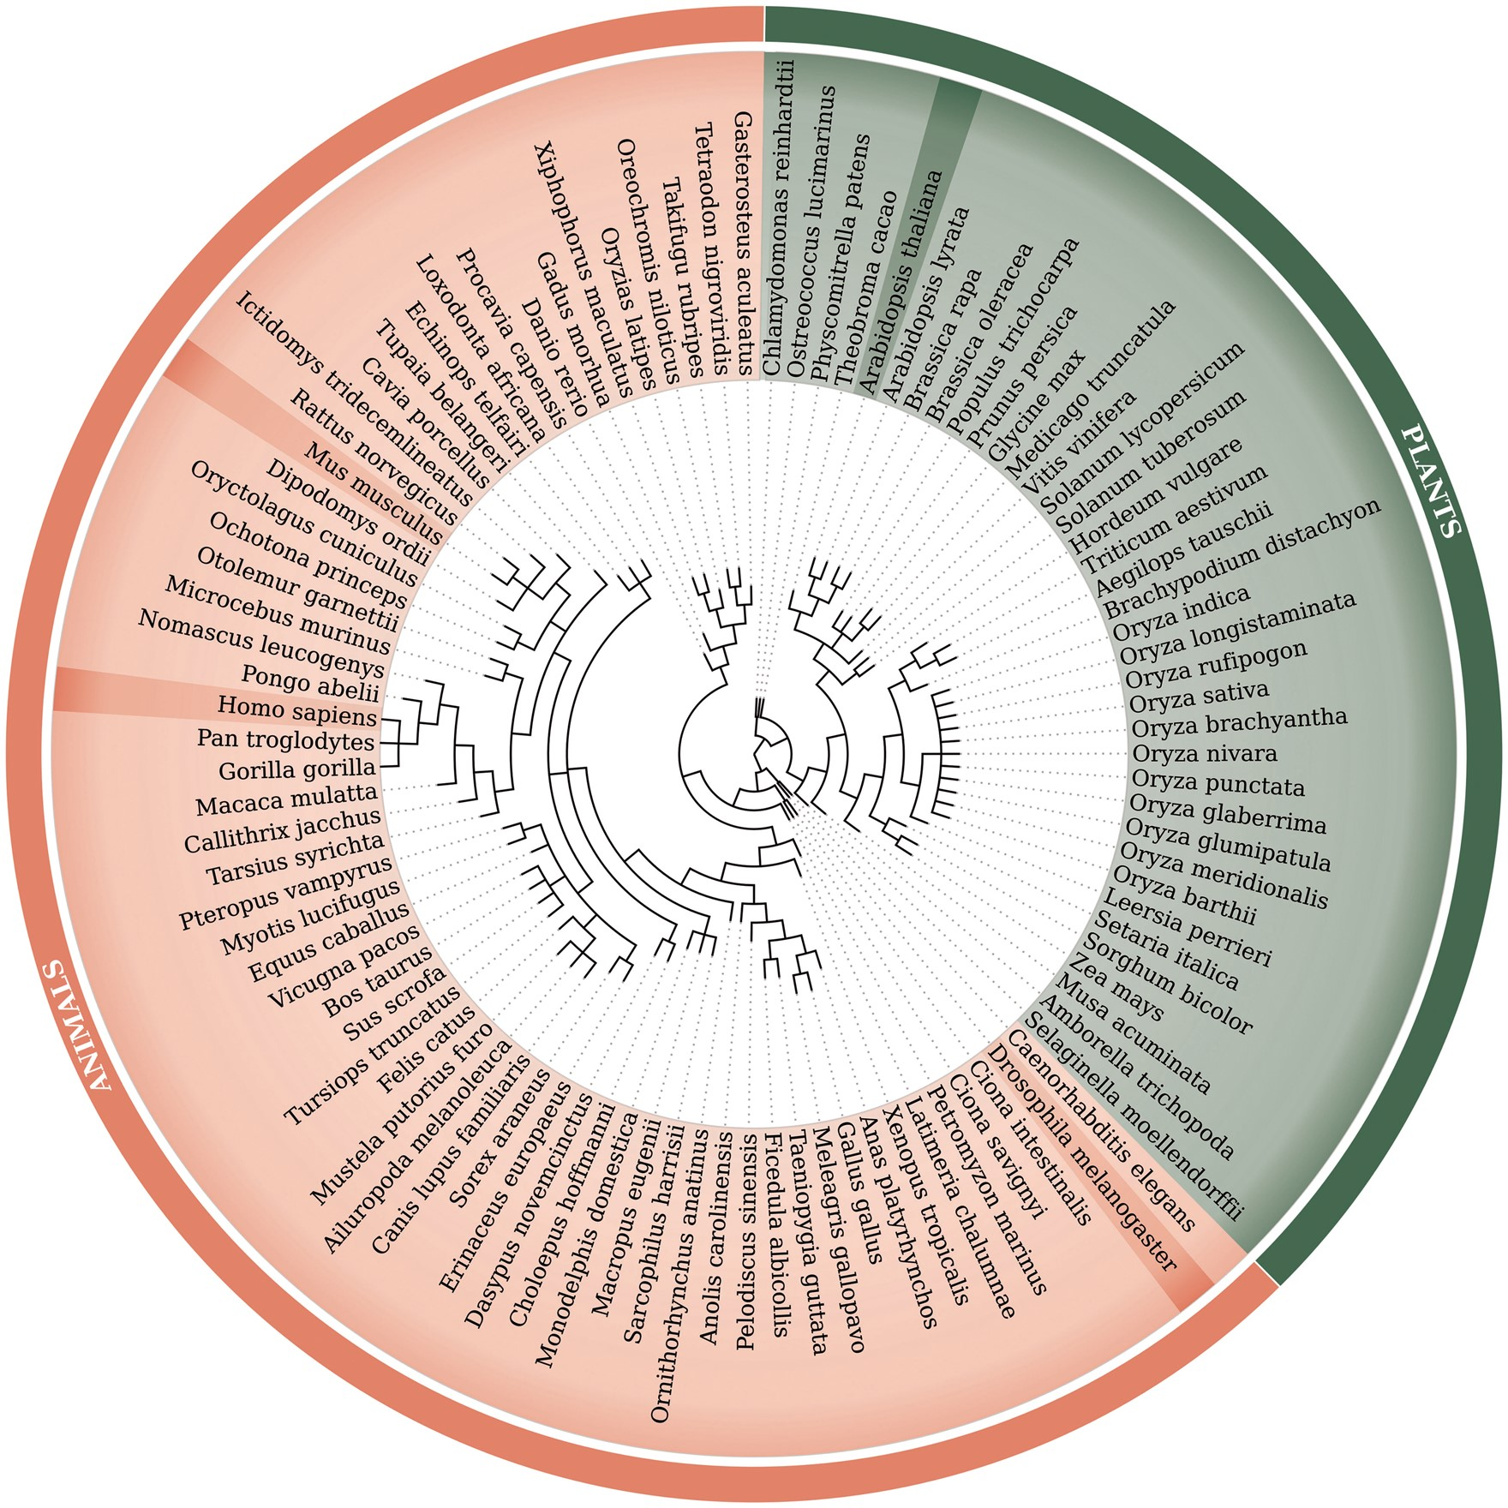
Figure 1. Phylogenetic tree of 99 species used within the updated RetrogeneDB database. The same tree is embedded into ...
Notes:
Figure 1. Phylogenetic tree of 99 species used within the updated RetrogeneDB database. The same tree is embedded into the database ‘browse’ web-page and interactively used to select a species of interest. Animal and plant species are colored in light red and green, respectively. Four chosen species, Homo sapiens, Mus musculus, Drosophila melanogaster and Arabidopsis thaliana, were highlighted for easier navigation. The web-based phylogenetic tree is drawn using the jsPhyloSVG library (37).
Unless provided in the caption above, the following copyright applies to the content of this slide: © The Author(s) 2017. Published by Oxford University Press.This is an Open Access article distributed under the terms of the Creative Commons Attribution License (http://creativecommons.org/licenses/by/4.0/), which permits unrestricted reuse, distribution, and reproduction in any medium, provided the original work is properly cited.

