Slide 1
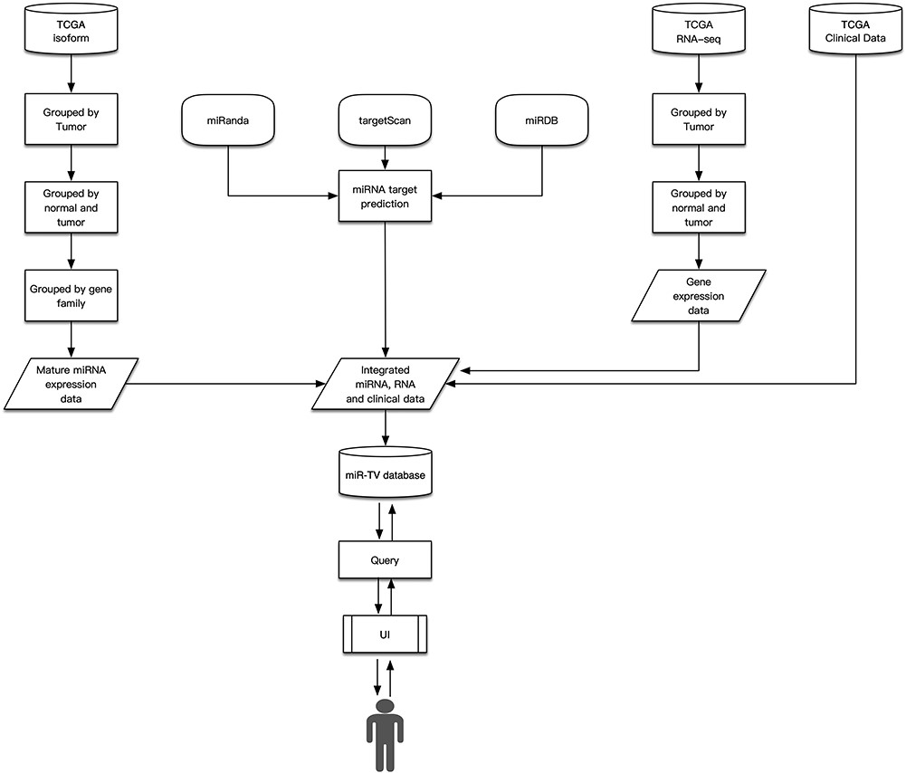
Figure 1 Design schema of miR-TV.
Notes:
Figure 1 Design schema of miR-TV.
Unless provided in the caption above, the following copyright applies to the content of this slide: © The Author(s) 2020. Published by Oxford University Press. All rights reserved. For Permissions, please email: journals.permissions@oup.comThis is an Open Access article distributed under the terms of the Creative Commons Attribution License (http://creativecommons.org/licenses/by/4.0/), which permits unrestricted reuse, distribution, and reproduction in any medium, provided the original work is properly cited.

Slide 2
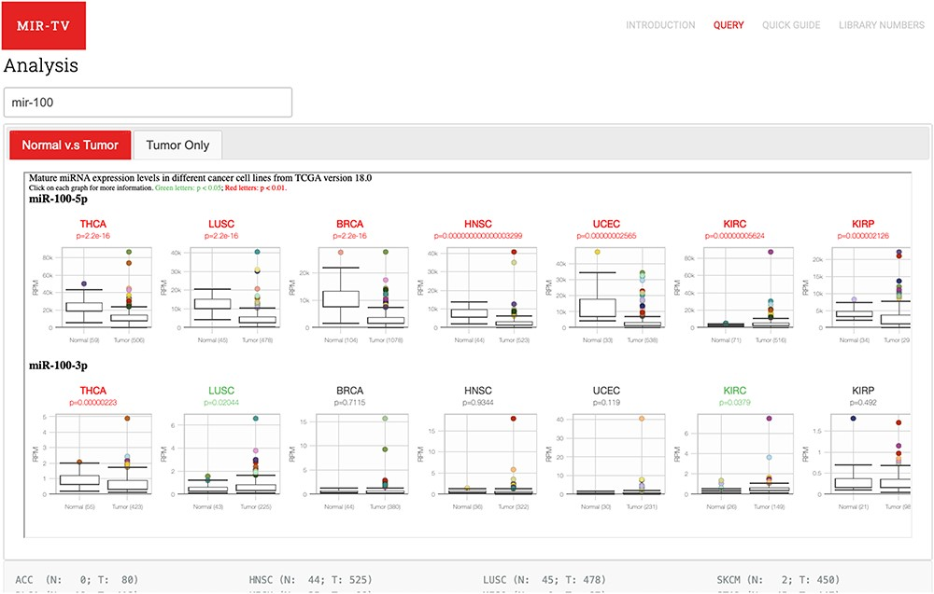
Figure 2 User query interface of miR-TV. First, users must enter the miRNA gene name in the query field. Once the ...
Notes:
Figure 2 User query interface of miR-TV. First, users must enter the miRNA gene name in the query field. Once the miRNA is selected, both 5p- and 3p-arm expression box plot graphs of the selected miRNA in different cancer types are displayed in the main working window, and users can browse through their expression patterns by scrolling to the right side. Red labels indicate cancer tissues with a P-value < 0.01, and green labels indicate those with a P-value < 0.05. Several cancer types contain only tumor tissue samples (i.e. no normal counterparts); therefore, they are listed in the Tumor Only tab page.
Unless provided in the caption above, the following copyright applies to the content of this slide: © The Author(s) 2020. Published by Oxford University Press. All rights reserved. For Permissions, please email: journals.permissions@oup.comThis is an Open Access article distributed under the terms of the Creative Commons Attribution License (http://creativecommons.org/licenses/by/4.0/), which permits unrestricted reuse, distribution, and reproduction in any medium, provided the original work is properly cited.

Slide 3
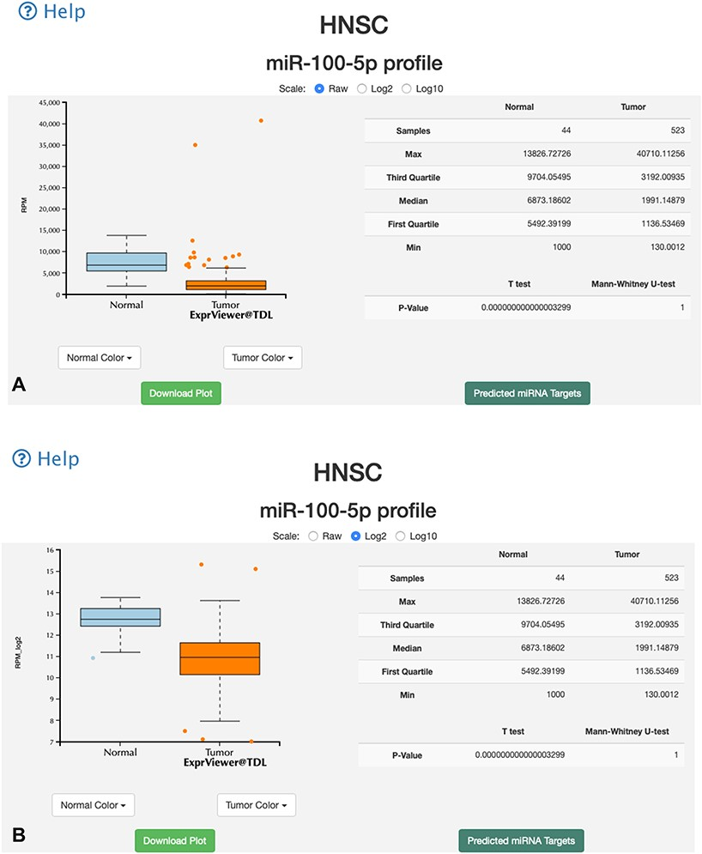
Figure 3 Overall-overview miRNA expression interface of miR-TV. (A) A new box plot graph window opens when the user ...
Notes:
Figure 3 Overall-overview miRNA expression interface of miR-TV. (A) A new box plot graph window opens when the user clicks on a specific cancer type for interrogation. The default expression scale is RPM values. (B) Users can change the y-axis scale to a Log2 or Log10 scale by using the scale buttons at the top. (C) To obtain a better illustration of all patient samples, users can click on the box-shaped regions in either of the Normal or Cancer groups and the box plots will instantly transform into scatter plots. Double clicking the scatter plot smoothly reverts the scatter plot back to a box plot. Each dot represents one patient sample, and moving the mouse over each dot reveals TCGA sample ID, clinical information and miRNA expression value. (D) Two color change buttons are available below the graph plot area. Users can change the Normal group or Cancer group colors according to their preference.
Unless provided in the caption above, the following copyright applies to the content of this slide: © The Author(s) 2020. Published by Oxford University Press. All rights reserved. For Permissions, please email: journals.permissions@oup.comThis is an Open Access article distributed under the terms of the Creative Commons Attribution License (http://creativecommons.org/licenses/by/4.0/), which permits unrestricted reuse, distribution, and reproduction in any medium, provided the original work is properly cited.

Slide 4
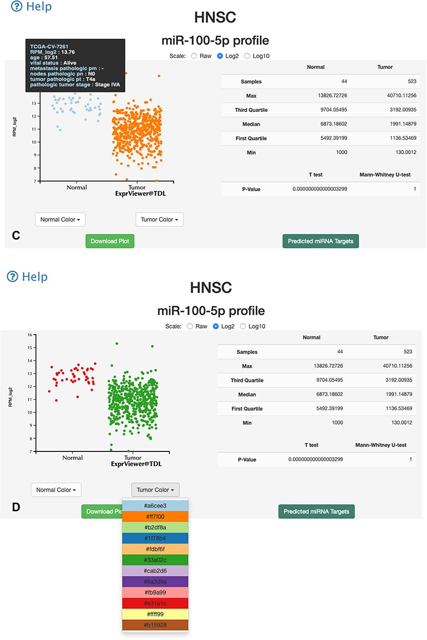
Figure 3 Overall-overview miRNA expression interface of miR-TV. (A) A new box plot graph window opens when the user ...
Notes:
Figure 3 Overall-overview miRNA expression interface of miR-TV. (A) A new box plot graph window opens when the user clicks on a specific cancer type for interrogation. The default expression scale is RPM values. (B) Users can change the y-axis scale to a Log2 or Log10 scale by using the scale buttons at the top. (C) To obtain a better illustration of all patient samples, users can click on the box-shaped regions in either of the Normal or Cancer groups and the box plots will instantly transform into scatter plots. Double clicking the scatter plot smoothly reverts the scatter plot back to a box plot. Each dot represents one patient sample, and moving the mouse over each dot reveals TCGA sample ID, clinical information and miRNA expression value. (D) Two color change buttons are available below the graph plot area. Users can change the Normal group or Cancer group colors according to their preference.
Unless provided in the caption above, the following copyright applies to the content of this slide: © The Author(s) 2020. Published by Oxford University Press. All rights reserved. For Permissions, please email: journals.permissions@oup.comThis is an Open Access article distributed under the terms of the Creative Commons Attribution License (http://creativecommons.org/licenses/by/4.0/), which permits unrestricted reuse, distribution, and reproduction in any medium, provided the original work is properly cited.

Slide 5
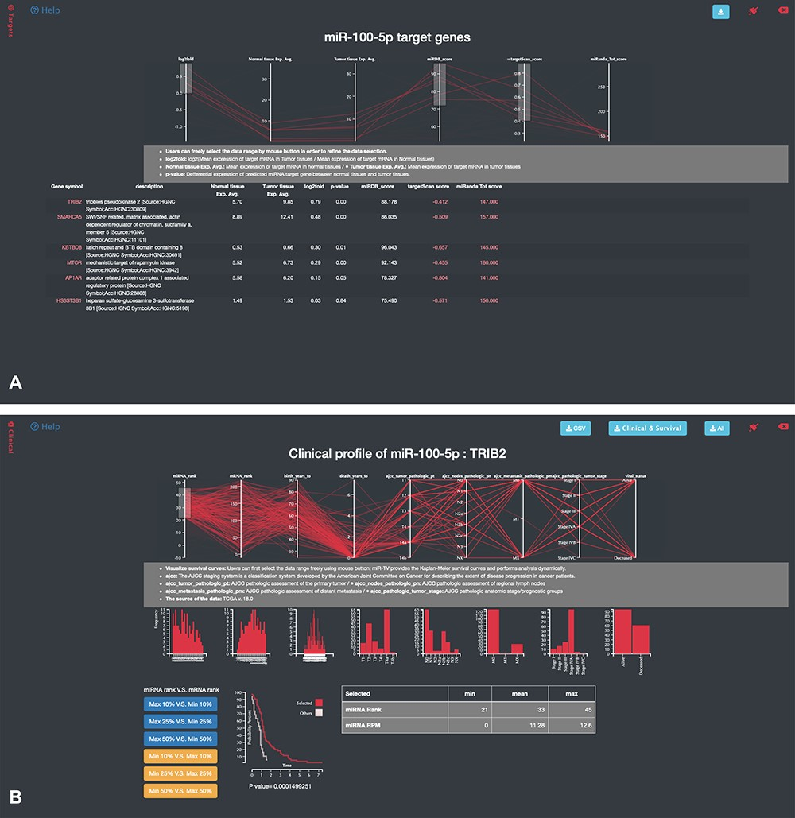
Figure 4 Specific-overview miRNA–target gene interface of miR-TV. (A) Users can enter the miRNA target gene ...
Notes:
Figure 4 Specific-overview miRNA–target gene interface of miR-TV. (A) Users can enter the miRNA target gene interrogation interface by clicking either the green colored ‘Predicted mRNA Targets’ button or the @Targets black side menu bar. Multiple features of miRNA/mRNA expression and target prediction scores are displayed and can be easily filtered according to the user’s criteria by clicking and dragging the mouse to make a selection. Lines connect all information for any given target gene, and by moving the mouse over any given gene symbol, users can view the connected information, which is highlighted by a bold line. Additional prediction information is displayed by clicking the targetScan score and miRanda Tot score links; (B) by clicking on any target gene, users can enter the specific-overview interface for individual target gene interrogation. In this interface, users can further interrogate clinical information and miRNA/mRNA expression information by clicking the green colored ‘Clinical Information on Target mRNA’ button. Users can select different miRNA and mRNA expression groups to interrogate the expression relationship of miRNA–mRNA gene pairs. In addition, different clinical information features can be freely interrogated by clicking and dragging the mouse to make a selection. Preset buttons on the lower left panel can be used to examine the inverse relationship between the miRNA and target mRNA. The Kaplan–Meier survival curve plot and expression information is then displayed to dynamically reflect the user’s changes. The survival graph and detailed expression information can also be retrieved by using the download button on the top panel.
Unless provided in the caption above, the following copyright applies to the content of this slide: © The Author(s) 2020. Published by Oxford University Press. All rights reserved. For Permissions, please email: journals.permissions@oup.comThis is an Open Access article distributed under the terms of the Creative Commons Attribution License (http://creativecommons.org/licenses/by/4.0/), which permits unrestricted reuse, distribution, and reproduction in any medium, provided the original work is properly cited.

Slide 6
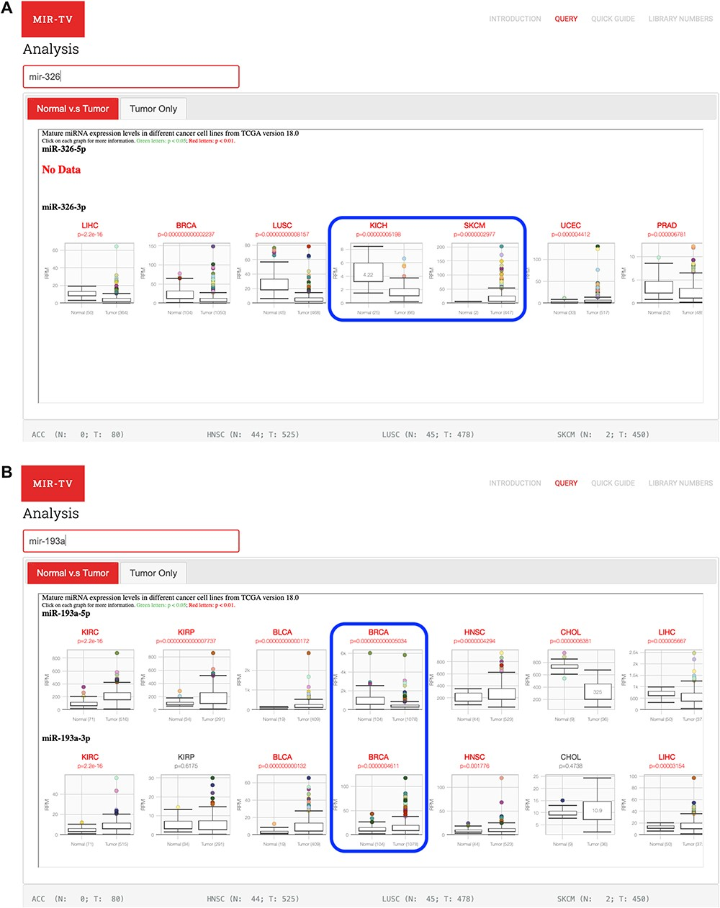
Figure 5 Examples of miRNAs and their targets using miR-TV interfaces. (A) Opposite miR-326 expression profiles in ...
Notes:
Figure 5 Examples of miRNAs and their targets using miR-TV interfaces. (A) Opposite miR-326 expression profiles in kidney cancers (KICH) and skin cancers (SKCM); (B) Differential miR-193a 5p- and 3p-arms expression profiles in breast cancer samples.
Unless provided in the caption above, the following copyright applies to the content of this slide: © The Author(s) 2020. Published by Oxford University Press. All rights reserved. For Permissions, please email: journals.permissions@oup.comThis is an Open Access article distributed under the terms of the Creative Commons Attribution License (http://creativecommons.org/licenses/by/4.0/), which permits unrestricted reuse, distribution, and reproduction in any medium, provided the original work is properly cited.

