Slide 1
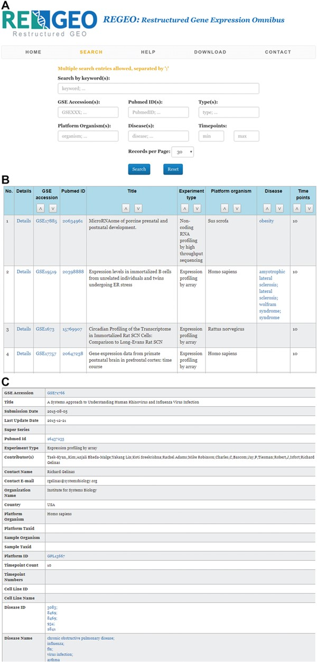
Figure 3 An illustration of the ReGEO database. a) The interface of ReGEO. b) Part of the search results from ReGEO ...
Notes:
Figure 3 An illustration of the ReGEO database. a) The interface of ReGEO. b) Part of the search results from ReGEO database for GEO series with ten or more time points. c) An example of a data set stored in ReGEO that annotated with specific DO terms (“influenza” and “flu”) and their corresponding DOIDs (8469).
Unless provided in the caption above, the following copyright applies to the content of this slide: © The Author(s) 2019. Published by Oxford University Press.This is an Open Access article distributed under the terms of the Creative Commons Attribution License (http://creativecommons.org/licenses/by/4.0/), which permits unrestricted reuse, distribution, and reproduction in any medium, provided the original work is properly cited.

