Slide 1
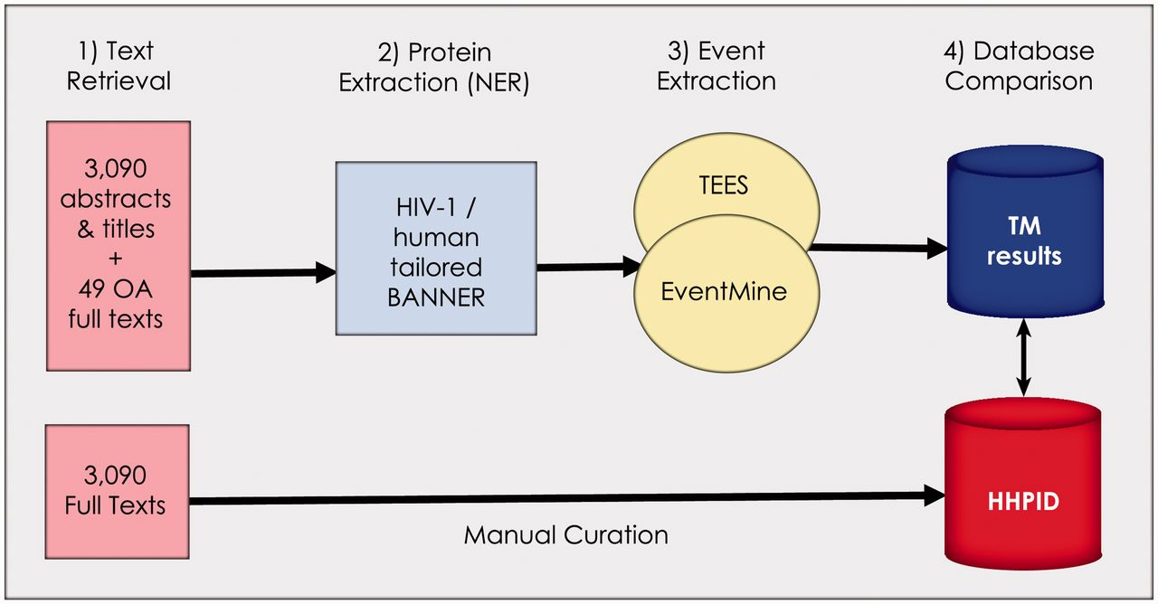
Figure 1. Summary of the methodology. Our methodology is divided into four stages: (1) retrieval of all abstracts and ...
Notes:
Figure 1. Summary of the methodology. Our methodology is divided into four stages: (1) retrieval of all abstracts and titles, as well as 49 open-access full texts from the 3090 citations in the HHPID, (2) proteins were extracted using an HIV-1/human tailored version of BANNER, (3) events were extracted using two event extraction tools (TEES and EventMine) and (4) a comparison of the results retrieved by TM was made with the manually curated HHPID.
Unless provided in the caption above, the following copyright applies to the content of this slide: © The Author(s) 2012. Published by Oxford University Press.This is an Open Access article distributed under the terms of the Creative Commons Attribution Non-Commercial License (http://creativecommons.org/licenses/by-nc/3.0), which permits unrestricted non-commercial use, distribution, and reproduction in any medium, provided the original work is properly cited.

